Slide 1
Slices: A Shape-proxy Based on Planar Sections
James McCrae, Karan Singh, Niloy J. Mitra
Notes:
1

Slide 2
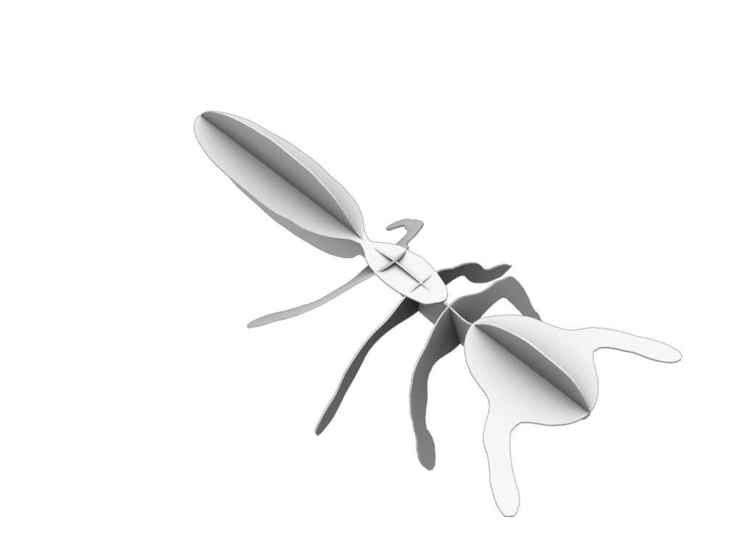
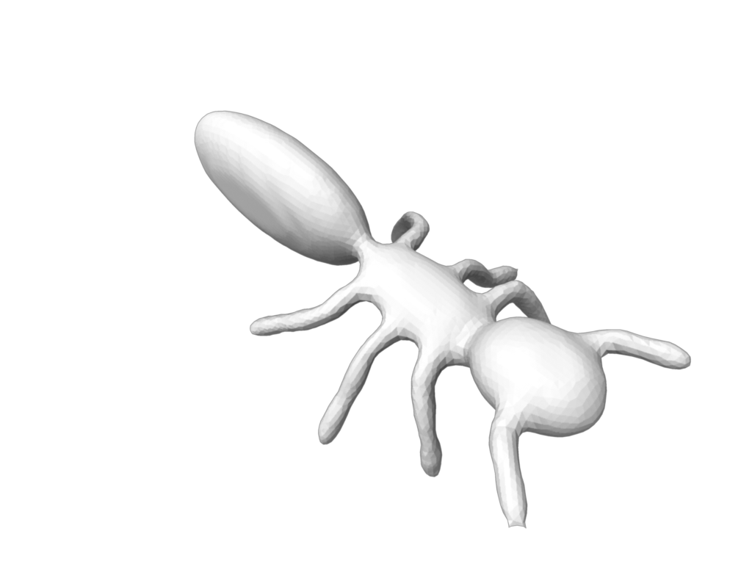
Problem Statement
Compute a recognizable abstraction of a 3D model using a minimal set of planar sections.
Notes:
2
2 - We want a planar section abstraction of a 3D model that uses a minimal number of planes, without compromising on one’s ability to recognize the object.

Slide 3
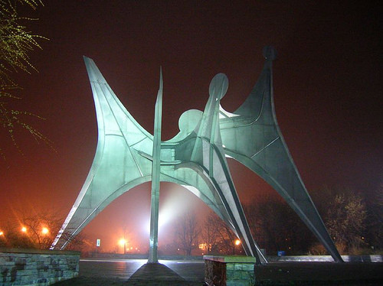
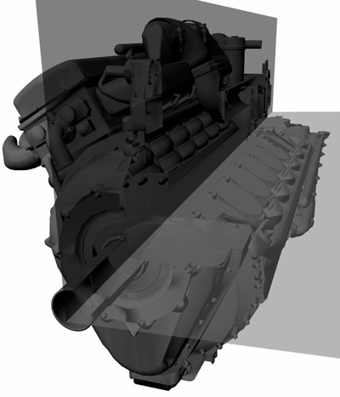
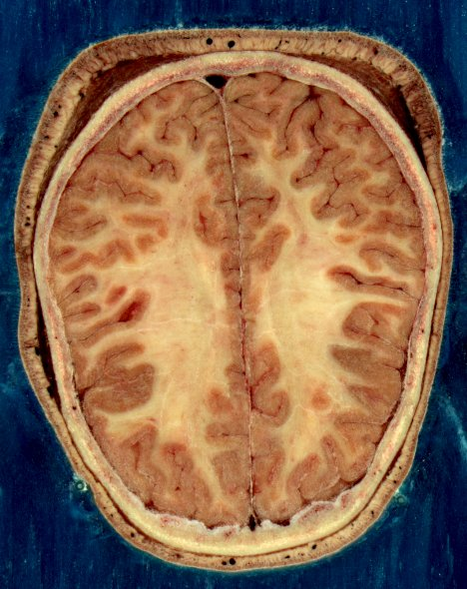
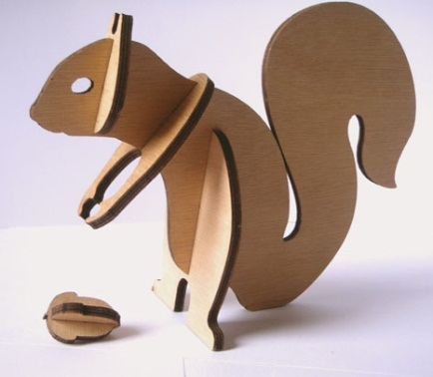
Planar Section Inspiration
Notes:
3
3 - Planar sections are popular primitives in architecture, sculpture, design, manufacturing, engineering and visualization, and its from such examples that we found inspiration for our work.

Slide 4
Planar Section Exploration Study
1. Can we produce minimal planar section abstractions that are recognizable?
2. Do abstractions correlate across users?
Notes:
4
4 - Our work began with an exploration study that set out to answer two fundamental questions. <CLICKING> The first: can humans, to their perceptual satisfaction, produce recognizable abstractions of common 3D shapes using a small number of planar sections? <CLICKING> And the second: Is there a correlation among the planar sections selected by different humans for the same 3D shape?

Slide 5
Planar Section Exploration Study
Notes:
5
5 - We created a software application (available online) which participants used in the study to author planar section shape proxies for a number of models.

Slide 6
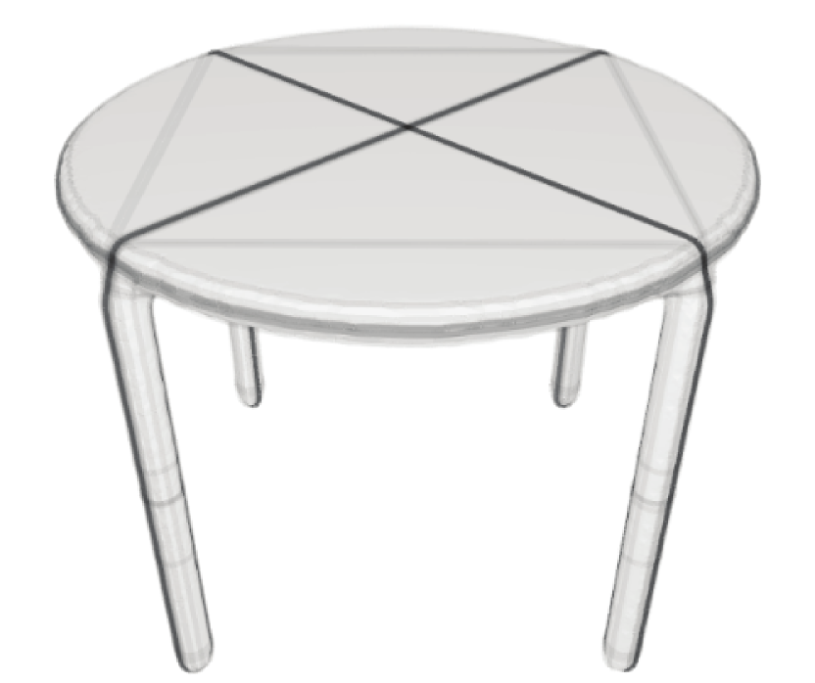
Planar Section Exploration Study
18 participants
Notes:
6
6 - Our study included results from 18 participants. To visualize the data, we render participant planes as thick, transparent black lines. So we can see where there was high agreement, as the lines overlap and appear darker. In this example, the two planes that form a dark X across the tabletop represent greater agreement than the lighter lines forming the square.

Slide 7
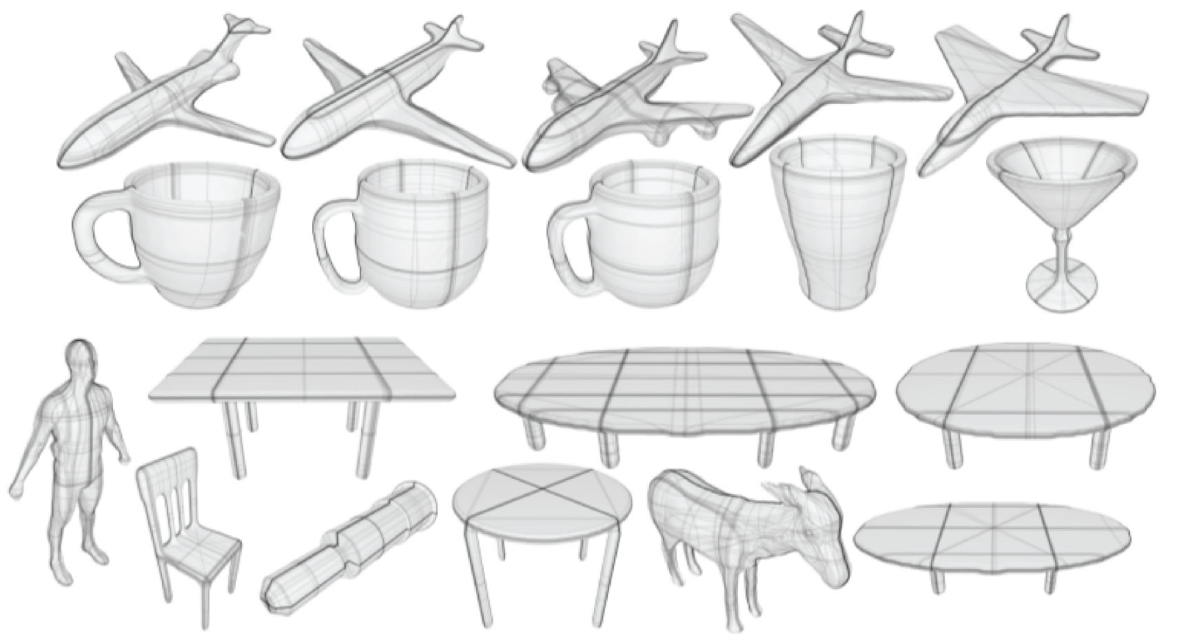
Planar Section Exploration Study
18 participants, 19 models, 1630 total planes
Notes:
7
7 - (Take time, ~20-30 sec.) Here we show results across the 19 models in our study. Our complete dataset obtained from participants contains 1630 planes in total. Looking at each example, there are always at least one or two planes where agreement is almost universal across participants. Some models have very thick, but lighter bands which still indicate high agreement, but are less precise in defining exactly where the intended plane should be.

Slide 8
Planar Section Exploration Study
1. Can we produce minimal planar section abstractions that are recognizable?
Yes!
Humans created proxies using few planes:
- 1.5% used 10+ planes
- Mean: 4.77 planes
Notes:
8
8 - So, can we produce minimal planar section abstractions which are recognizable? <CLICKING> Yes! Participants in the study were given a soft maximum of 10 planes to use for each model. <CLICKING> We found only 1.5% of the abstractions created contained 10 or more planes. The low mean of 4.77 indicates that generally, participants were comfortable in using a number of planes well below 10.

Slide 9
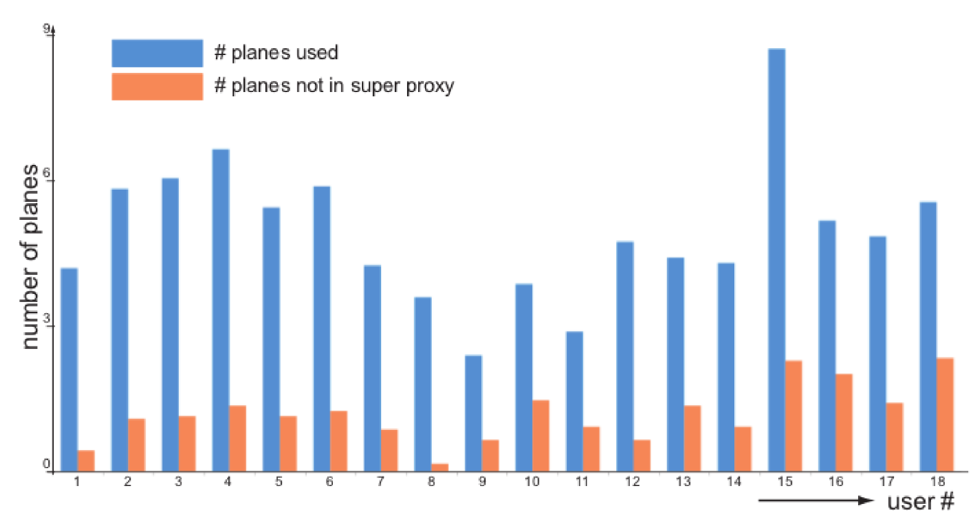
Planar Section Exploration Study
2. Do abstractions correlate across users?
Yes!
Notes:
9
9 - So did the abstractions correlate, that is, did different participants tend to produce similar abstractions on the same model? <CLICKING> Yes! If we cluster the planes from all participants for each model together, and keep a representative plane for the cluster when there is reasonable agreement, we form what we call the super-proxy set of planes. The existence of these clusters shows us this correlation, <CLICKING> and it is further revealed by the graph below which shows the proportion of participants planes used in blue, and those that did not appear in the super proxy set in orange.

Slide 10
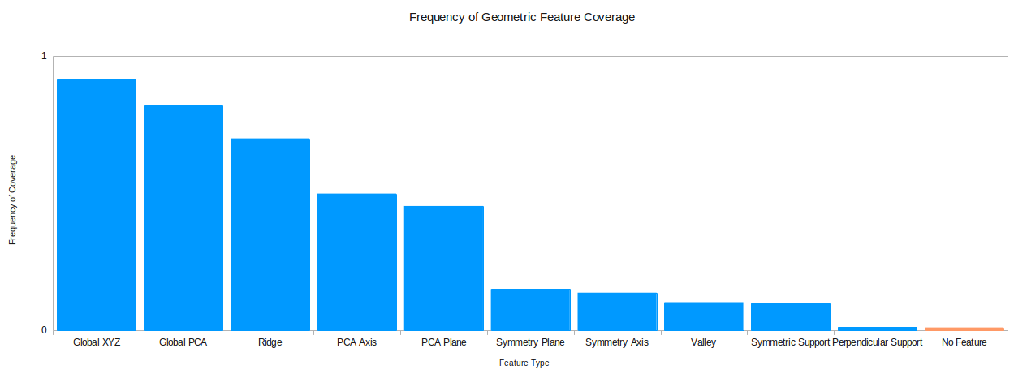
Exploration Study Insights
1. Human-selected planar sections correlate with geometric features.
2. Planar sections often correlate with multiple geometric features.
Notes:
10
10 - We learned two very valuable insights that guided our approach. <CLICKING> The first is that human-selected planar sections correlate with geometric features of the model. Only about 1% of the 1630 planes authored in the study were not explainable by some geometric feature. <CLICKING> Also, examining a graph showing normal feature coverage, we observe any given plane is likely to correlate with multiple features. For instance, 80% of the planes correlated with the global PCA planes of the model, and 70% with a ridge.

Slide 11
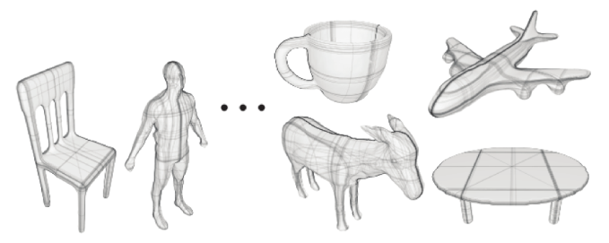
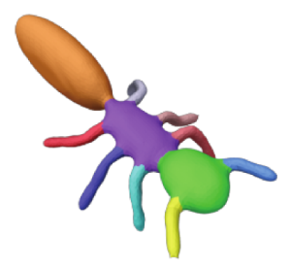
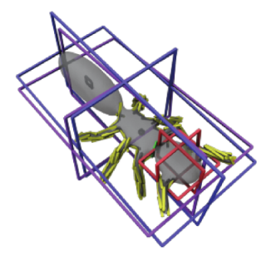
Problem Statement Revisited
Compute a recognizable abstraction of a 3D model using a minimal set of planar sections.
Compute a minimal set of planar sections that cover the set of geometric features.
Notes:
11
11 - The insights from the exploration study tell us that the recognizable abstractions produced by participants consist of planes that correlate with geometric features of the model. Thus we can reformulate our original problem the more tractable problem of finding a minimal set of planar sections that cover the object's geometric features.

Slide 12
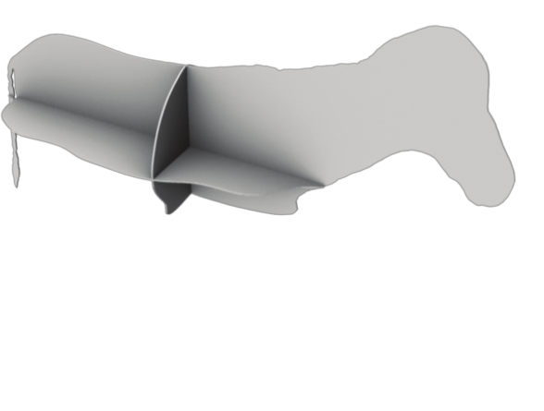
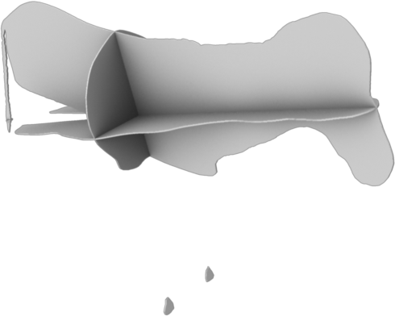
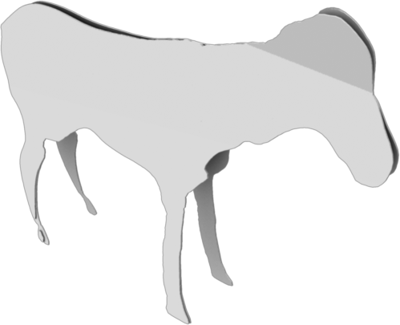
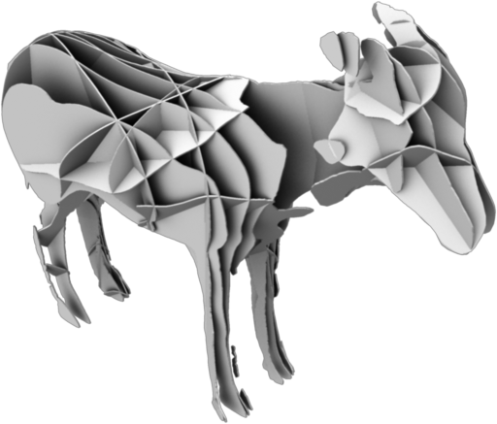
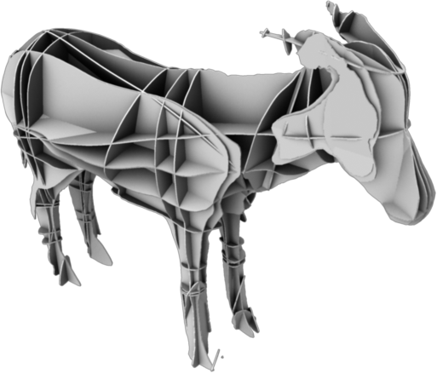
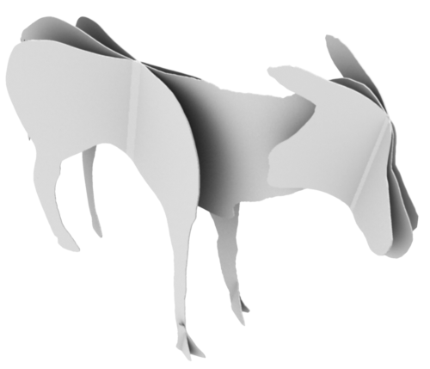
Algorithmic Insights I
Naïve collections of planes that cover geometric features perform poorly.
Global XYZ
Global PCA
Maximum Area
Ridges
Segment PCA
Our Approach
Global XYZ
Notes:
12
12 - Naive approaches perform poorly - missing important features of the model altogether, or being haphazard and far from minimal. <CLICKING> By comparison, the approach we propose is minimal and captures important geometric features.

Slide 13
Algorithmic Insights II
We prove the “minimum planar section” problem to be NP-hard.
(Refer to paper for further details)
Notes:
13
13 - We show by polynomial-time reduction of the NP-complete minimum vertex cover problem that the minimum planar section problem, as we formulate it, is NP-hard. The proof is included in the appendix of the paper. Thus efficient approaches may not be globally optimal. It is for this reason that we employ a greedy method.

Slide 14
Algorithmic Insights III
Geometric features act as humans of varying expertise “suggesting” planes that cluster together
1. Use a large collection of geometric features
2. Feature weights reflect “expertise” - learned from user study data
3. Greedy selection of high-weight planes
Notes:
14
14 - One can think of the geometric feature types themselves as being like humans in our exploration study, "suggesting" candidate planes. Our approach will be to <CLICKING> (#1) use a large number of geometric participants. <CLICKING> (#2) Each geometric feature type will be assigned a weight, which can be learned from data from the study. And finally <CLICKING> (#3) the algorithm will perform greedy selection, at each iteration choosing the current maximal feature-covering plane at each step.

Slide 15
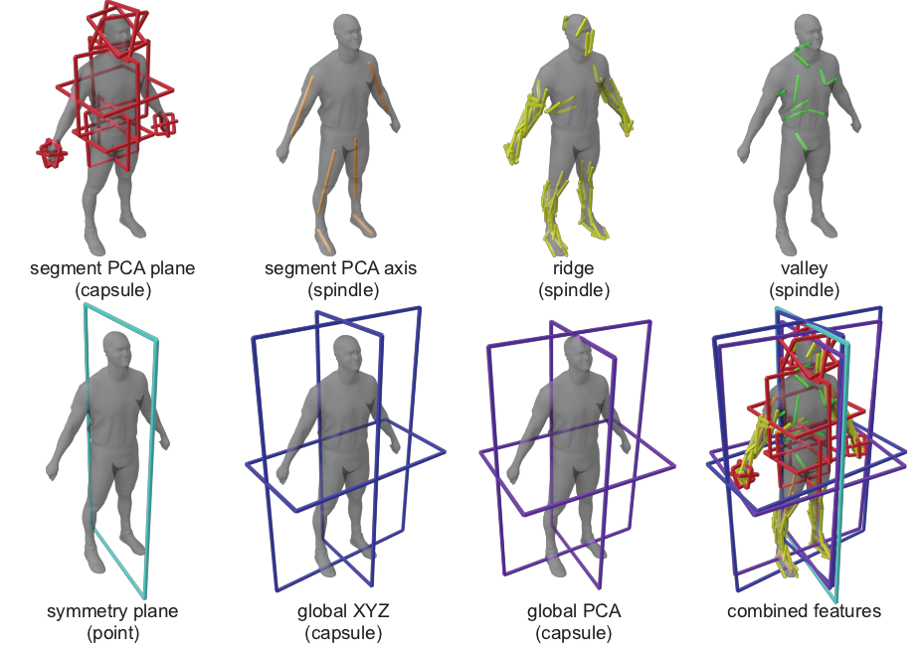
Our Approach – Geometric Features
Notes:
15
15 - Here we show some of the geometric features we have chosen. Segments of a model are assigned either PCA planes or an axis based on their dimensions. We compute ridges and valleys, representing these as a set of line segments or "spindle" features in space. We have symmetry planes (or symmetry axes) when present, and planes with normals corresponding to global XYZ and global PCA directions. At bottom right we show a visualization of these combined features on the model.

Slide 16
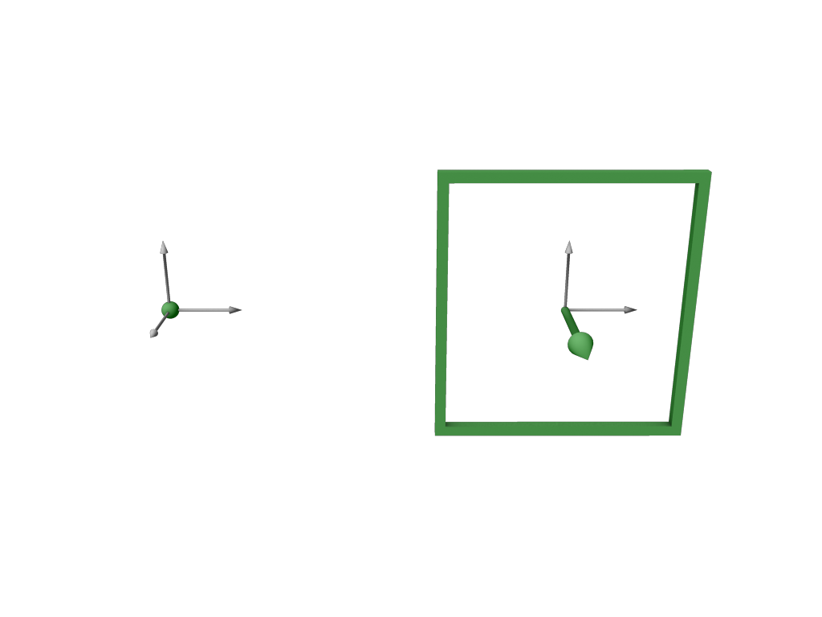
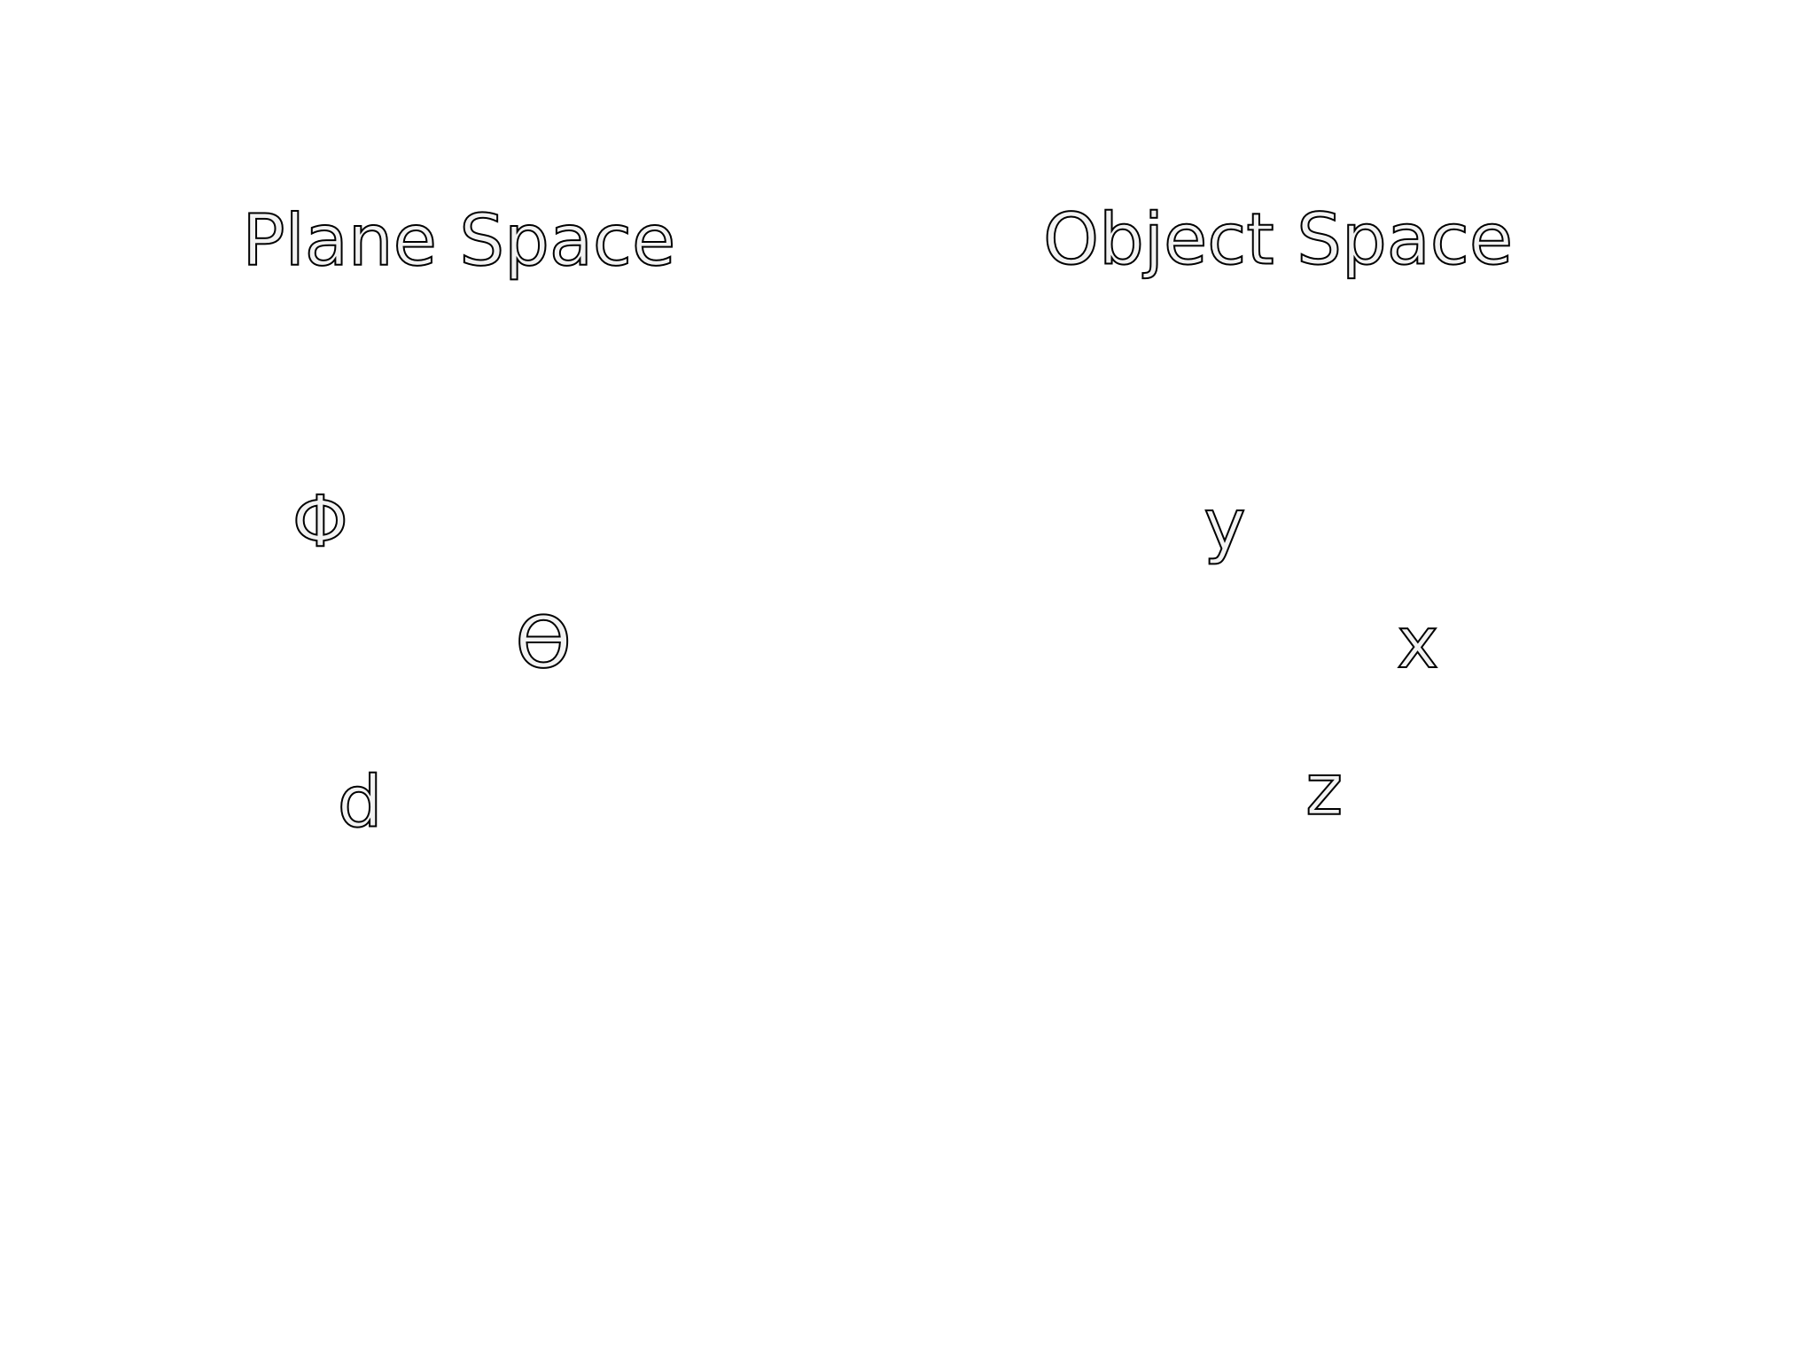
Our Approach – Geometric Features
Notes:
16
16 - So how exactly are geometric features represented? We have the plane-space on the left and the object's space on the right. We represent planes using the normal-intercept form. A point in the plane-space corresponds to a plane in the object space. Theta and phi define the normal direction, and the d value defines distance from the origin. Note that the origin in object space will be the centroid for all models.

Slide 17
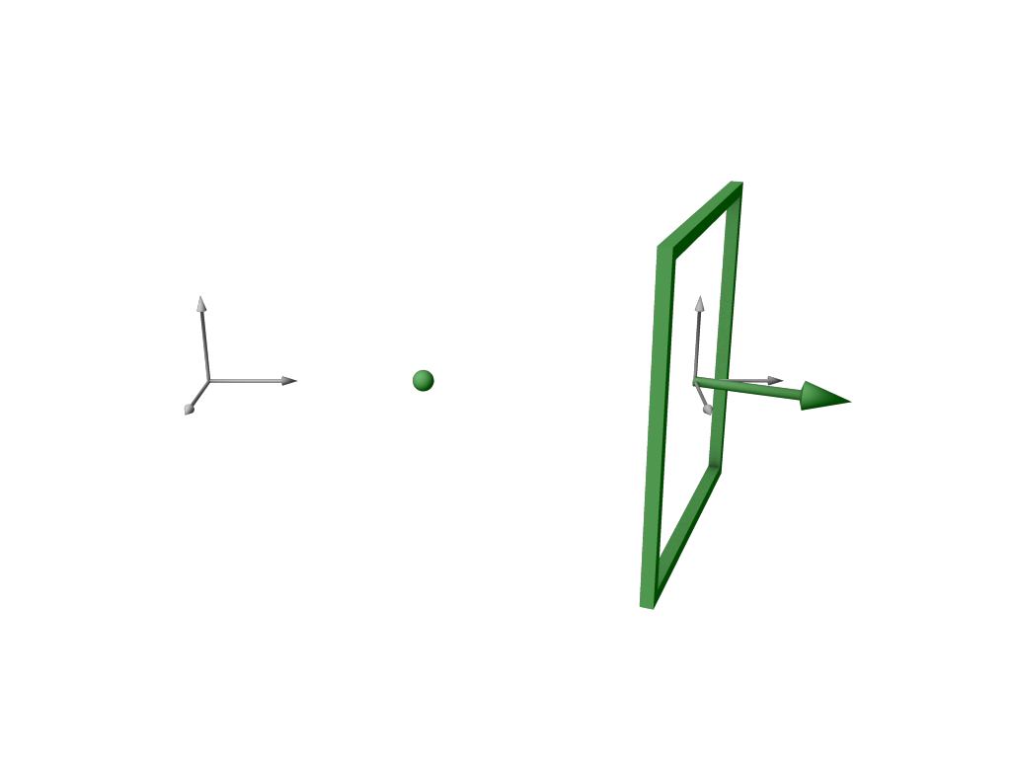
Our Approach – Geometric Features
Notes:
17
17 - We show varying theta.

Slide 18
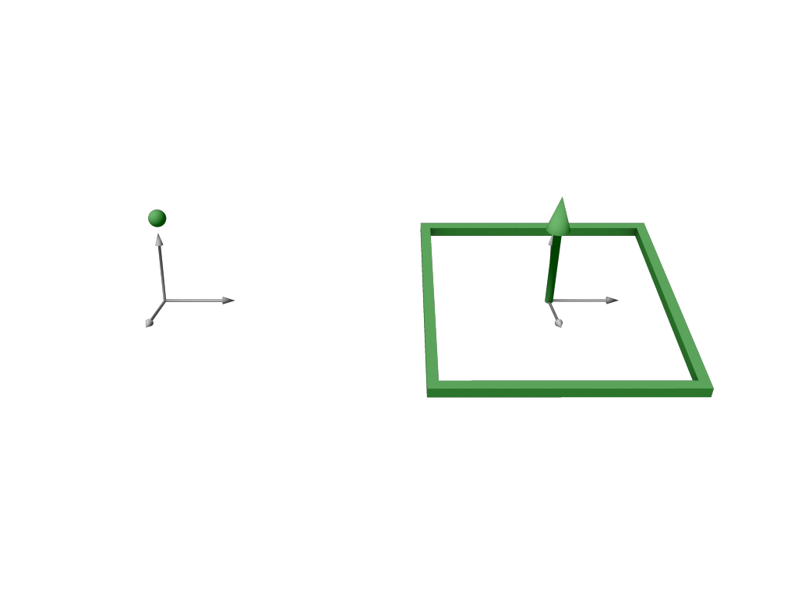
Our Approach – Geometric Features
Notes:
18
18 - Phi.

Slide 19
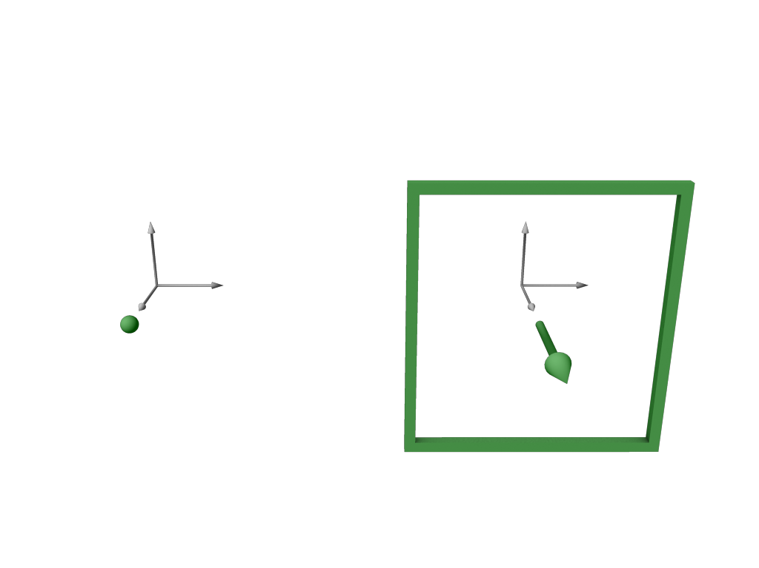
Our Approach – Geometric Features
Notes:
19
19 - And D.

Slide 20
Geometric Features – Point Type
Notes:
20
20 - A point in this space will actually be represented as a volume, with a small radius that represents an amount of tolerable variation. This serves two purposes: The first is to encourage intersections of features (e.g. two features may be "about aligned" and one plane might suffice to cover both). And the second is to alleviate issues with aliasing, as we in fact use discrete representations in this space. The cubes represent the discrete bins in the space, their size represents a weight that is highest at the centre and zero at the extents of the volume. Symmetry planes for example are a point type feature.

Slide 21
Geometric Features – Capsule Type
Notes:
21
21 - We can extrude the point type along the d-axis to produce a capsule shape. It is used where the normal direction is specific but the d value can be any value within an interval, such as for a segment PCA plane.

Slide 22
Geometric Features – Spindle Type
Notes:
22
22 - Last we have spindle type. Consider the yellow line segment in object space. There are a family of planes that intersect the line, where the normal and d values vary together. Symmetry axes, segment PCA axes, and ridges and valleys are all represented as spindle types.

Slide 23
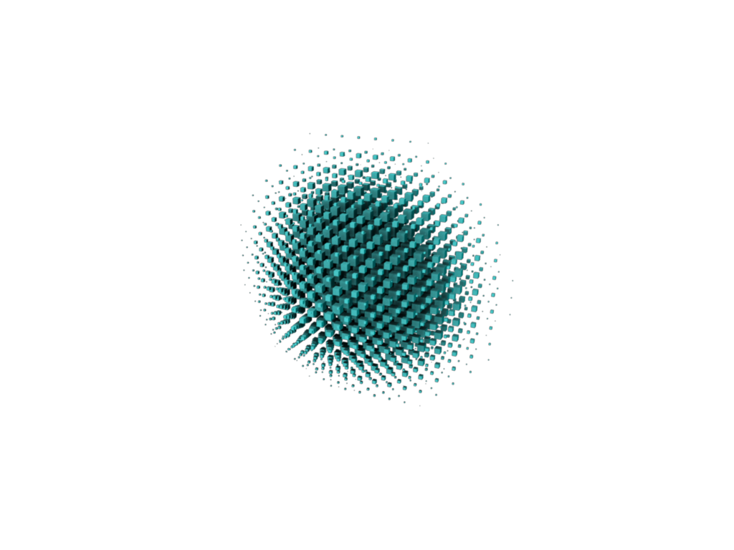
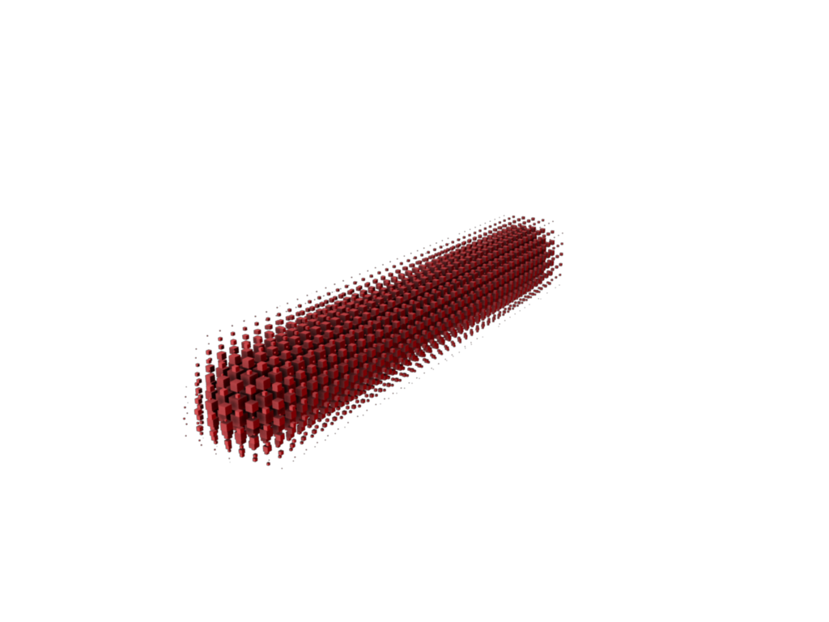
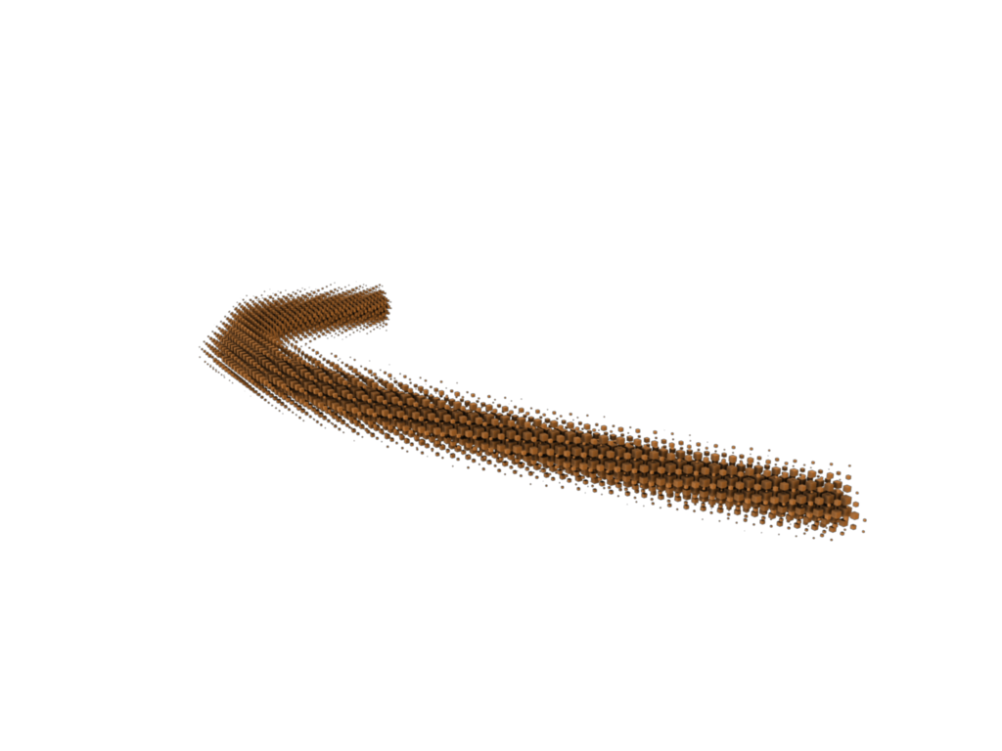
Our Approach – Geometric Features
Geometric features take one of three forms depending on the family of planes that correlate
Point: no variation
Capsule: variation in d
Spindle: variation in n and d
Notes:
23
23 - Just to summarize, geometric features are represented as one of these three volumes in plane-space: point, capsule or spindle.

Slide 24
Our Approach – Geometric Features
Notes:
24
24 - Let's now visualize an example of geometric features from a model.

Slide 25
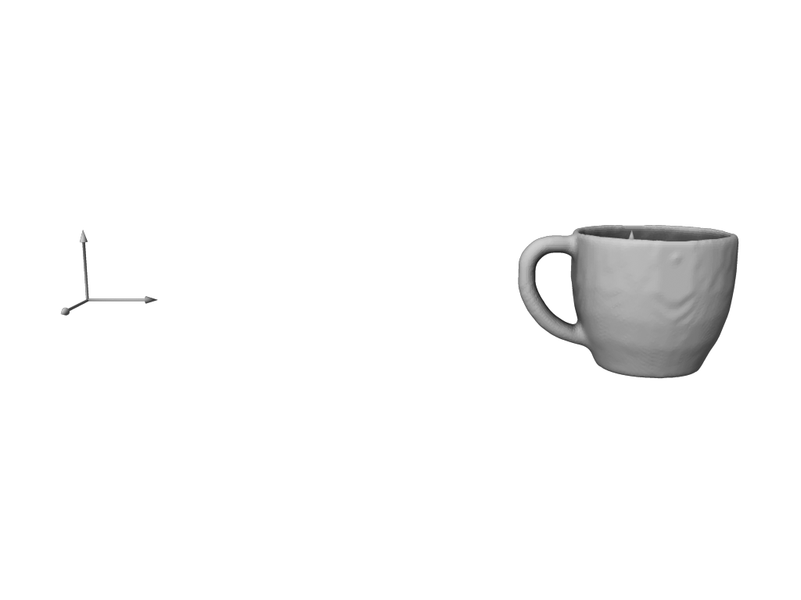
Our Approach – Geometric Features
Notes:
25
25 – No photograph for a bit please! Our model in the object space on the right, is the leaked prototype model for next year's SIGGRAPH ASIA 2012 mug, highly sought after by researchers.

Slide 26
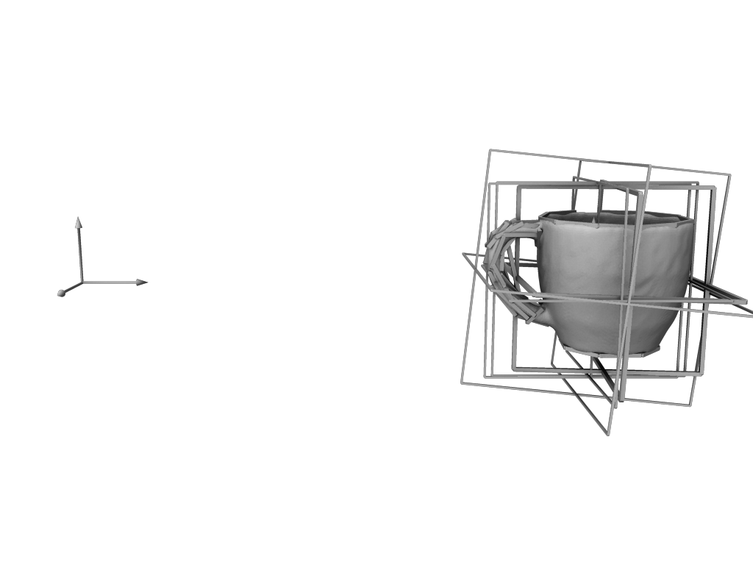
Our Approach – Geometric Features
Notes:
26
26/27 - These are all the geometric features computed for it.

Slide 27
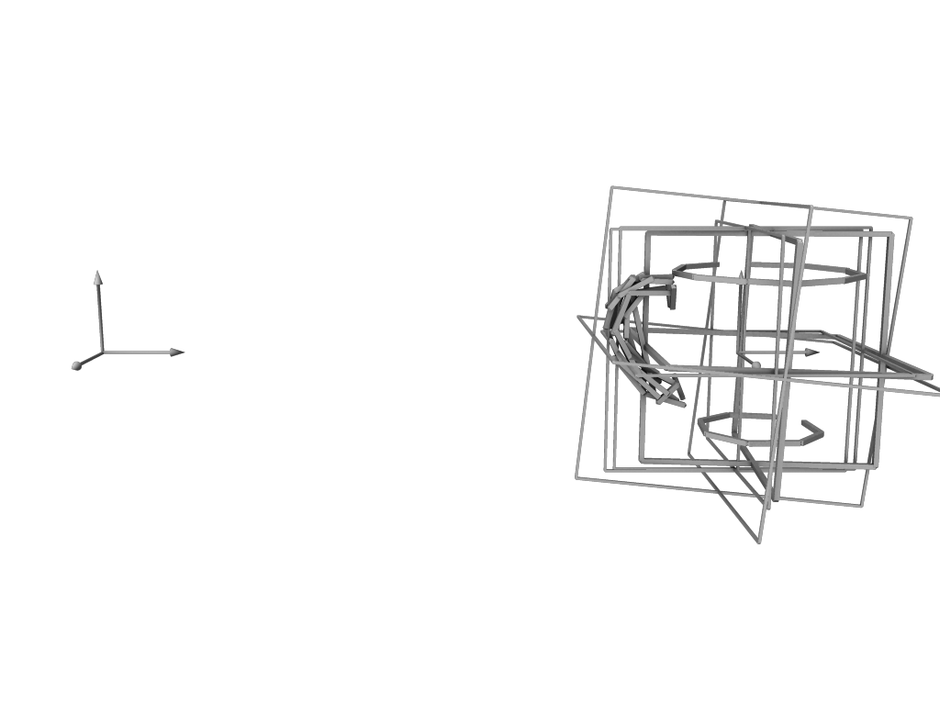
Our Approach – Geometric Features
Notes:
27

Slide 28
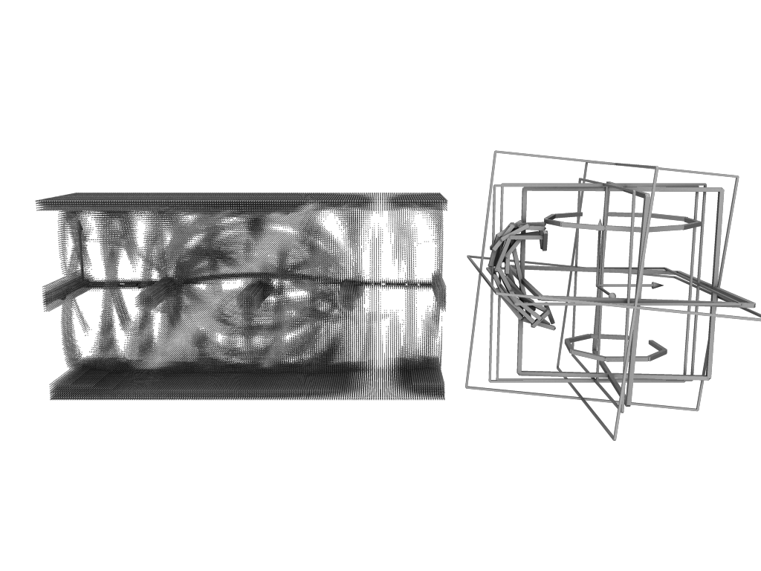
Our Approach – Geometric Features
Notes:
28
28 - This is an aggregation of all the geometric features as volume in the plane-space on the left. Let's examine each type.

Slide 29
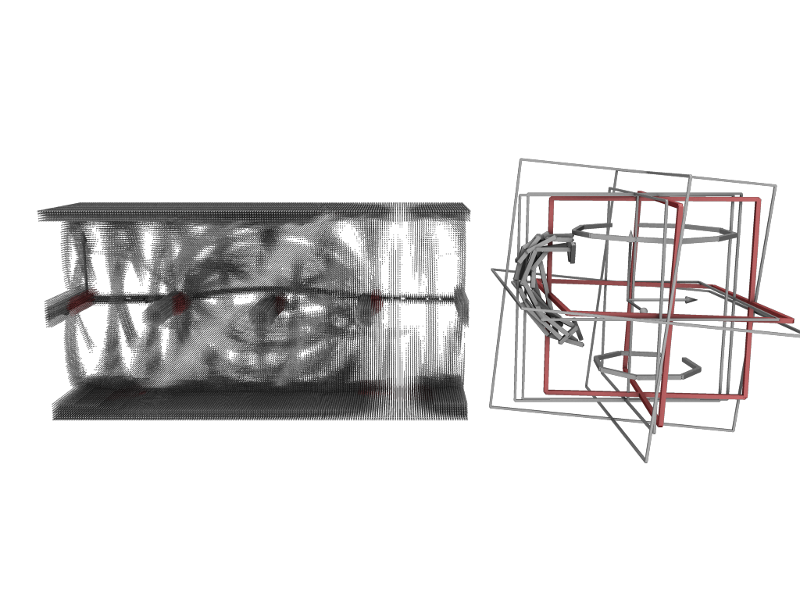
Geometric Features – Segment PCA Plane
Notes:
29
29 - Segment PCA planes

Slide 30
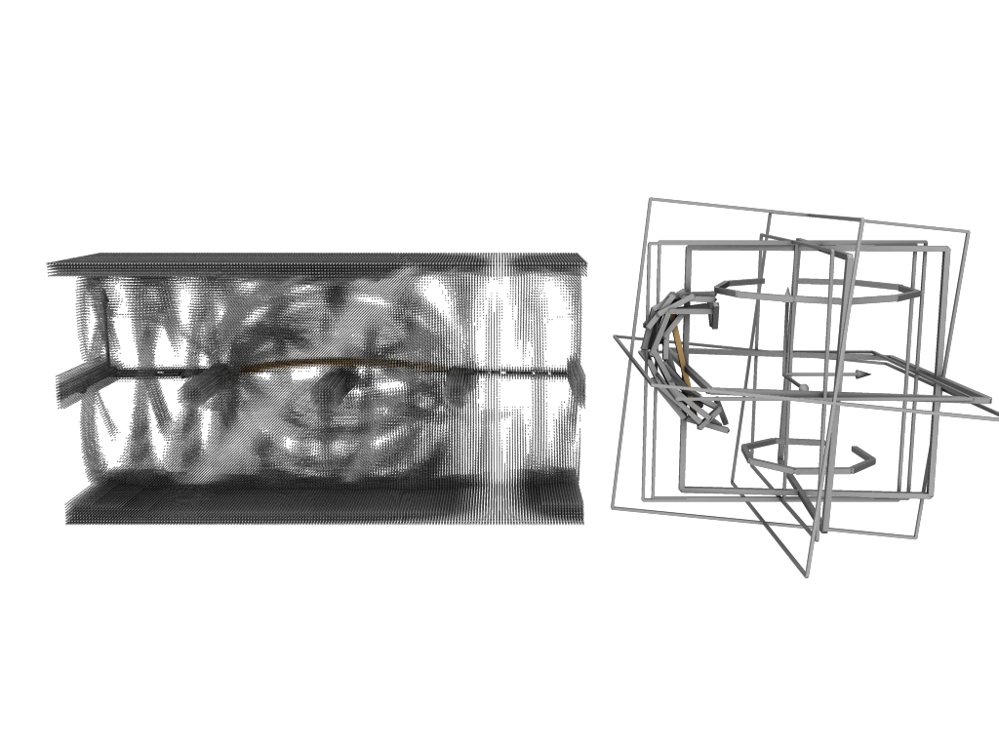
Geometric Features – Segment PCA Axis
Notes:
30
30 - Segment PCA axes

Slide 31
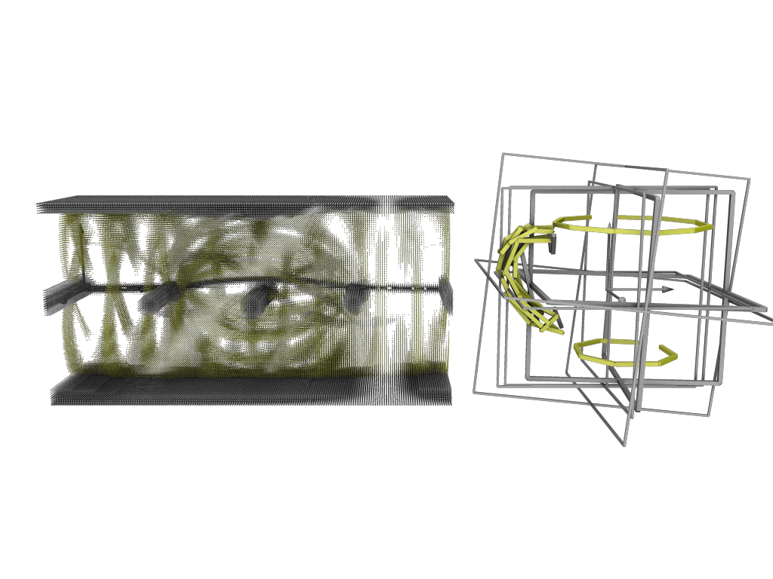
Geometric Features - Ridge
Notes:
31
31 - Ridges

Slide 32
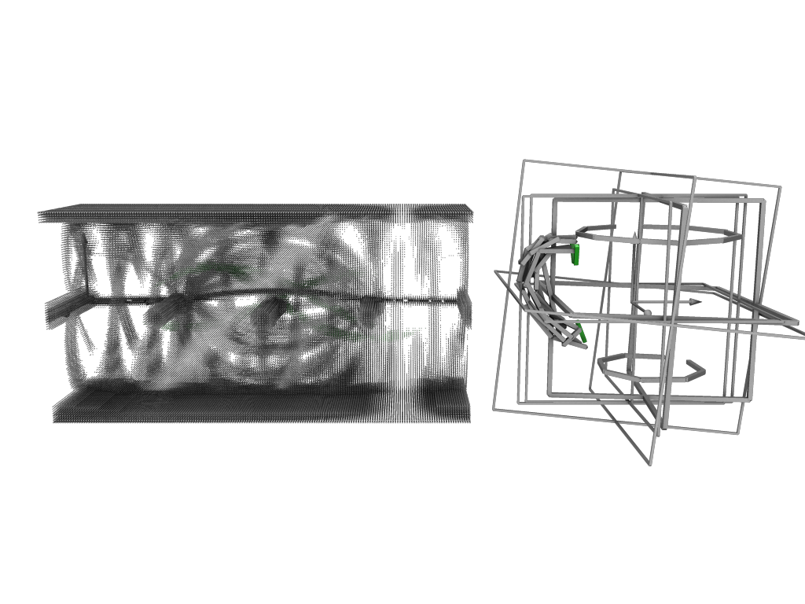
Geometric Features - Valley
Notes:
32
32 - Valleys

Slide 33
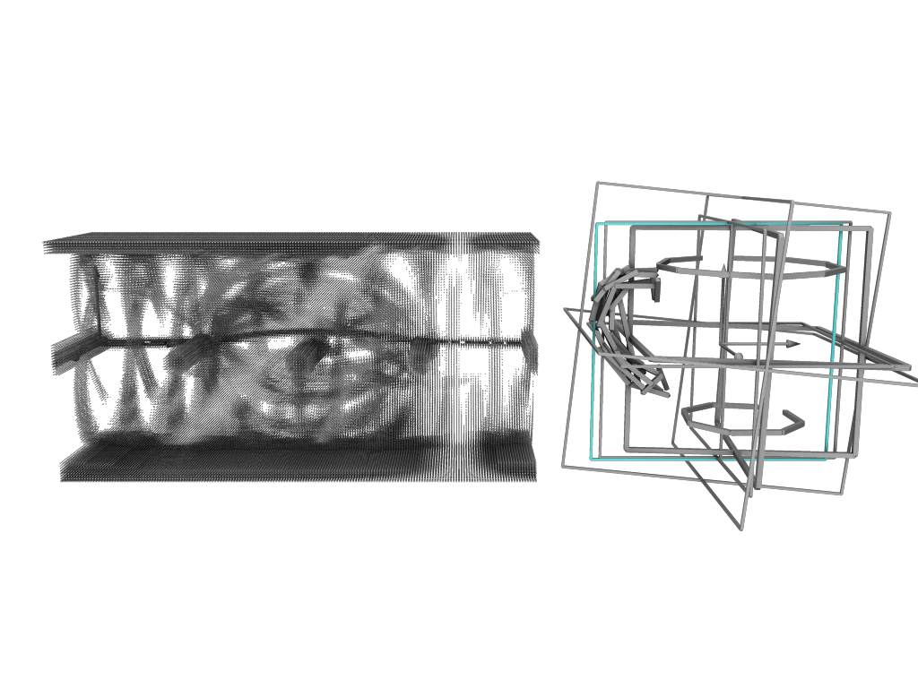
Geometric Features – Symmetry Plane
Notes:
33
33 - Symmetry plane

Slide 34
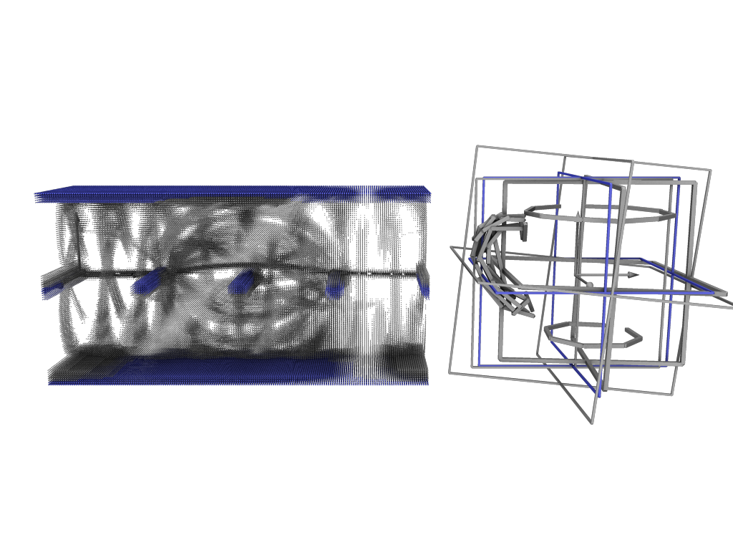
Geometric Features – Global XYZ Plane
Notes:
34
34 - Global XYZ planes

Slide 35
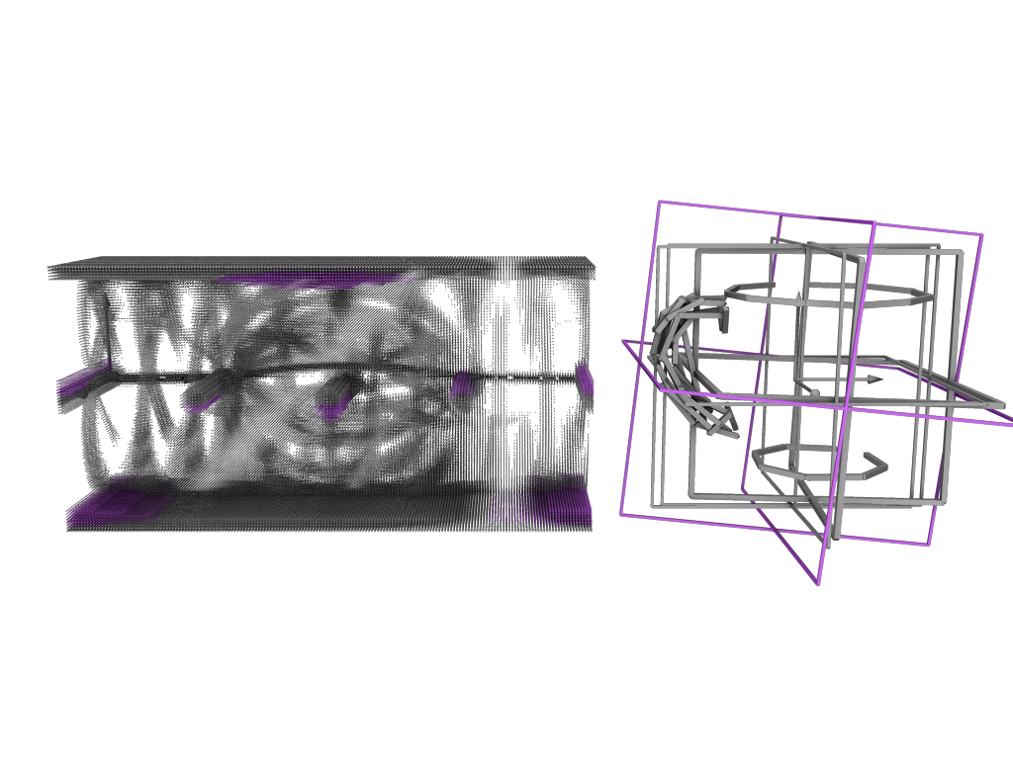
Geometric Features – Global PCA Plane
Notes:
35
35 - Global PCA planes

Slide 36
Our Approach – Greedy Selection
Notes:
36
36 - With these features as volumes in place, we'll look now at the greedy selection performed by our algorithm.

Slide 37
Our Approach – Greedy Selection
Notes:
37
37 - The video I have to show for this shows the iterative selection of the maximum bin (emphasized with coloured spheres). It also shows the features that intersect each selected bin being removed from the plane space for the next iteration, as they are now "covered".

Slide 38
Our Approach – Greedy Selection
Notes:
38
38 - So, each of those bins selected is a plane-space point, and defines the planar section we add in object space. We show the first three here. The greedy algorithm continues to choose planes while the value of the maximum bin exceeds a threshold. In the case of the 4th green bin, it fell below the threshold, causing us to discard the planar section at the bottom of the cup that would have been generated.

Slide 39
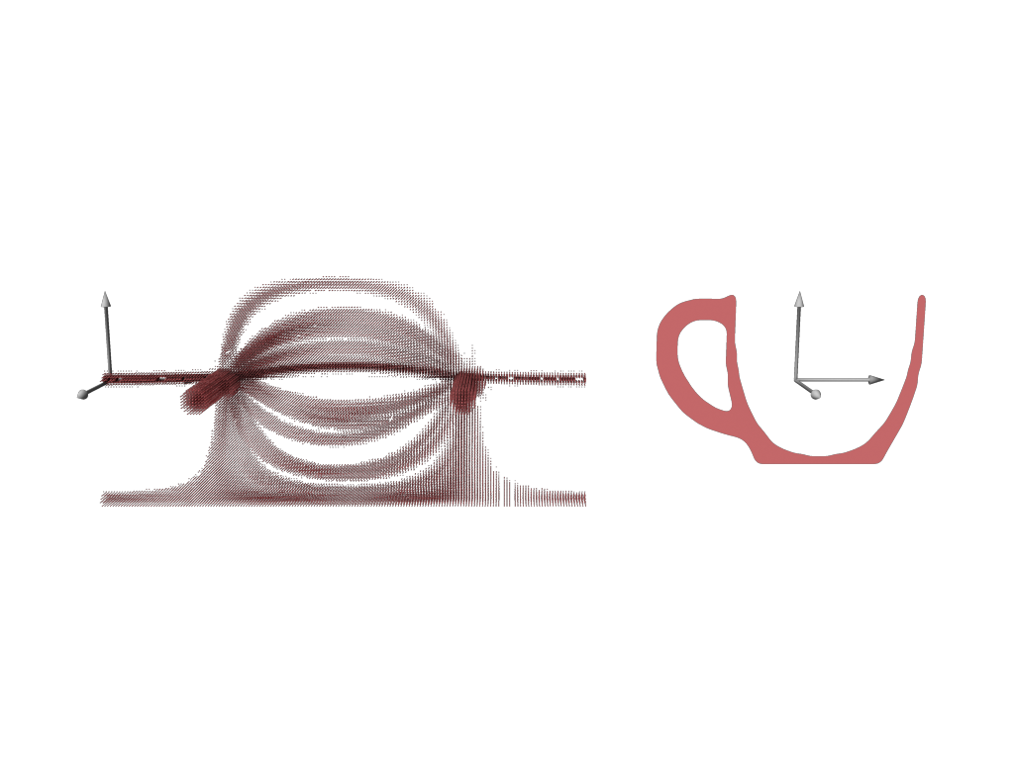
Our Approach – Greedy Selection
Notes:
39
39/40/41/42 - Here we visualize again each planar section being added and the feature coverage in plane-space.

Slide 40
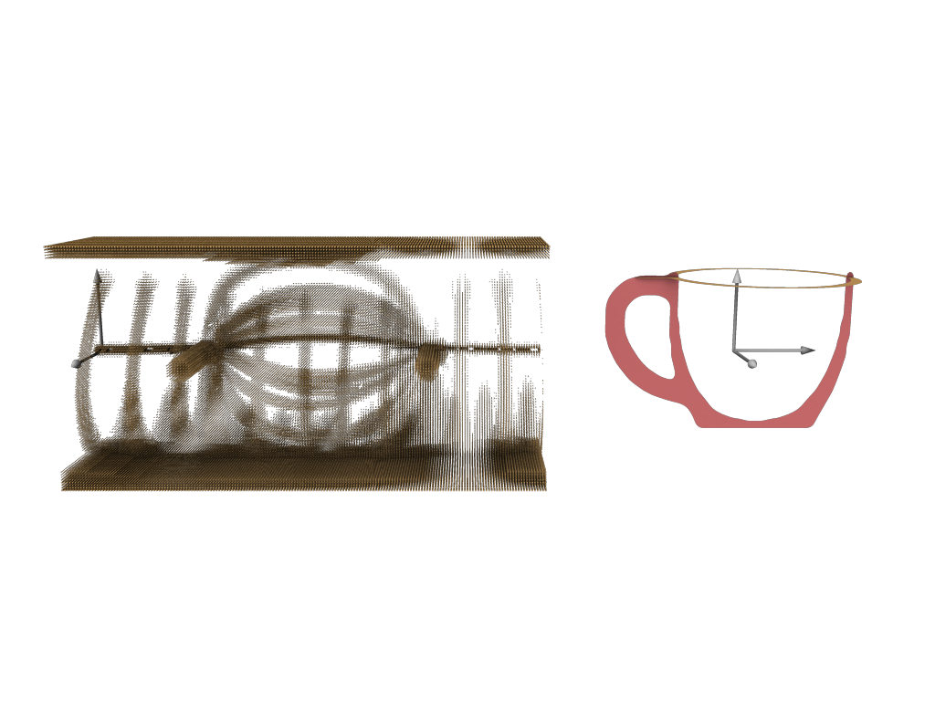
Our Approach – Greedy Selection
Notes:
40

Slide 41
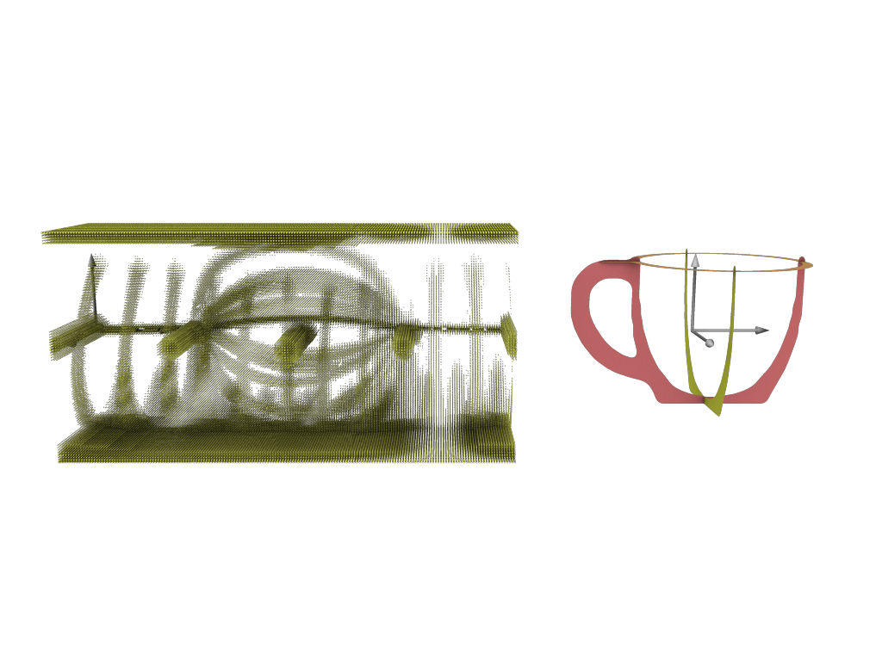
Our Approach – Greedy Selection
Notes:
41

Slide 42
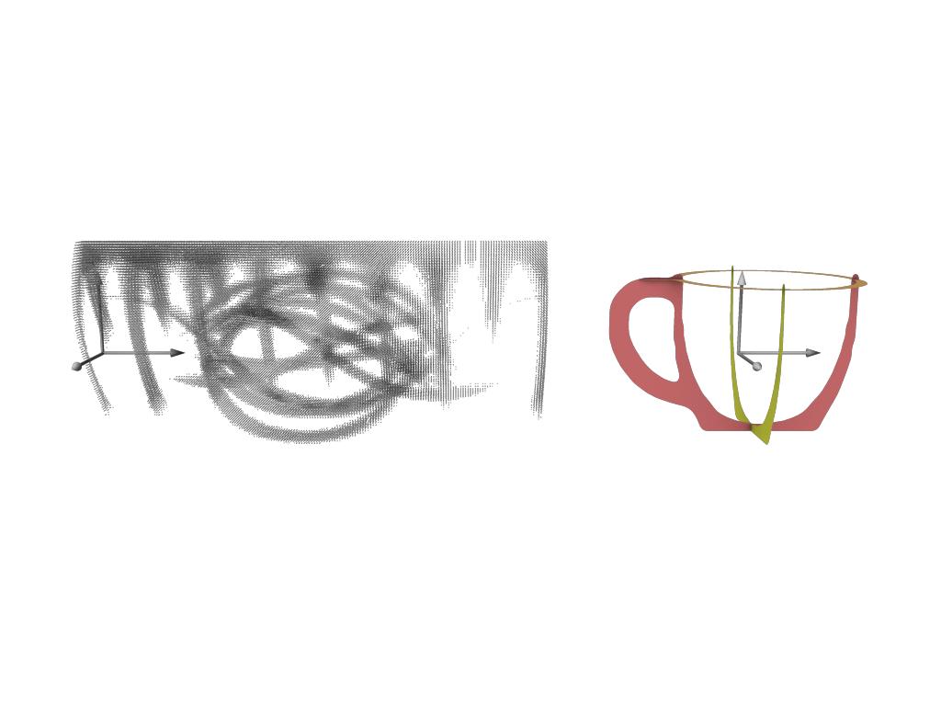
Our Approach – Greedy Selection
Notes:
42

Slide 43
Our Approach – Learning Weights
Learned from super proxy:
- Clustering of human-selected planes
- Forms representative set
- 6% of planes used
Agreement: red (15 humans) to blue (4 humans)
Notes:
43
43 - We want to learn feature weights from the exploration study data so that our algorithm can choose planes as humans do. We take the data (the planar sections generated by all users) and cluster all the nearby planes together to create the representative set that we call the super-proxy. The super proxy is shown in the bottom row, and the super proxy planes are coloured to show the level of agreement between users from red (15 humans) to blue (4 humans).

Slide 44
Our Approach – Learning Weights
Intuition:
- Fill plane-space with geometric features
- Super-proxy points should be high
- Other points should be low
(Refer to paper for further details)
Notes:
44
44 - The way we learn weights for geometric feature types is modelled by the same process as how our algorithm selects planes. Consider an oracle algorithm that greedily chooses exactly the planes from the super proxy set, in order of highest agreement. Note that the discrete bins in the plane-space that correspond to each of the oracle's selections should have a weighted sum above the threshold. That gives us one set of constraints. Conversely, when the oracle has finished selecting planes, the bins corresponding to the uncovered geometric features that remain should have a weighted sum below the threshold. That gives another set of constraints. We solve for the weights that satisfy both sets of constraints. Refer to the paper for further details.

Slide 45
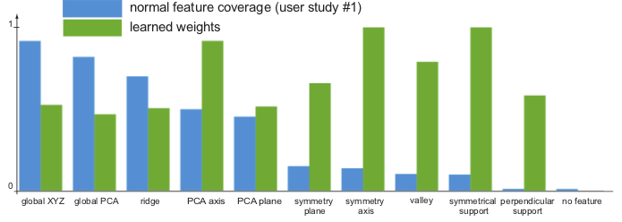
Our Approach – Learning Weights
Notes:
45
45 - The green bars on this graph show the learned weights. From these, we can gain some insight in terms of the amount of perceptual importance humans attribute to specific geometric feature types. For instance, as predicted, symmetry-related features are of relatively high importance when creating minimum planar section representations.

Slide 46
Results
Super-proxy
Algorithm Output
Notes:
46
46 - Here are the results of our algorithm on our training set, the models from our original exploration study. Compared to the super proxy set which is the "gold standard" we aim for, our algorithm comes close to emulating these results. Sometimes, our algorithm omits a blue super-proxy plane where there was less human agreement. Other times, our algorithm is arguably an improvement over the super-proxy, for example in the case of the donkey, or the chair (where a concavity on the underside of the seat was captured, perhaps without intention).

Slide 47
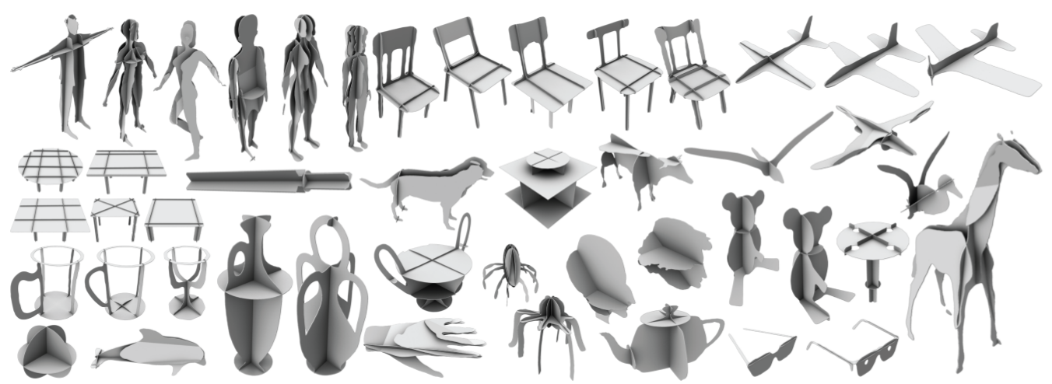
Results
Notes:
47
47 - Here are some results on a number of new models. Note that all of these results use the weights learned from our training set, no individual tuning of parameters was required.

Slide 48
Evaluation I
Q: Are the abstractions recognizable?
We performed a second user study to verify this.
Notes:
48
48 - So, are the abstractions generated recognizable? This was the original problem. We ran a second study specifically to find out.

Slide 49
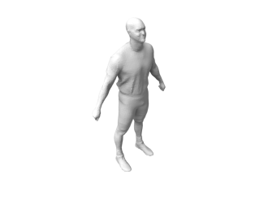
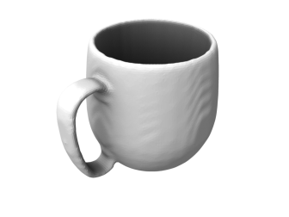
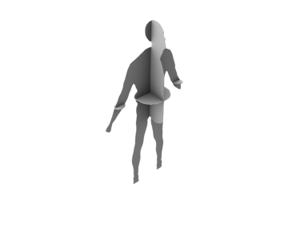
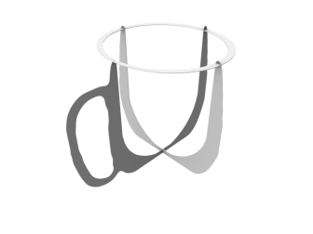
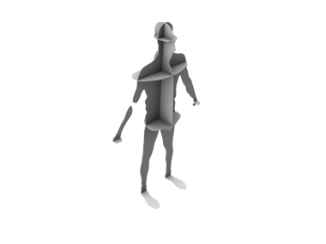
Evaluation I – Recognition Study
Models (11)
Task: Identify objects
- Timed trials
- 66 participants
- 11 models (6 old, 5 new)
- 5 representations
Mesh
...
Algorithm
...
Human
...
PCA
...
Random
...
Notes:
49
49 - In our recognition study, with 66 participants, we used 6 models from the last study, and 5 new ones. We had 5 representations, the original model, human-selected and algorithm-selected representations, as well as two others: a naive PCA approach and random cuts. Users went through each of the 11 models in a random order, and were shown a random image of one of the 5 representations. When the participant was able to recognize the object, they would press a key which would hide the image and they would be prompted to identify it. These results were timed, and the responses themselves of course had to be manually verified.

Slide 50
Evaluation I – Recognition Study
For mesh, human, algorithm:
- Recognition rate > 90%
- Reaction time < 2 sec.
For PCA:
- Recognition rate = 57%
- Reaction time > 4 sec.
For random:
- Recognition rate = 38%
- Reaction time > 4 sec.
Notes:
50
50 - The results were ideal! The human and algorithm abstractions performed similar to the original mesh models, with recognition rates above 90% and average reaction times less than 2 seconds. PCA and random abstractions performed significantly worse.

Slide 51
Evaluation II - Persistence
Notes:
51
51 - Our algorithm's ability to persist depends on how well the underlying features persist. Naturally, the use of features or shape descriptors which themselves persist better under simplification and noise will be of benefit.

Slide 52
Evaluation III - Limitations
Notes:
52
52 - Highly articulated characters, or non-planar models (for example, the curved chair backrest) are less amenable to a planar section representation. In addition, models with "too many" or "too few" features can cause problems for plane selection.

Slide 53
Algorithmic Refinements
Notes:
53
53 - There are a number of refinements we can make to our original algorithm. Plane refinement: Convergent algorithm to look within neighbourhood of bin to maximize planar section area. Counters issues with discretization of our plane-space. Segment coverage: not halting selection until all segments of mesh are intersected by a planar section. Adaptive refinement: varying the minimum threshold, to choose more (or fewer) planes before halting.

Slide 54
Applications – Paper Puppets
Notes:
54
54 - Paper puppets. These are physical models one can construct. The templates for some models, and our application for producing the templates, can both be downloaded online.

Slide 55
Applications – Articulating Puppets
Notes:
55
55 - Using a model's segmentation data, instead of cutting the model globally we can create sections for each segment independently, performing a hermite join of open curves at the segment boundaries to close the shapes. We can then "pin" two planar sections together to form a joint, to make characters with some simple articulation.

Slide 56
Applications - Annotation
Notes:
56
56 - Also in our software application, a planar section abstraction provides a set of planes which can invisibly exist as annotation surfaces. The active plane for annotation can be selected by utilizing camera parameters like position and view direction. In this example, the plane along a symmetry axis will dynamically rotate its normal to face the camera.

Slide 57
Applications – Artistic Abstraction
Notes:
57
57 - Our algorithm can be applied to each part of a more complex model, the union of these parts forming an artistic planar abstraction.

Slide 58
Summary
Key Contribution: Introduction and exploration of 3D shape abstraction using minimal planar sections
- How humans define planar sections
- Relative importance of geometric features
- Algorithm to produce recognizable results
- Applications
Notes:
58
58 - Our key contribution is to introduce and explore the use of minimal planar section shape proxy. We gained insights into how humans define planar sections and the importance of geometric features. We presented an algorithm to efficiently produce minimal abstractions that are similar to what a human would author, and through a second study showed that they are as recognizable as the original mesh models. We also explored a number of potential applications for minimal planar section abstractions.

Slide 59
Acknowledgements
Individuals:
Doug DeCarlo
Wilmot Li
Chantal Timms
Sawsan Alhalawani
Anastasia Khrenova
Organizations:
Notes:
59
59 - We acknowledge the following individuals and organizations, for discussion, helping to create some physical models, and funding.

Slide 60
Thank You
Code and data available online:
http://www.dgp.toronto.edu/~mccrae/projects/slices/
Notes:
60
60 - And thank you for your attention.
Other related areas of work: Visual perception. Where do people draw lines? Cole et al. SIGGRAPH 2008. Shape simplification: Billboards/polypostors. Geometric features: curvature, symmetry, segmentation, etc. Curves: iWires, Wires.

Slide 61
Extra Slides…
Liu et al. Surface Reconstruction from Non-Parallel Curve Networks. Eurographics 2008.
Notes:
61
Surface Reconstruction From Non-parallel Curve Networks, Computer Graphics Forum (Proceedings of Eurographics 2008), 27(2):155-163
L. Liu, C. Bajaj, J.O. Deasy, D.A. Low, T. Ju Second place in SIGGRAPH 2007 SRC (student research competition). University of Washington

Slide 62
Extra Slides…
Notes:
62
User proxy problems: (left) regular sections in our pilot study; (middle) inadvertently capturing concave under side of chair; (right) planes covering no geometric feature on the donkey.

