Slide 1
Gestural Motion Editing
Using Mobile Devices
Noah Lockwood
University of Toronto
Industrial Light & Magic
Karan Singh
University of Toronto

Slide 3
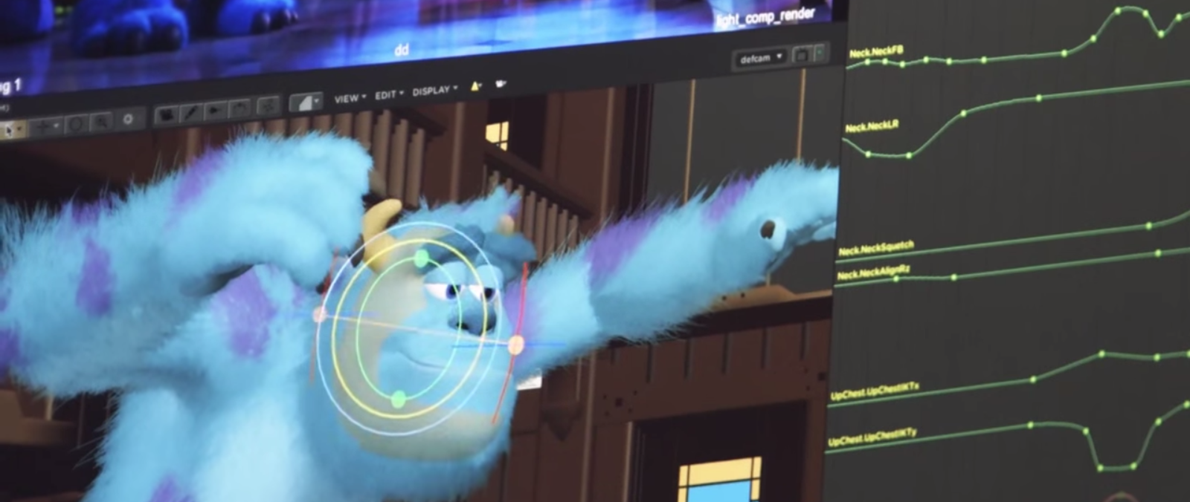
Background
Animating is very difficult and time-consuming.
Performance interfaces are a way to easily and quickly create (limited) animation.
Is this possible without specialized equipment?

Slide 4
Related Work
Motion editing:
Automated cleanup
Retargeting
Path-based
Performance interfaces:
Handheld devices
Full body performance
Touch/pen input

Slide 5
Overview
Path-based motion editing algorithm
Mobile device sensor data
Motion editing with discrete gestures
Motion editing with continuous gestures
Conclusion

Slide 6
Overview
Path-based motion editing algorithm
Mobile device sensor data
Motion editing with discrete gestures
Motion editing with continuous gestures
Conclusion

Slide 7
Motion Path Editing
Interactive editing of an entire motion and its timing by manipulating path "handles":

Slide 8
Jump Path Editing
Vertical adjustments and acceleration-based timewarping:

Slide 9
Overview
Path-based motion editing algorithm
Mobile device sensor data
Motion editing with discrete gestures
Motion editing with continuous gestures
Conclusion

Slide 10
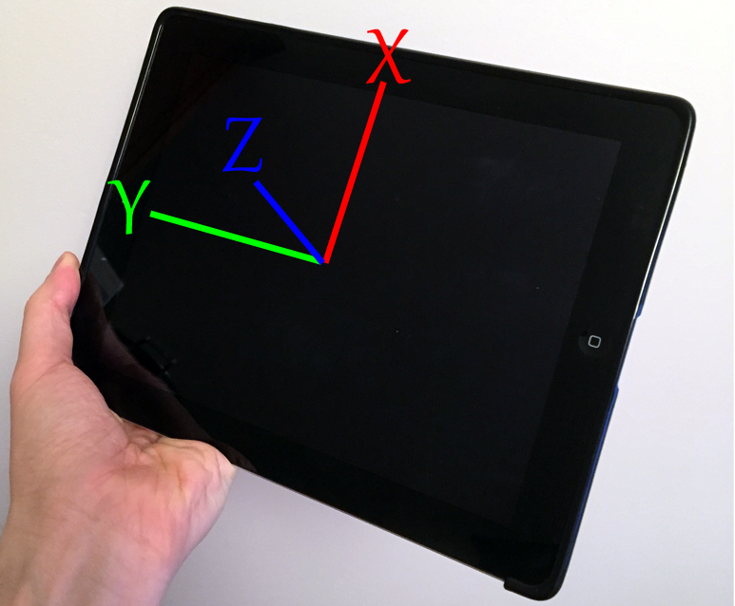
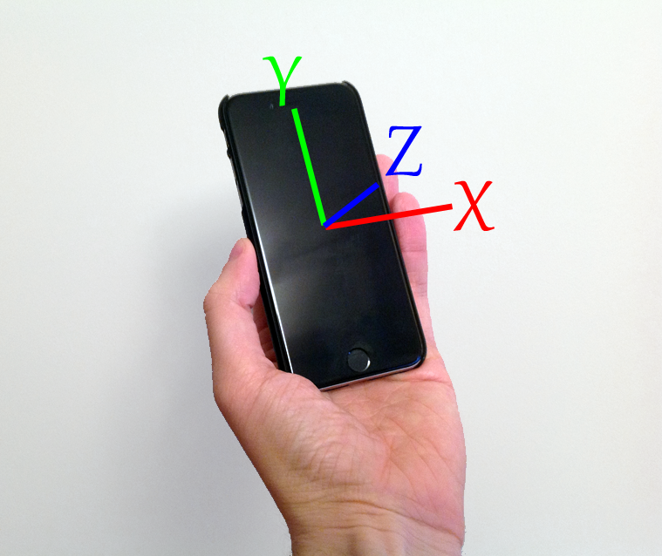
Mobile Device Motion Data
Simple sensors: accelerometer, magnetometer, compass, gyroscope.
Data: orientation and acceleration in a semi-arbitrary world coordinate frame.

Slide 11
Gestural Data
Sensor data during a "jump up" gesture:
Acceleration:

Slide 12
Gestural Data
Sensor data during a "jump up" gesture:
Acceleration:
Position:

Slide 13
Gestural Data
Sensor data during a "jump up" gesture:
Acceleration:
Velocity:
Position:

Slide 14
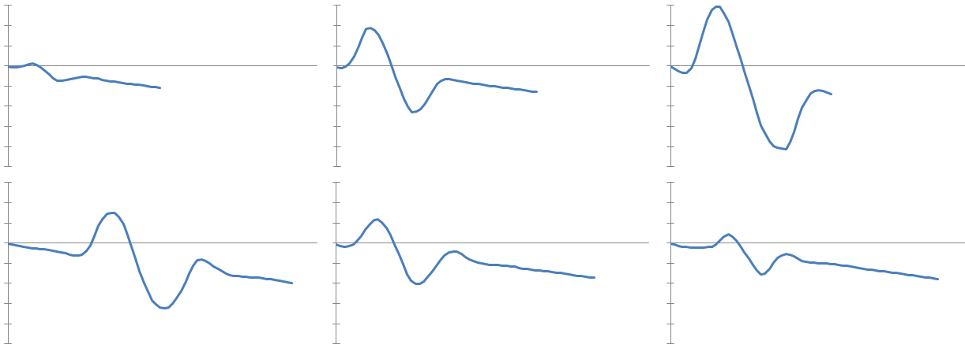
Gesture Velocity Data
Gestures of differing magnitude result in similar "velocity profiles":

Slide 15
Overview
Path-based motion editing algorithm
Mobile device sensor data
Motion editing with discrete gestures
Motion editing with continuous gestures
Conclusion

Slide 16
Discrete Gestures
How big is a "normal" jump?
Gesture scale is arbitrary and unclear.
But different gestures can be compared.

Slide 17
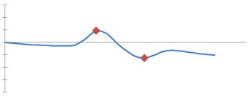
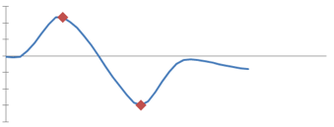
Discrete Gestures
User performs reference gesture to mimic, and editing gesture to modify.
Similarity transform to relate profiles, determined by corresponding features.
Bidimensional scale of the transform determines gestural scaling factor.
Reference Gesture
Editing Gesture

Slide 18
Discrete Gestures

Slide 19
Parameterized Motion Edits
Start with an editable reference motion.
Define editing handle positions as fixed or dependent on a scalar distance parameter.
Determine reference motion parameter value r.
For a gestural scaling factor s, new motion is defined by parameter value s * r.

Slide 20
Parameterized Motion Edits

Slide 21
Jump Height Edit

Slide 22
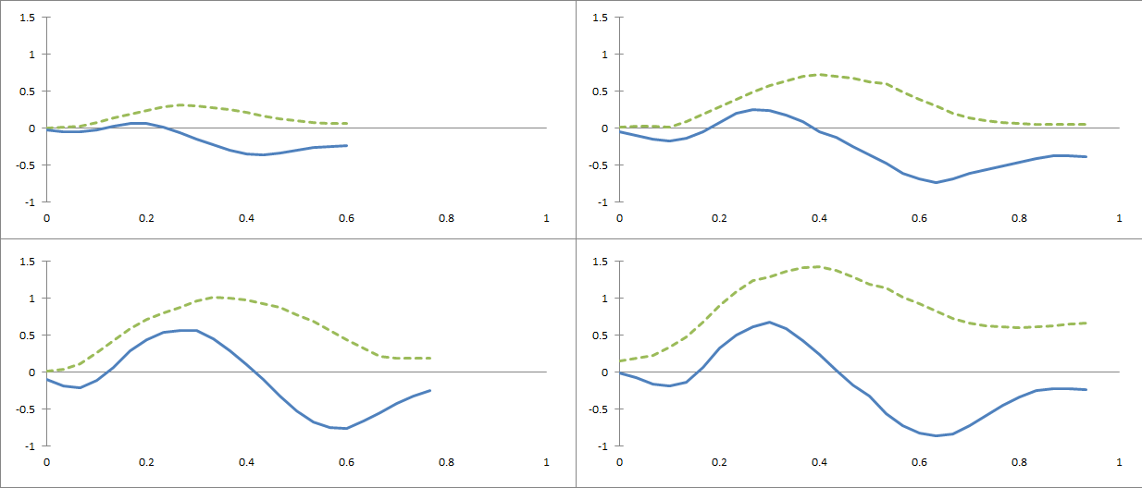
Jump Distance Editing
Use horizontal velocity in addition to vertical:
Time scaling from vertical features, velocity scaling from horizontal magnitude.

Slide 23
Jump Distance Edit

Slide 24
Stride Distance Editing
Again, horizontal and vertical velocity:
Multiple "hops" - potentially different between gestures.
Scaling factor from average of all reference hops and average of all editing hops.

Slide 25
Stride Distance Edit

Slide 26
Overview
Path-based motion editing algorithm
Mobile device sensor data
Motion editing with discrete gestures
Motion editing with continuous gestures
Conclusion

Slide 27
Continuous Gestural Editing
Interactive editing of ongoing motion in real-time.
Decompose orientation sensor data for "steering wheel"-style control:

Slide 28
Continuous Path Editing
Good idea: steering to bend a motion path.
Bad idea: continuously editing a motion's path.

Slide 29
Editing a "Sidecar" Motion
time t
Sidecar
Motion
Displayed
Motion

Slide 30
Editing a "Sidecar" Motion
time t
time t +1
Sidecar
Motion
Displayed
Motion

Slide 31
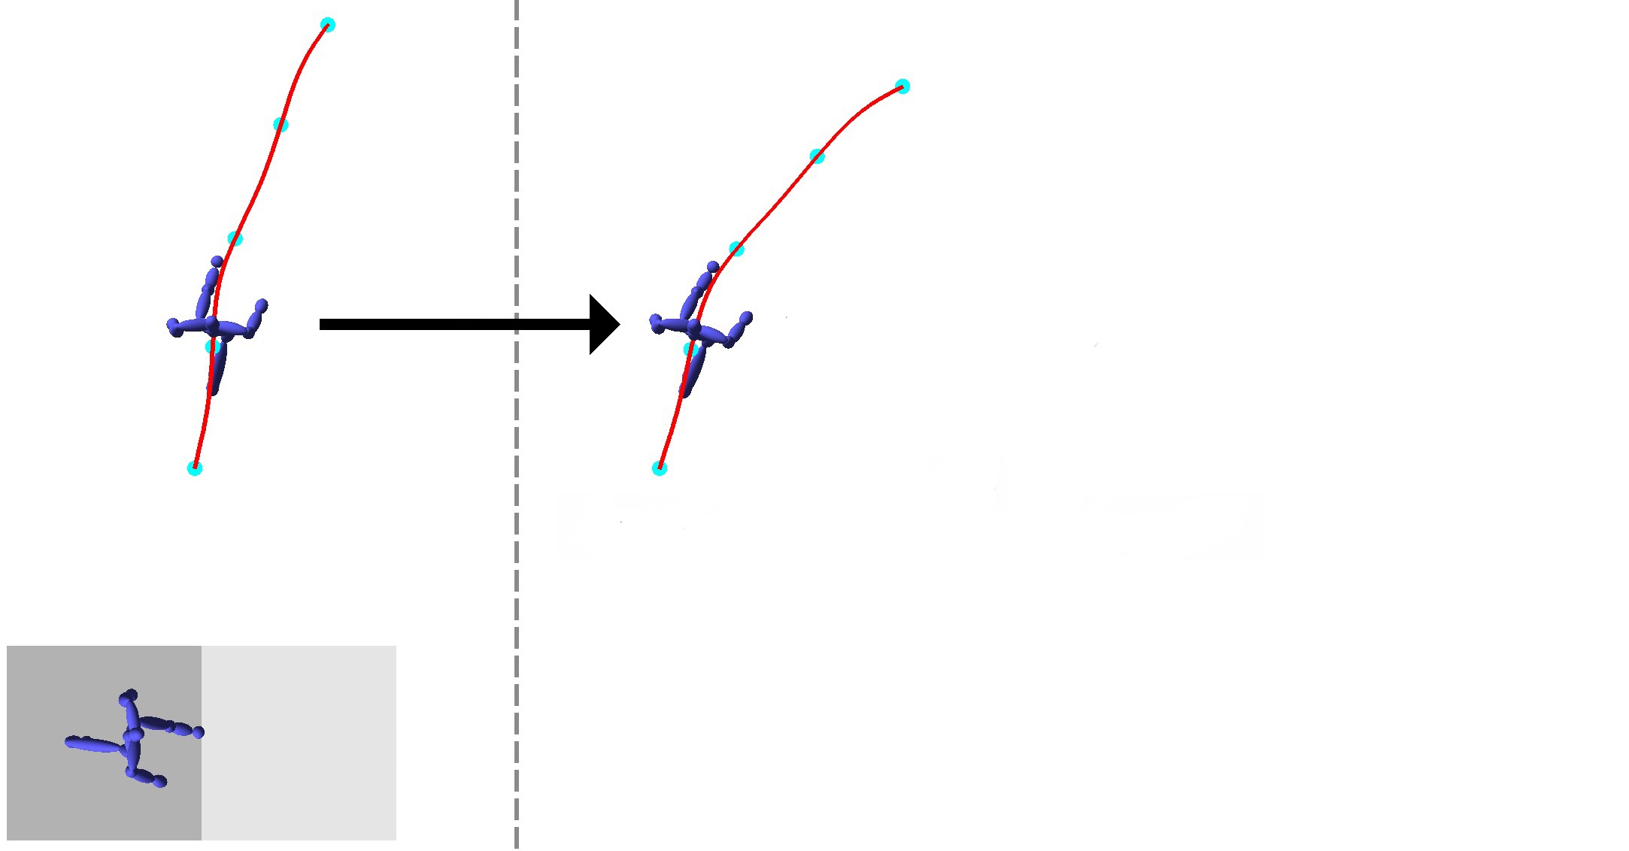
Editing a "Sidecar" Motion
time t
time t +1
Sidecar
Motion
Bend Path
Displayed
Motion

Slide 32
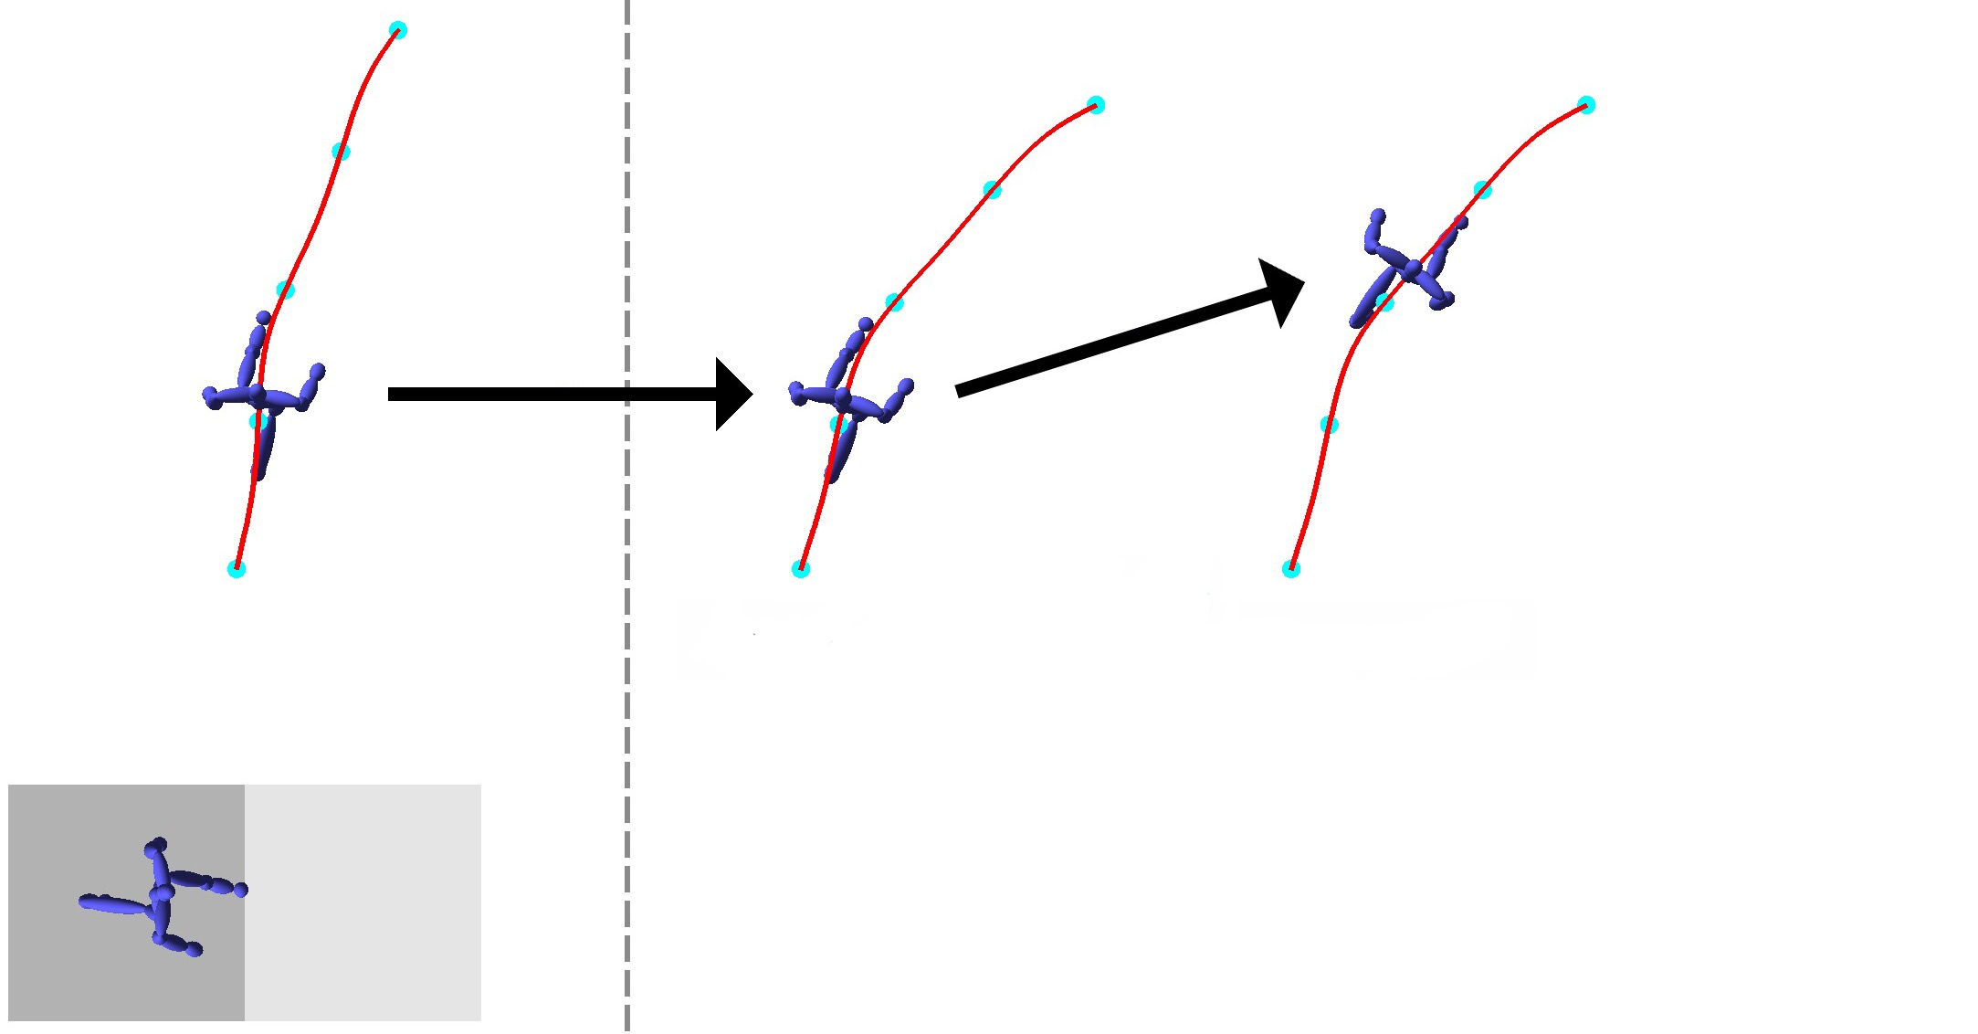
Editing a "Sidecar" Motion
time t
time t +1
Sidecar
Motion
Advance
Time
Bend Path
Displayed
Motion

Slide 33
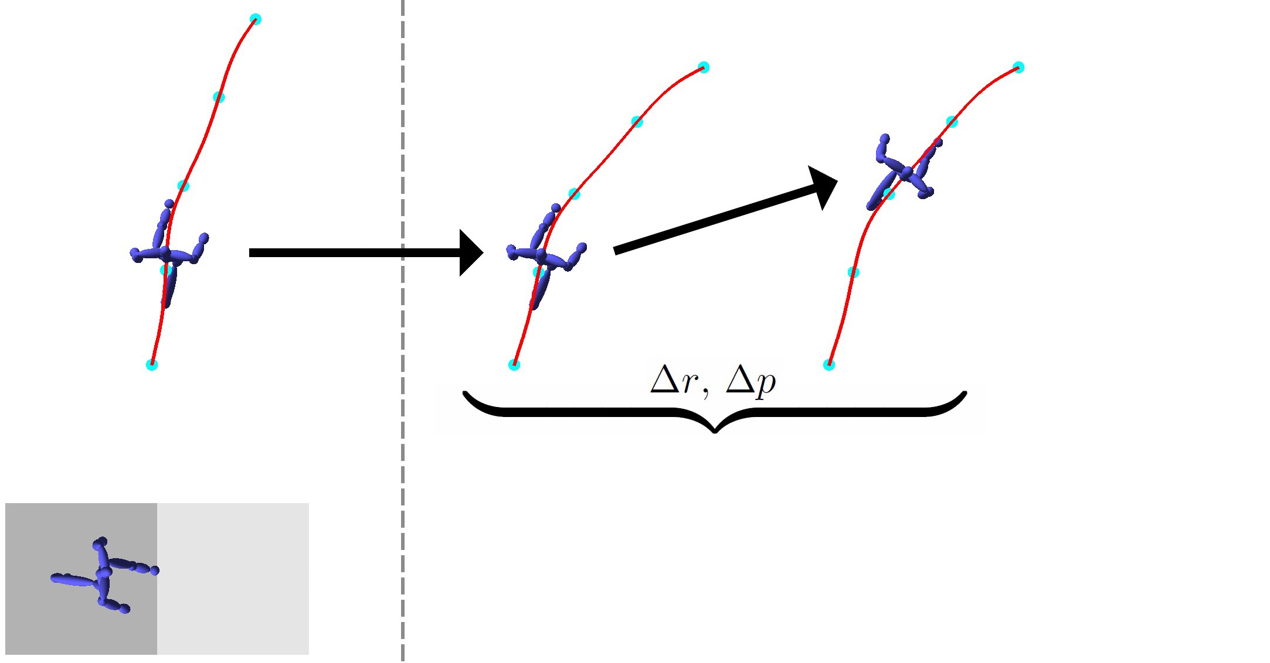
Editing a "Sidecar" Motion
time t
time t +1
Sidecar
Motion
Relative
Transformation
Displayed
Motion

Slide 34
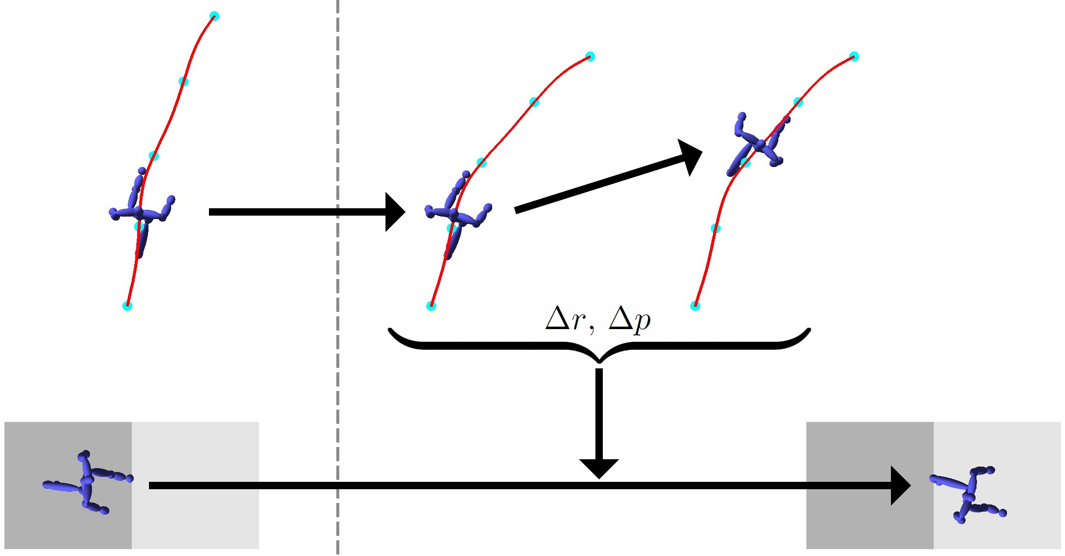
Editing a "Sidecar" Motion
time t
time t +1
Sidecar
Motion
Displayed
Motion

Slide 35
Transferring Deltas
Sidecar Motion
Displayed Motion

Slide 36
Cyclic Motion
Sidecar motion can be short - just two steps.
Reset to beginning if timestep goes past end.
Pose continuity if first/last keyframes identical.
Turning rate continuity is a problem.

Slide 37
Cycling
Sidecar: 2 steps

Slide 38
Cycling
Sidecar:
middle 2 of 4 steps
Sidecar: 2 steps

Slide 39
Continuous Editing Results

Slide 40
Overview
Path-based motion editing algorithm
Mobile device sensor data
Motion editing with discrete gestures
Motion editing with continuous gestures
Conclusion

Slide 41
Recap
Handheld manipulation of mobile devices using:
A pair of discrete gestures to edit single motions.
Continuous gesturing to edit ongoing motion.
Core ideas:
Simple motion sensors can be expressive.
Motion editing algorithms can be adapted for real-time.

Slide 42
Applications
What can "quick and easy" techniques do?
Help make animating accessible to novices.
Help professionals. Animators spend too much time and effort on blocking animations.

Slide 43
Limitations and Future Work
Better/more sensor data - full 6DOF tracking?
Automatic motion parameterization.
Combined discrete and continuous control.
Performance study to evaluate ease and user satisfaction with results.

Slide 44
Thanks!
Questions?
Acknowledgements:
Isabelle Ortega
Andrew German
John Hancock
MiG2016 Reviewers

