Slide 1
Finger Walking: Motion Editing with Contact-Based Hand Performance
Noah Lockwood
University of Toronto
Industrial Light & Magic
Karan Singh
University of Toronto

Slide 2
Background
Keyframe animation is very difficult for novices
Performance-based interaction is increasingly common, and could improve accessibility
So how can users express motion?

Slide 3
Expressing Motion - Commercial

Slide 4
Expressing Motion - Amateur

Slide 5
Related Work
Full-body animation performance
Hand performance (direct mapping)
Handheld devices
Footsteps

Slide 6
Overview
Exploratory study and analysis
Prototype system:
Classification
Animation editing
Performance study & results

Slide 7
Overview
Exploratory study and analysis
Prototype system:
Classification
Animation editing
Performance study & results

Slide 8
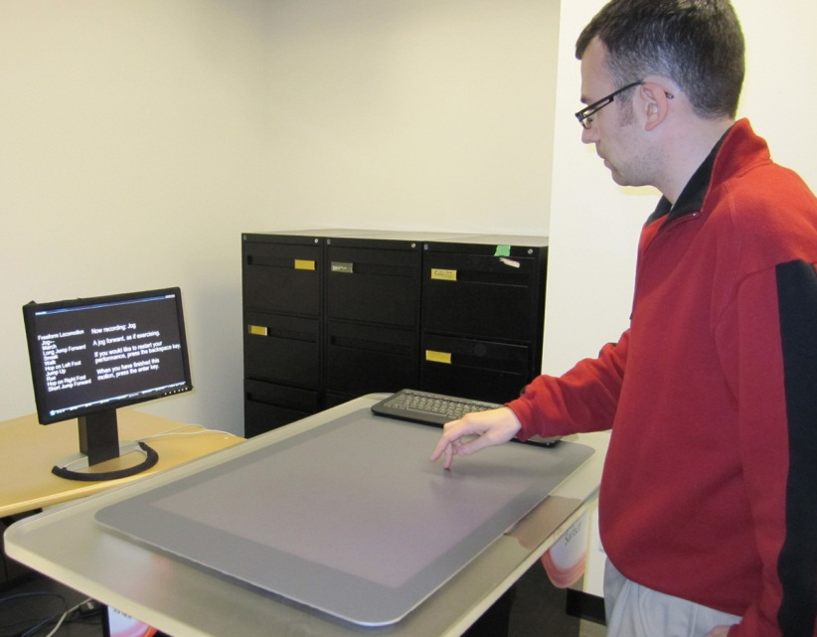
Exploratory Study
How do users express full-body motion using their hands?
12-person open-ended study:
Contact and video recording
Different locomotion types by description and example
Performances rated 1-5

Slide 9
Observations
73% of performances used "classical" finger walking, by 11 out of 12 participants
Finger walking average rating: 3.7 out of 5, other techniques average rating: 3.3 out of 5
Lower body motion indicated as more important

Slide 10
Analysis
Sampled (30Hz) contact shapes:

Slide 11
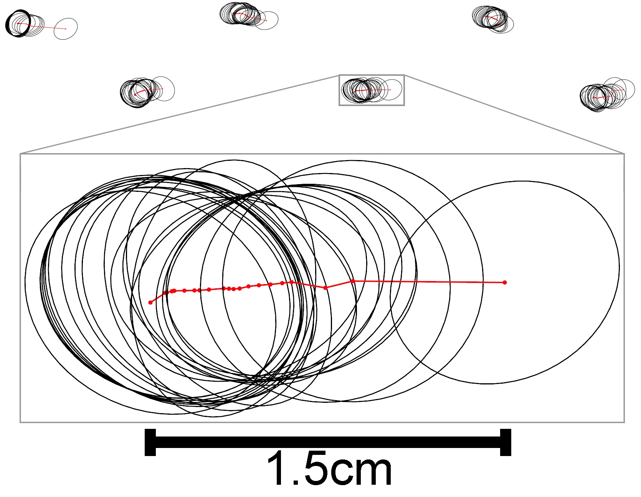
Analysis
Sampled (30Hz) contact shapes:

Slide 12
Analysis
Number of active contacts over time:
Full-body walk:

Slide 13
Analysis
Number of active contacts over time:
Full-body walk:
Finger walk:

Slide 14
Analysis
Gait parameters of finger walking and full-body motions of the same type:

Slide 15
Analysis
Gait parameters of finger walking and full-body motions of the same type:

Slide 16
Exploratory Study Conclusions
Finger walking is a natural method to express motion
Moment-to-moment finger walking parameters are imprecise
Varying similarity to full-body motions
Finger walking performances are illustrative

Slide 17
Overview
Exploratory study and analysis
Prototype system:
Classification
Animation editing
Performance study & results

Slide 18
Prototype System
"Walk up and use it" approach to producing animated variations of locomotion
Gestural interface based on more robust parameters describing the entire performance
Example-based motion classification and animation editing, from a single performance

Slide 19
Classification
Must work for a variable number of cycles
Feature vector of average gait parameters, e.g.:
Contact frequency
Contact-to-contact distance
Example-based classification using feature vectors from other users

Slide 20
Motion Editing
"Canonical" animations of each type for output
Cycled animations, path-based editing (SCA2011) to match path of performance

Slide 21
Motion Editing
"Canonical" animations of each type for output
Cycled animations, path-based editing (SCA2011) to match path of performance

Slide 22
Motion Editing
"Canonical" animations of each type for output
Cycled animations, path-based editing (SCA2011) to match path of performance

Slide 23
Motion Editing
"Canonical" animations of each type for output
Cycled animations, path-based editing (SCA2011) to match path of performance

Slide 24
Motion Editing
"Canonical" animations of each type for output
Cycled animations, path-based editing (SCA2011) to match path of performance
Heuristics for consistency:
Scale of character
Number of cycles
Step layout along path
Final animation timing is independent of performance

Slide 25
Motion Editing Example

Slide 26
Overview
Exploratory study and analysis
Prototype system:
Classification
Animation editing
Performance study & results

Slide 27
Performance Study
Goal was to evaluate classification accuracy and subjective quality of animations
8 new participants
Pre-set motion types; post-hoc classification
Motion type descriptions and target paths
Output animations rated 1-5

Slide 28
Classification Results
Accuracy of 62-74%, depending on classifier
Data normalization increased accuracy 1-2%
Average accuracy varied by motion type:
Walk: 89%
Run: 82%
Forward jump: 65%
Sneak: 23%

Slide 29
Animation Results
Average satisfaction rating of 4.67 out of 5

Slide 30
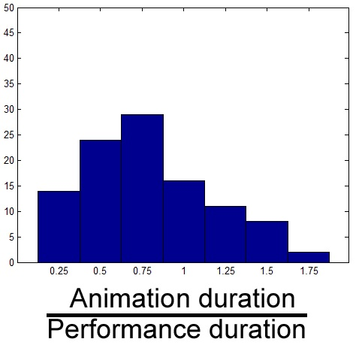
Animation Results
Average satisfaction rating of 4.67 out of 5
Animations generally slightly shorter than performances:

Slide 31
Results: Run

Slide 32
Results: March

Slide 33
Results: Jump Forward

Slide 34
Results: U-turn

Slide 35
Recap
Finger walking is natural and expressive, but is illustrative and imprecise
A gestural interface accommodates this, by using classification and animation editing
With a variety of users, classification is reliable and the animations are satisfying

Slide 36
Limitations & Discussion
Trade-off: control vs. accessibility
Limitations:
Full-body editing
Timing and step control
Possible extensions:
Gestural hand input beyond contact
Online interaction
Mixed motions and transitions

Slide 37
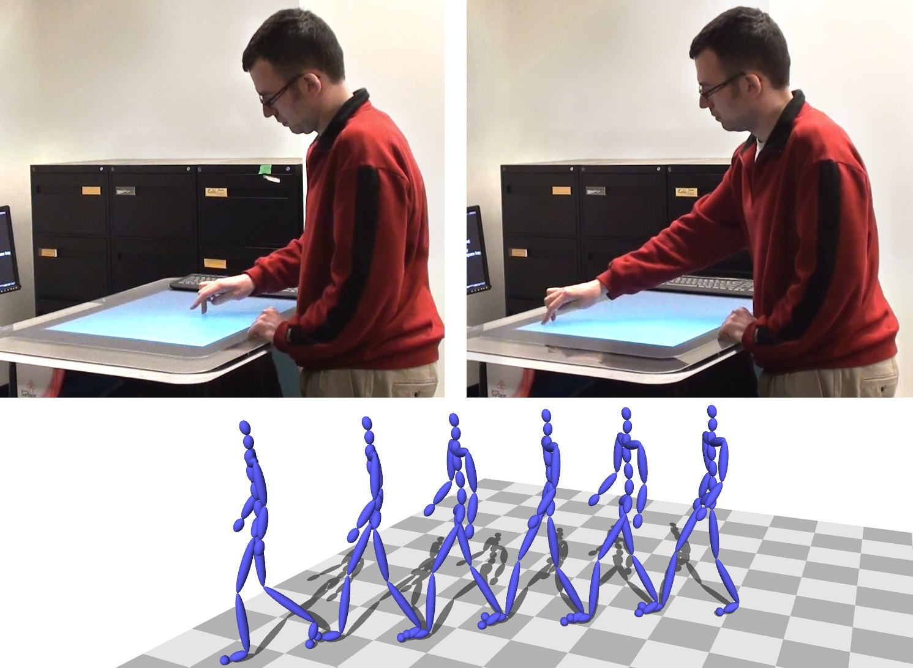
Thanks!
Questions?
Acknowledgments:
Isabelle Ortega
Study participants
SCA2012 reviewers
CMU Motion Capture Database
Khai Truong, Dustin Freeman, John Hancock, Peter O'Donovan, Martin de Lasa

