Slide 1
Color Compatibility From Large Datasets
Peter O’Donovan
University of Toronto
Aseem Agarwala
Adobe Systems, Inc.
Aaron Hertzmann
University of Toronto

Slide 2
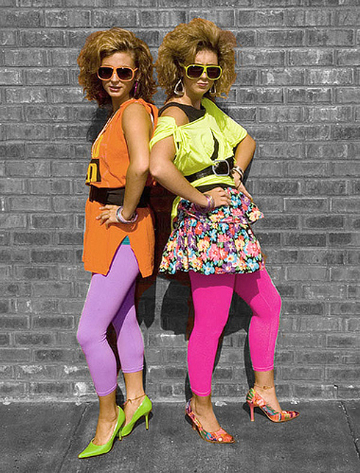
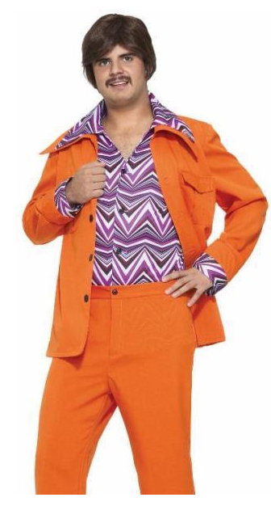
Choosing colors is hard for many people
Notes:
Choosing colors can hard for many people, whether it’s choosing an outfit for a ‘hot date’…

Slide 3
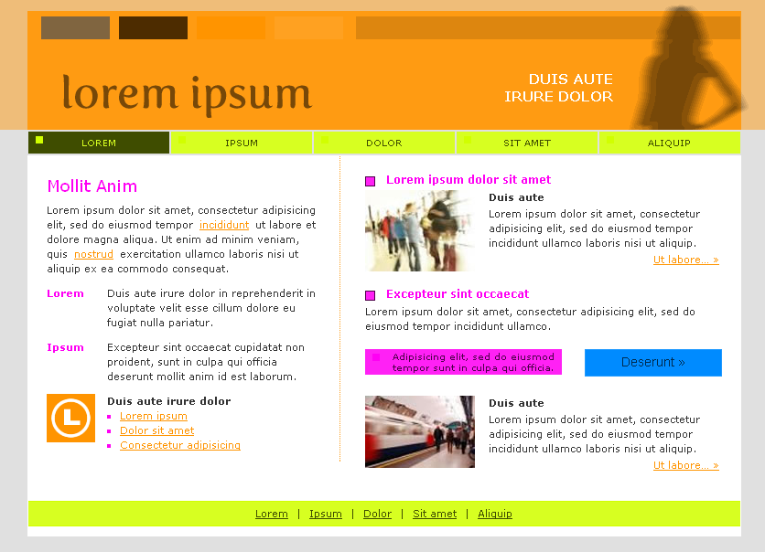
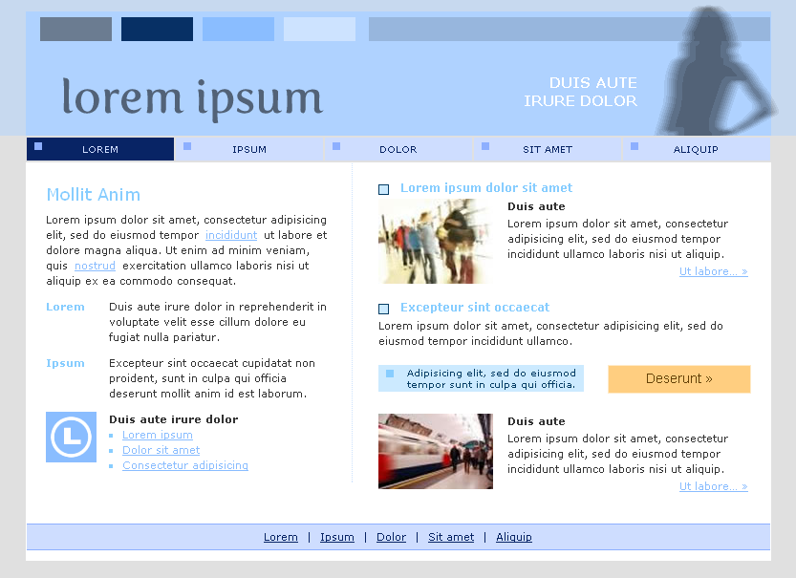
Choosing colors is hard for many people
Notes:
Or creating a palette for a website, color choices can make the difference between an poor distracting design, and a clear readable one.

Slide 4
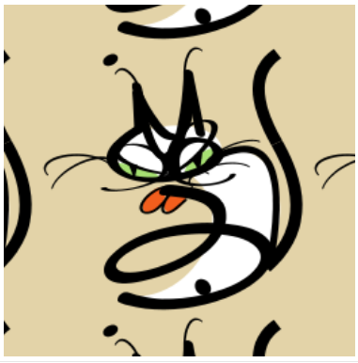
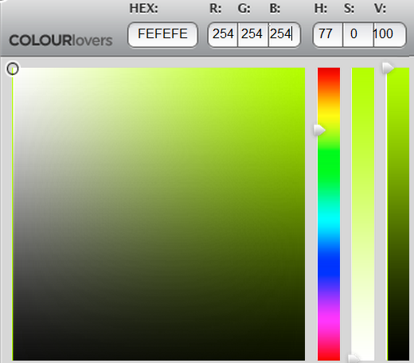

?
Notes:
For many of us, particularly non-designers, choosing colors can be overwhelming and intimidating however. Choosing a color (for example for this cat’s body) often involves manually exploring the color space, usually with simple tools like color sliders or squares, which is both time-consuming and fairly subjective.

Slide 5
How do designers choose colors?
Notes:
So how do designers choose colors? Often this involves searching for examples of successful color combinations which can be used as a starting point for a design.

Slide 6
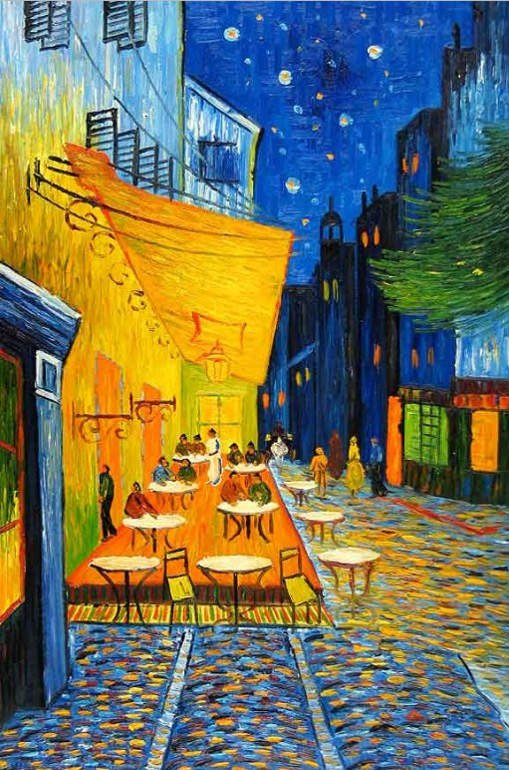
How do designers choose colors?
Picasso
Notes:
Such examples can be found anywhere from art

Slide 7

How do designers choose colors?
You the Designer
Notes:
To blogs; the article shown here offers ’44 cool flyer designs for inspiration’.
But artists also look at more abstract color combinations.

Slide 8
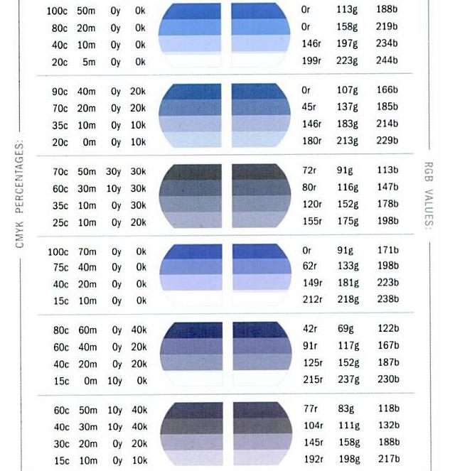
How do designers choose colors?
Krause [2002]
Notes:
Such as those found in color palette books. Examining colors without context (like these palettes) can be useful for artists, again by providing successful examples.

Slide 9
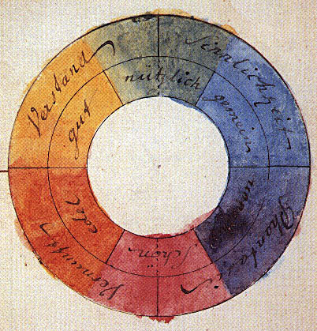
Goethe [1810]
Complementary Color Theory: colors opposite on the color wheel are compatible
Notes:
Philosophers and scientists have also long been interested in understanding color compatibility and have proposed numerous theories.
Two centuries ago Goethe described complementary color theory: that colors opposite on the color wheel are compatible. So blue is compatible with orange, red is compatible with green, etc.

Slide 10
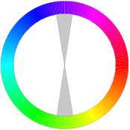
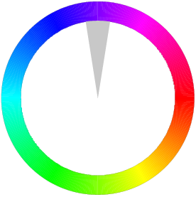

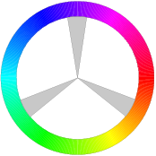
Hue Templates: relative orientations producing compatible colors
Complementary
Monochromatic
Analogous
Triad
Notes:
Over the centuries, this idea became generalized to hue templates: relative orientations about the hue wheel which produce compatible colors. So the complementary template has hues 180 degrees apart, monochromatic has only a single hue, analogous as a spread of similar hues, etc. Hue templates like this are the most popular form of color compatibility, appearing in many art and design books, websites,

Slide 11
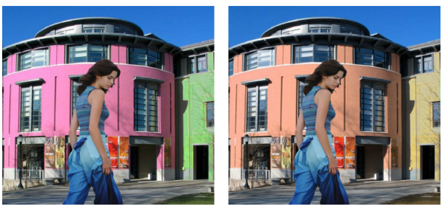
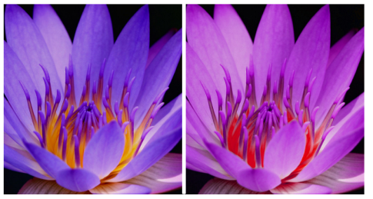
Color Harmonization
Cohen-Or et al. 2006
Photo and Video Quality Evaluation:
Focusing on the Subject
Luo and Tang 2008
Color Harmonization for Videos
Sawant and Mitra 2008
Aesthetic Visual Quality Assessment of Paintings
Li and Chen 2009
Notes:
As well as several graphics and vision papers.
However, there has been fairly little evaluation of different hue templates, and it’s an open question as to how well they work in practice.

Slide 12
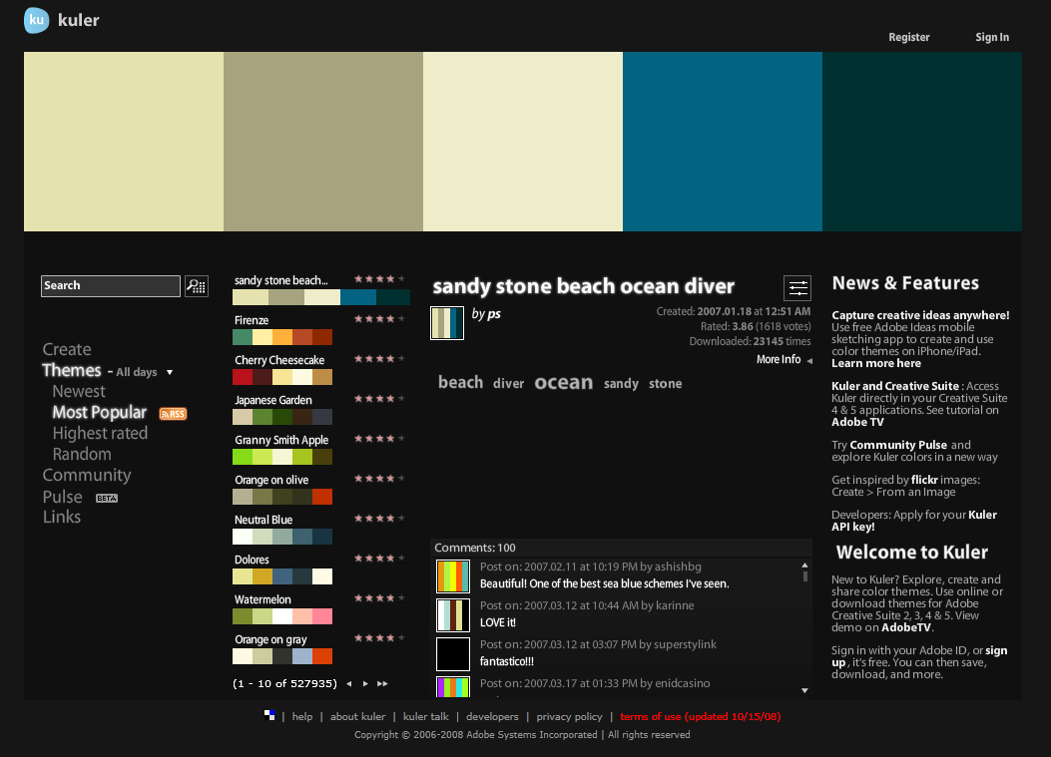
Notes:
Several websites allow users to create and share color palettes or themes. A color theme is an ordered set of 1-5 colors.

Slide 13
Adobe Kuler
527,935 themes
Ratings: 1-5 stars
Notes:
On site is Adobe Kuler, which has over a half a million themes

Slide 14
Adobe Kuler
527,935 themes
Ratings: 1-5 stars
Notes:
Users can tag themes with keywords.

Slide 15
Adobe Kuler
527,935 themes
Ratings: 1-5 stars
Notes:
Write comments

Slide 16
Adobe Kuler
527,935 themes
Ratings: 1-5 stars
Notes:
And rate themes between 1 to 5 stars.

Slide 17
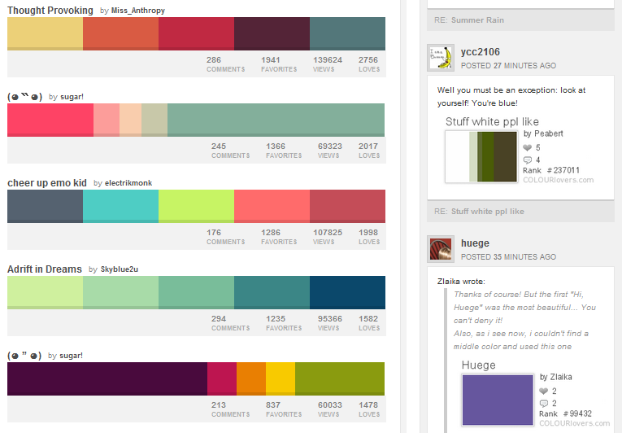
COLOURLovers
1,672,657 themes
Views and “Likes”
Notes:
Another popular site is COLOURLovers, which has over a million and a half user-created themes which users can ‘like’ instead of directly rating them.

Slide 18
COLOURLovers
1,672,657 themes
Views and “Likes”
Notes:
And also includes social networking features for comments and discussion.
The vast amount of data on these sites presents a fascinating new opportunity. For the first time, we can now examine color compatibility in practice, and also model it with large-scale data-driven approaches.

Slide 19
Goals
1. Analysis
Test hypotheses and compatibility models
2. Learn Models
Predict mean ratings for themes
3. New Applications
Develop new tools for choosing colors
Notes:
This project has three main goals. First, we analyze these datasets to test hypotheses and compatibility models. Second, we learn models to predict ratings for color themes. Third, we develop new applications to help users choose colors.

Slide 20
Goals
1. Analysis
Test hypotheses and compatibility models
2. Learn Models
Predict mean ratings for themes
3. New Applications
Develop new tools for choosing colors
Notes:
We start with analysis.

Slide 21
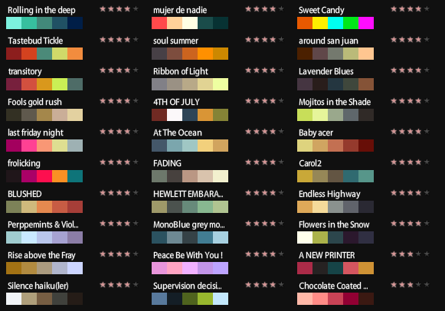
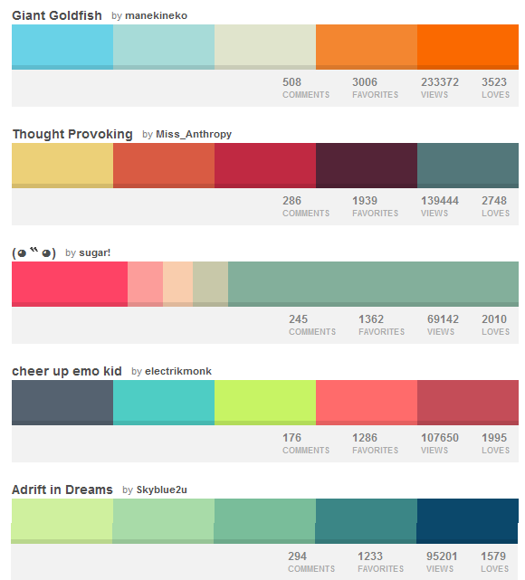
Kuler Dataset
COLOURLovers Dataset
  104,426 themes
  Ratings: 1-5 stars
  383,938 themes
  # Views and “Likes”
Notes:
For this project we collected two initial datasets: 100,000 rated themes from Kuler and 400,000 themes from COLOURLovers. However, these sites do have numerous biases. For example, users are more likely to be designers or highly aware of color. There are also selection biases since popular themes tend to be viewed and rated more often, the so-called ‘rich get richer’ effect.

Slide 22
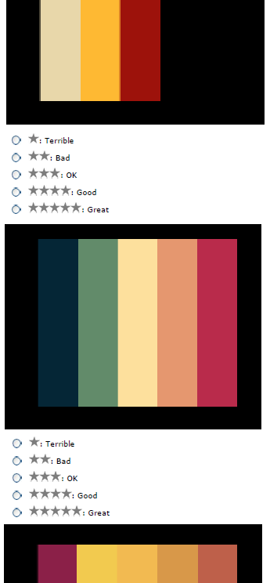
Mechanical Turk dataset
10,743 themes from Kuler
40 ratings per theme
1,301 total participants
Notes:
To address some of these issues, we created a third dataset using mechanical turk. We received 40 ratings on 11,000 themes chosen from Kuler, with 1,300 total participants.

Slide 23
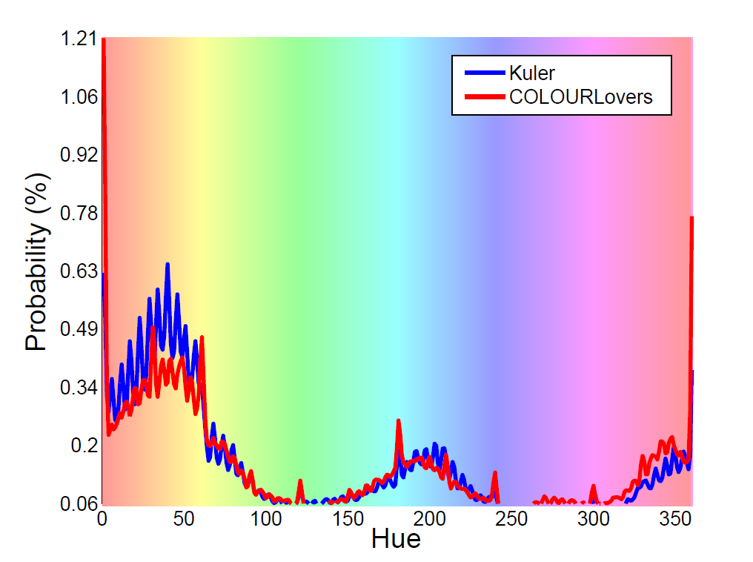
Histogram of hue usage
% of all themes
Hue
Overall preference for warmer hues and cyans
Notes:
What are the most popular colors in these datasets? To examine this question, we plot a histogram of hue usage. The horizontal axis is the hue and the vertical axis is the fraction of themes this hue appears in. Note this plot integrates over saturation and value.
The graph shows a strong preference for warmer hues (yellows, oranges, reds) and cyans over greens and purples. The take-home message here is that not all colors are created equal; there are strong preferences for particular colors.

Slide 24
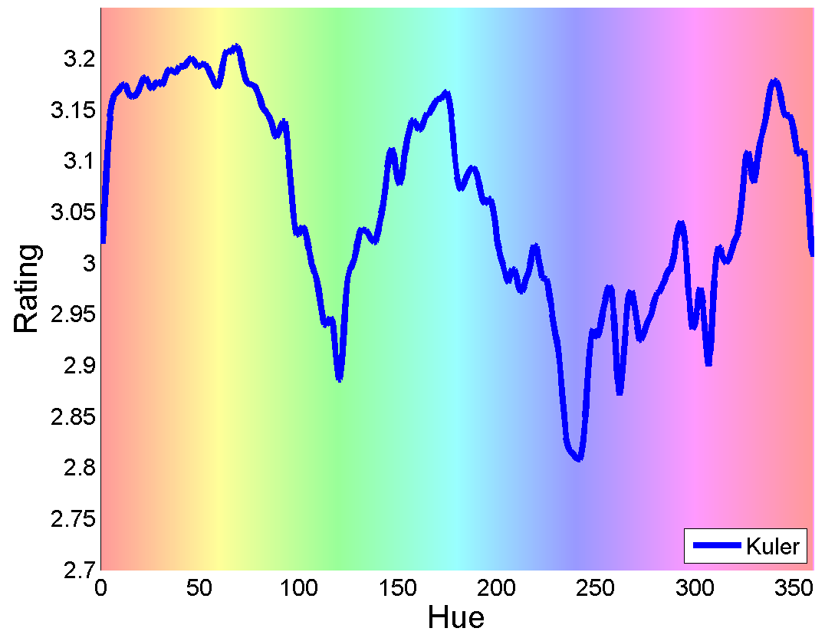
Mean rating for themes containing a hue
Mean Rating
Hue
Overall preference for warmer hues and cyans
Notes:
Does this extend to ratings?...
We can also plot the mean rating over all themes that contain a particular hue. And again, we see a similar preference for warm hues and cyans.

Slide 25
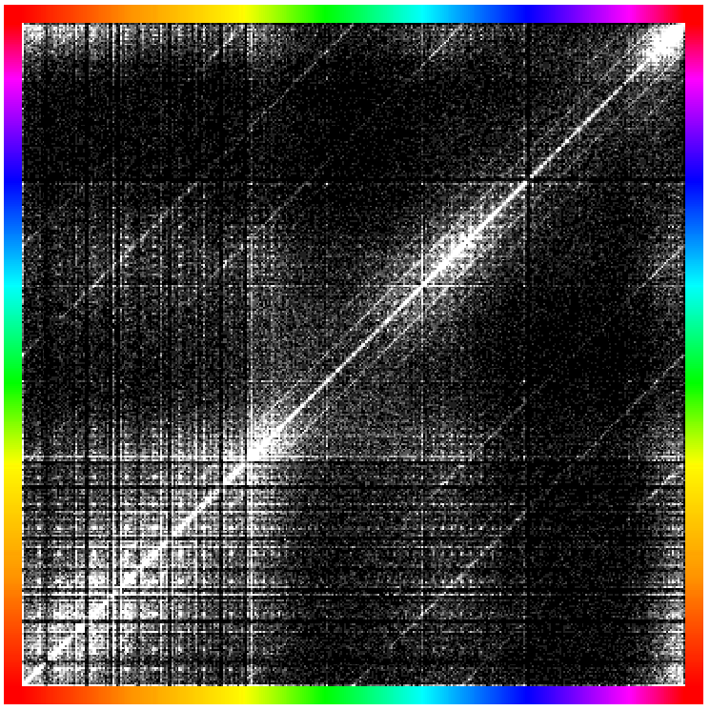
Histogram of hue adjacency (Kuler)
Notes:
We next examine how often it is for two hues to be placed adjacently in a theme. To read this histogram, we can choose a hue on the x-axis.

Slide 26
Histogram of hue adjacency (Kuler)
Notes:
For example, orange is shown here. The lightness on the y-axis indicates how common the second hue is to be paired with the first.

Slide 27
Histogram of hue adjacency (Kuler)
is more likely than
Notes:
So yellow is more likely to be paired with orange than green.

Slide 28
Histogram of hue adjacency (Kuler)
Significant structure
Notes:
We can also see significant structure in this plot.

Slide 29
Histogram of hue adjacency (Kuler)
Significant structure
Warm hues pair well with each other
Notes:
Warm hues pair well with each other as well as blues.

Slide 30
Histogram of hue adjacency (Kuler)
Significant structure
Warm hues pair well with each other
Greens and purples more compatible with themselves
Notes:
While greens and purples are more compatible with themselves.

Slide 31
Hue Template Analysis
Notes:
Since hue templates are the most popular theory for color compatibility, we analyze them in greater detail. First, we’ll explain the basic properties of this model, and then test them against the data.

Slide 32
Hue Templates: relative orientations producing compatible colors
Notes:
As we mentioned earlier, a hue template is defined as a fixed rotation along the color wheel. The complementary template are colors 180 degrees apart, for example, green and purple….

Slide 33
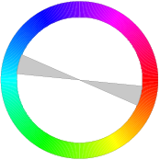
Hue Templates: relative orientations producing compatible colors
Templates are rotationally invariant
Notes:
…or teal and orange. This is because template theory assumes rotationally invariance, so any rotation is equally compatible.

Slide 34
Hue Templates: relative orientations producing compatible colors
Complementary
Monochromatic
Analogous
Triad
Different templates equally compatible
Notes:
Past color theorists have also defined sets of hue templates which are assumed to be all equally compatible.

Slide 35
Hue adjacency in a theme (Kuler)
Diagonal lines are hue templates (Kuler interface bias)
Notes:
We can actually see evidence of templates directly in the adjacency histogram. Kuler’s interface allows users to easily ‘snap’ themes to templates, producing a bias in the data. The diagonal lines here correspond to those templates.

Slide 36
Hue adjacency in a theme (Kuler)
Complementary template
Diagonal lines are hue templates (Kuler interface bias)
Notes:
For example, here’s the complementary template with hues 180 degrees from the main diagonal.

Slide 37
Hue adjacency in a theme (Kuler)
Complementary:
Notes:
The complementary template suggests that purple is strongly compatible with yellow.

Slide 38
Hue adjacency in a theme (Kuler)
Complementary:
Data:
Notes:
However, the data suggests that blue is much more likely to be chosen as a contrasting color.

Slide 39
Hue adjacency in a theme (Kuler)
In template theory, diagonals should be uniform
Notes:
In template theory, these diagonals should be uniform.

Slide 40
Hue adjacency in a theme (Kuler)
In template theory, diagonals should be uniform
Large dark bands indicates no rotational invariance
Notes:
However, the large dark bands show us that not all rotations are equally popular, so there’s no rotational invariance.

Slide 41
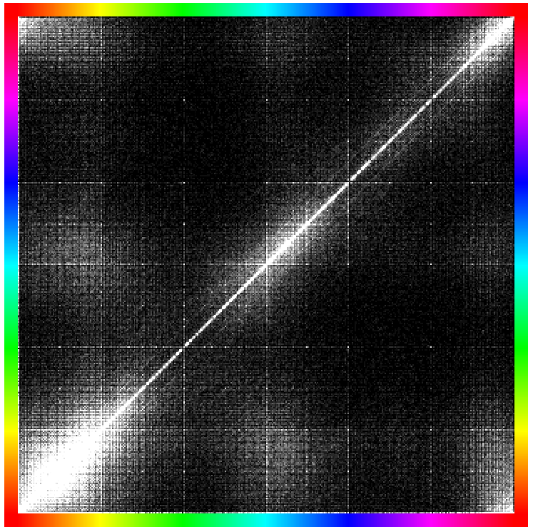
Hue adjacency in a theme
Kuler
CL
COLOURLovers’ has less interface bias
Templates are not present
Notes:
We can also look at the COLORLovers dataset which has a weaker interface bias since templates are buried in an advanced mode that’s difficult to access.
As we can see, the lack of diagonal lines here show that templates are not strongly present in the data.
However, so far we’ve only been discussing density. If template theory held, the ratings for themes near a template should be higher than those farther away.

Slide 42
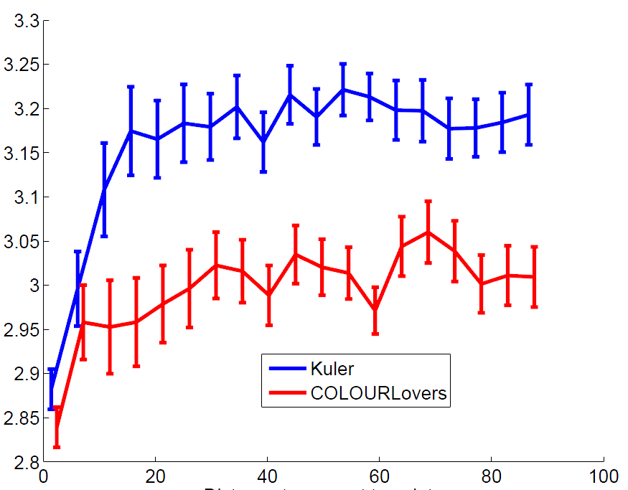
Rating
Distance to template
Notes:
However, when we plot the rating vs distance to a template, we see the reverse.

Slide 43
Rating
Distance to template
Themes near a template score worse
Notes:
Themes very near a template score poorly. And as the distance increases, it plateaus with little impact on the rating.
A: “near a template” might need to be spelled-out a little more.

Slide 44
Rating
Distance to template
Themes near a template score worse
- “Newbie” factor
- “Too simple” factor
Notes:
This is likely caused by a ‘newbie’ factor where new users initially use the interface defaults, and are penalized by more experienced users. Also, users often penalize themes which are ‘too simple’, particularly themes with only a single hue.

Slide 45
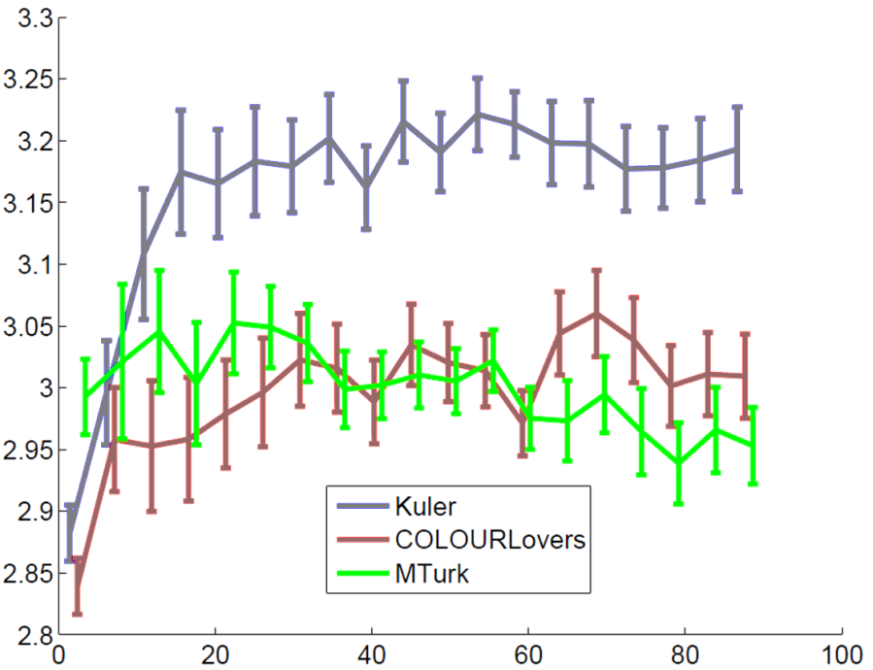
Rating
Distance to template
MTurk has no interface bias: much flatter
Notes:
For the mechanical turk dataset, which has no such biases, the plot is effectively flat with no statistical difference.

Slide 46
Template Conclusions
Templates do not model color preferences
Themes near a template do not score better than those farther away
Not all templates are equally popular
  Simple templates preferred (see paper)
Notes:
In this work, we examined hue templates from several angles and found them generally to be a poor model.
First, there are strong color preferences so not all rotations of templates are equally compatible.
Second, themes near templates do not score better than those farther away.
Third, not all templates are equally popular. In the paper we examine this in more detail, but one observation is that the most popular themes tend to be fairly simple, with roughly one or two distinct hues. This suggests that how simple or complex a theme is might help predict the rating.

Slide 47
Hue Entropy: entropy of hues along the hue wheel
Notes:
To examine this, we define a simplicity measure based on hue entropy, which is roughly speaking the spread of hues along the hue wheel.

Slide 48

Hue Entropy: entropy of hues along the hue wheel
Low Entropy
Few Distinct Colors
Notes:
Low entropy corresponds to few distinct colors

Slide 49

Hue Entropy: entropy of hues along the hue wheel
Low Entropy
High Entropy
Few Distinct Colors
Many Distinct Colors
Notes:
Low entropy corresponds to few distinct colors, and high entropy corresponds to many distinct colors

Slide 50
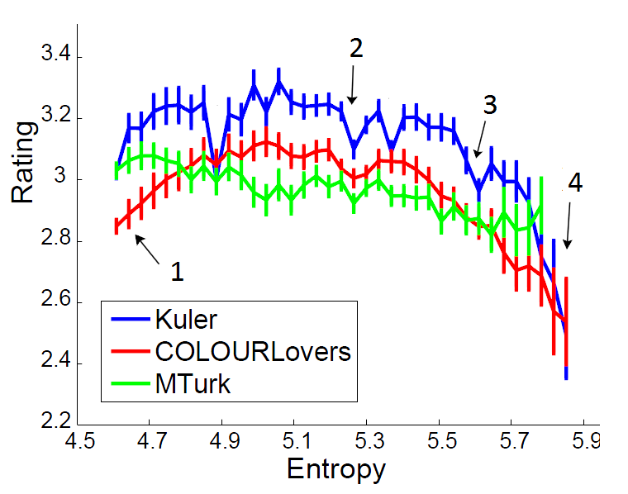
Hue Entropy: entropy of hues along the hue wheel
Rating
Hue Entropy
Notes:
Here we plot the hue entropy versus the mean rating for a theme

Slide 51
Hue Entropy: entropy of hues along the hue wheel
Rating
Hue Entropy
Notes:
The number on the figure here indicate equally spaced hues, so the complementary template has 2 equally spaced hues, a triad has 3, and an X shaped theme has 4 hues.

Slide 52
Hue Entropy: entropy of hues along the hue wheel
Rating
Hue Entropy
Notes:
As themes become more complex, they score significantly worse.

Slide 53
Hue Entropy: entropy of hues along the hue wheel
Rating
Hue Entropy
Notes:
And there is also a drop in rating for very simple themes.

Slide 54
Main Analysis Results
1. Overall preference for warmer hues and cyans
Notes:
To summarize our main analysis results, we’ve shown an overall preference for warmer hues and cyans.

Slide 55
Main Analysis Results
1. Overall preference for warmer hues and cyans
2. Strong preferences for certain adjacent colors
Notes:
A strong preference for certain adjacent colors,

Slide 56
Main Analysis Results
1. Overall preference for warmer hues and cyans
2. Strong preferences for certain adjacent colors
3. Hue templates a poor model for compatibility
Notes:
That hue templates are a poor model for color compatibility,

Slide 57
Main Analysis Results
1. Overall preference for warmer hues and cyans
2. Strong preferences for certain adjacent colors
3. Hue templates a poor model for compatibility
4. People prefer simpler themes (but not too simple)
Notes:
And that people generally prefer simpler themes, but not too simple.

Slide 58
Main Analysis Results
1. Overall preference for warmer hues and cyans
2. Strong preferences for certain adjacent colors
3. Hue templates a poor model for compatibility
4. People prefer simpler themes (but not too simple)
See paper for other tests
Notes:
Also, please see our paper for other analysis tests.

Slide 59
Goals
1. Analysis
Test hypotheses and compatibility models
2. Learn Models
Predict mean ratings for themes
3. New Applications
Develop new tools for choosing colors
Notes:
Next, we turn to learning a model for color compatibility, as well as some analysis using this model.

Slide 60
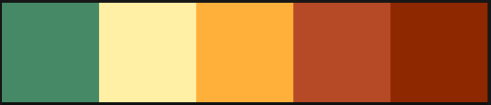
3.63
Notes:
Our goal here is to automatically rate a colors combination from one to five.

Slide 61

3.63
$$f\left(x\right)=\overline{y}$$
Notes:
To accomplish this, we want to learn a function f which maps from x, a set of features derived from a color theme, to y

Slide 62
3.63
$$f\left(x\right)=\overline{y}$$
Mean rating over all users
Notes:
the mean rating over all users

Slide 63
3.63
$$f\left(x\right)=\overline{y}$$
Features (326 total)
Colors, sorted colors, differences, min/max, max-in, mean/std dev, PCA features, hue probability, hue entropy
RGB, HSV, CIELab, Kuler color wheel
“Kitchen Sink”
Notes:
X is a vector of 326 features such as colors, differences, hue entropy, etc in various color spaces. Since we don’t know which features are useful, we use a ‘kitchen sink’ approach and try a huge number of features which help. We then perform feature selection to determine the most relevant features.

Slide 64
3.63
$$f\left(x\right)=\overline{y}$$
Models
Constant baseline: mean of training targets
SVM-R, KNN
Lasso
    Linear regression model with L1 norm on weights
    Solutions have many zero weights: feature selection
Notes:
We tested several regression models, including a baseline of the mean of the training targets, SVM-regression, and K-nearest neighbor regression. We also use Lasso, a popular linear regression model with an L1 norm on the weights. This method automatically selects the most relevant features, since solutions have many zero weights.

Slide 65
Dataset MAE | Constant Baseline | KNN | SVM-R | Lasso | Lasso over Baseline
Kuler | 0.572 | 0.533 | 0.531 | 0.521 | 9%
COLORLovers | 0.703 | 0.674 | 0.650 | 0.644 | 8%
MTurk | 0.267 | 0.205 | 0.182 | 0.179 | 33%
Notes:
We found that Lasso performed the best in all datasets

Slide 66
Dataset MAE | Constant Baseline | KNN | SVM-R | Lasso | Lasso over Baseline
Kuler | 0.572 | 0.533 | 0.531 | 0.521 | 9%
COLORLovers | 0.703 | 0.674 | 0.650 | 0.644 | 8%
MTurk | 0.267 | 0.205 | 0.182 | 0.179 | 33%
Notes:
Achieving an increase of 33% over the baseline score for Mturk, compared to only 8 or 9% for the other datasets. These somewhat low scores reflect basically how subjective color preferences are and how much noise there is in the data.

Slide 67
Dataset MAE | Constant Baseline | KNN | SVM-R | Lasso | Lasso over Baseline
Kuler | 0.572 | 0.533 | 0.531 | 0.521 | 9%
COLORLovers | 0.703 | 0.674 | 0.650 | 0.644 | 8%
MTurk | 0.267 | 0.205 | 0.182 | 0.179 | 33%
Many more ratings per theme in MTurk
Notes:
The results on the Mturk dataset are better simply because we have 30-40 ratings per theme, compared to usually 2 or 3 for Kuler.

Slide 68
Dataset MAE | Constant Baseline | KNN | SVM-R | Lasso | Lasso over Baseline
Kuler | 0.572 | 0.533 | 0.531 | 0.521 | 9%
COLORLovers | 0.703 | 0.674 | 0.650 | 0.644 | 8%
MTurk | 0.267 | 0.205 | 0.182 | 0.179 | 33%
MTurk has an average std dev of 0.33
Kuler has an average std dev of 0.72
Notes:
Another way to see this is to compare the mean std deviation over all themes. For mturk this is 0.33, compared to 0.72 for Kuler, which is quite large considering themes are only rated between 1 and 5.

Slide 69
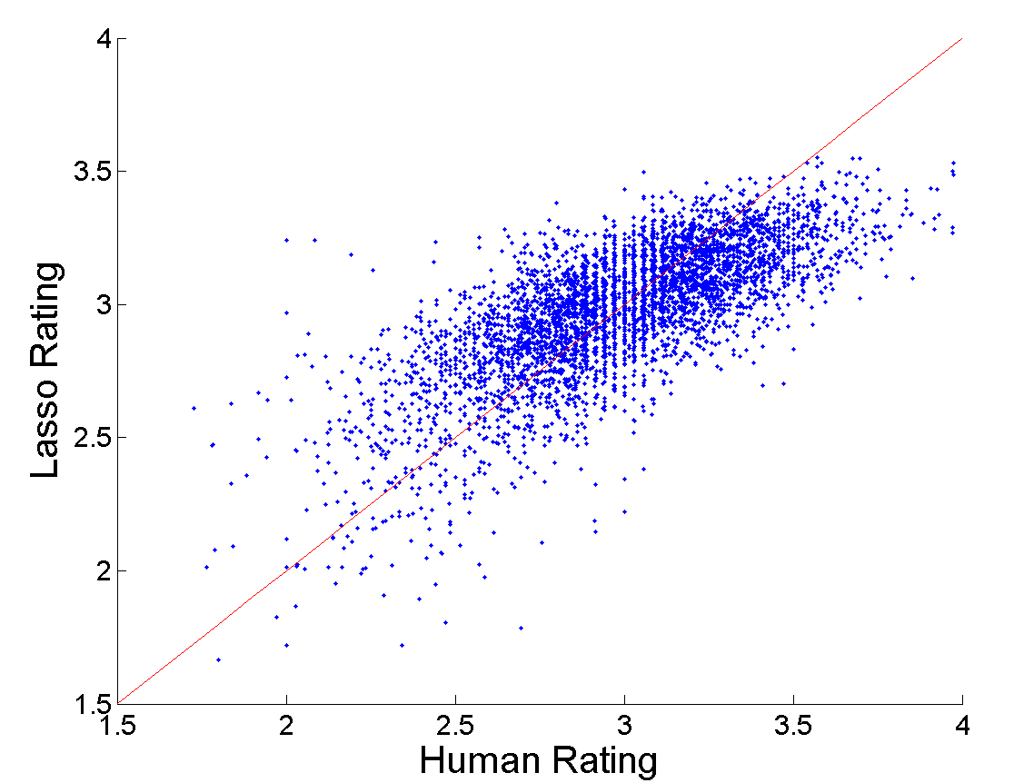
MTurk
Test Set
Lasso Rating
Human Rating
Notes:
We can also plot the mechanical turk test set: comparing the human ratings on the x-axis with the estimated lasso rating on the y-axis. The red line indicates a perfect prediction. While there is significant noise in the regression, lasso does a reasonable job at modeling the trend

Slide 70
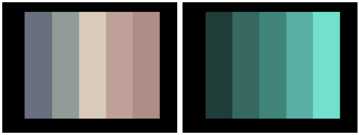


High-rated
$$\overline{y}=3.90, f\left(x\right)=3.41$$
$$\overline{y}=3.79, f\left(x\right)=3.50$$
Notes:
Next, we show some examples. Here we see two highly rated themes which also scored well with our model, note that highly rated themes often tend to be fairly simple, and gradients are often used.

Slide 71
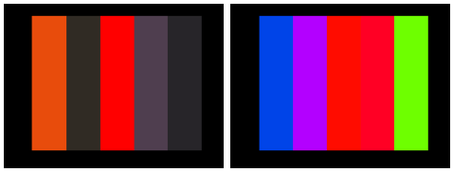


High-rated
$$\overline{y}=3.90, f\left(x\right)=3.41$$
$$\overline{y}=3.79, f\left(x\right)=3.50$$
Low-rated
$$\overline{y}=1.71, f\left(x\right)=2.27$$
$$\overline{y}=1.78, f\left(x\right)=2.25$$
Notes:
The next row has some poorly rated themes, caused by poor color choices(too dark, or too colorful) and poor ordering.

Slide 72
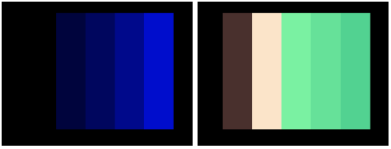


High-rated
$$\overline{y}=3.90, f\left(x\right)=3.41$$
$$\overline{y}=3.79, f\left(x\right)=3.50$$
Low-rated
$$\overline{y}=1.71, f\left(x\right)=2.27$$
$$\overline{y}=1.78, f\left(x\right)=2.25$$
High prediction error
$$\overline{y}=2.74, f\left(x\right)=1.78$$
$$\overline{y}=2.22, f\left(x\right)=3.16$$
Notes:
The bottom show shows themes with a high prediction error where our model messed up. On the left, we predicted too low, on the right, we predicted too high.
The paper also includes tests with segmentation by demographics, and predicting scores for individuals given some initial ratings.

Slide 73
Model Analysis
Notes:
Since lasso performs feature selection, we can also analyze the feature weights to get a rough sense of what features are important, and get additional insights into what makes a good or bad color themes

Slide 74


Important Lasso Features
Positive: high lightness mean & max, mean hue probability
Notes:
zzOne thing we find…
Show seperate
Features with a strong positive weight include the lightness mean and max, indicating darker themes are lower rated. The mean hue probability is also high; so popular colors should be generally be chosen.

Slide 75


Important Lasso Features
Positive: high lightness mean & max, mean hue probability
Negative: high lightness variance, min hue probability
Notes:
spacing
Some negative weights include high lightness variance, as well as minimum hue probability, suggesting that themes can’t just have the most popular colors.
However, since these features interact non-linearly, analysis of weights is tricky and examining individual weights doesn’t really give a complete picture of how the model performs

Slide 76
Goals
1. Analysis
Test hypotheses and compatibility models
2. Learn Models
Predict mean ratings for theme
3. New Applications
Develop new tools for choosing colors
Notes:
Finally, we look at some applications of the model.

Slide 77
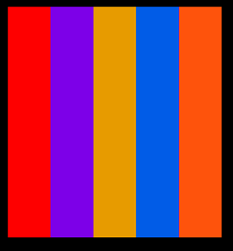
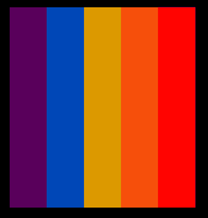
1. Improve a Theme
Notes:
First, we can improve a theme to get a better color combination.

Slide 78
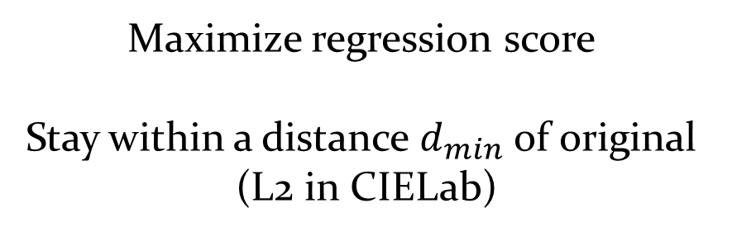
Maximize regression score
Stay within a distance $d_{min}$ of original
(L2 in CIELab)
Notes:
For this task, we’d like to maximize the regression score while also staying within a distance(d min) of the original theme.

Slide 79
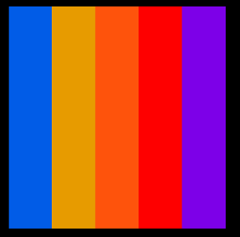
Select order which maximizes score
Notes:
First, note that the order of colors can influence the rating, as we can see in this case. The color order is therefore one degree of freedom we exploit to improve the score.

Slide 80
Optimize colors with CMA [Hansen 1995]
Notes:
As well, we’d like to optimize the colors themselves. To do this, we perform a joint optimization of colors and order using the CMA optimization algorithm.

Slide 81
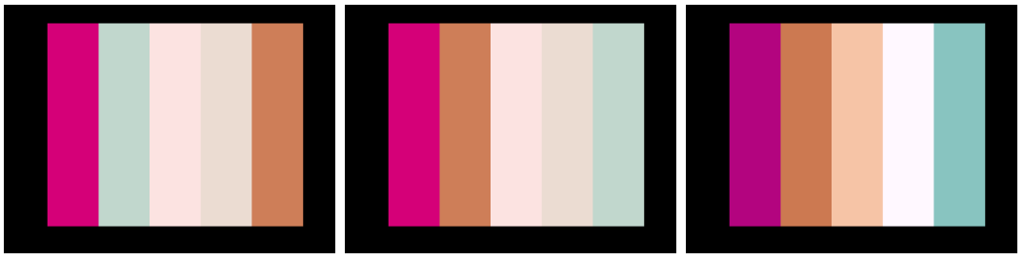

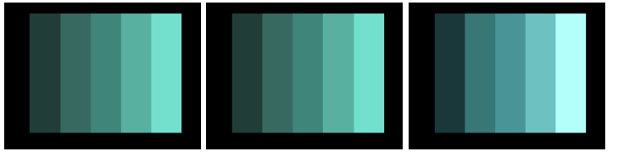









Original
Best Order
Color and Order
$$f\left(x\right)=2.92$$
$$f\left(x\right)=3.04$$
$$f\left(x\right)=3.35$$
$$f\left(x\right)=3.00$$
$$f\left(x\right)=3.11$$
$$f\left(x\right)=3.37$$
$$f\left(x\right)=3.50$$
$$f\left(x\right)=3.50$$
$$f\left(x\right)=3.70$$
Notes:
Here are some examples. In the middle column, we show the best ordering of the original theme. In the right column, the optimized color and order. In the top row the theme is improved mostly by adding a stronger gradient in colors. In the second row, the order is improved by pairing the greens and browns. The bottom row shows a well rated theme, where the order remains the same and colors are only brightening slightly.
A: Build by rows

Slide 82









Original
Best Order
Color and Order
$$f\left(x\right)=2.92, \overline{y}=3.04$$
$$f\left(x\right)=3.04, \overline{y}=2.99$$
$$f\left(x\right)=3.35, \overline{y}=3.40$$
$$f\left(x\right)=3.00, \overline{y}=2.96$$
$$f\left(x\right)=3.11, \overline{y}=3.21$$
$f\left(x\right)=3.37,$ $\overline{y}=3.35$
$$f\left(x\right)=3.50,\overline{ y}=3.72$$
$$f\left(x\right)=3.50, \overline{y}=3.69$$
$$f\left(x\right)=3.70, \overline{y}=3.82$$
Notes:
We also asked Turkers to rate the new themes. As we can see, the final optimized themes here all have higher mean ratings.

Slide 83
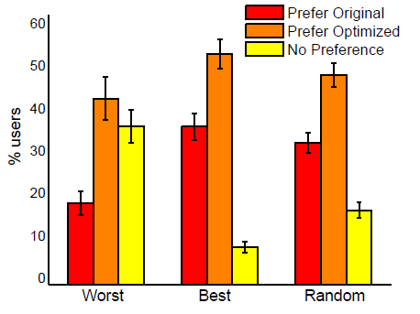
Order and Color
MTurk A/B test
with original and optimized themes
Notes:
To further evaluate the new themes, we performed an AB test on mechanical turk, asking users which theme they preferred. Three sets of themes were chosen: the 50 worst rated themes, the 50 best themes, and 100 random. For all sets, the optimized themes were preferred over the original.

Slide 84
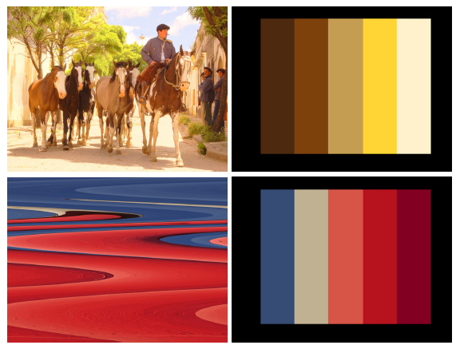
2. Choose 5 colors that best ‘represent’ an image
Notes:
Next, we describe an algorithm that extracts 5 representative colors from an image.

Slide 85
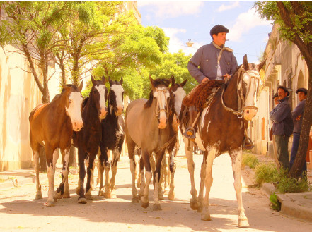
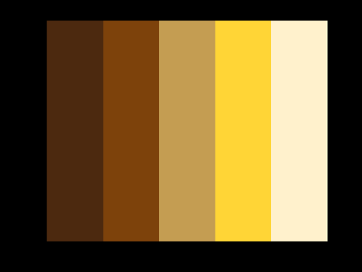
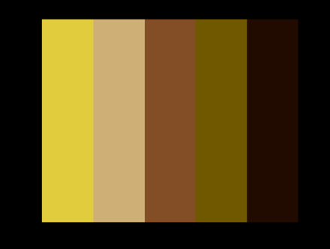
One approach: k-means clustering
Notes:
A simple approach here would be to do k-means clustering on the pixel colors.

Slide 86
One approach: k-means clustering
This ignores color compatibility
Notes:
However, this approach ignores color compatibility, so we can’t be sure the colors will look good together.

Slide 87
Optimize 5 colors that
Match the image well
Maximize regression score
Notes:
To choose the 5 colors, we optimize an energy function that matches the image well, while also maximizing a regression score.

Slide 88
Optimize 5 colors that
Match the image well
Maximize regression score
See paper for details
Notes:
But I’ll leave the details for the paper and skip to the examples.

Slide 89
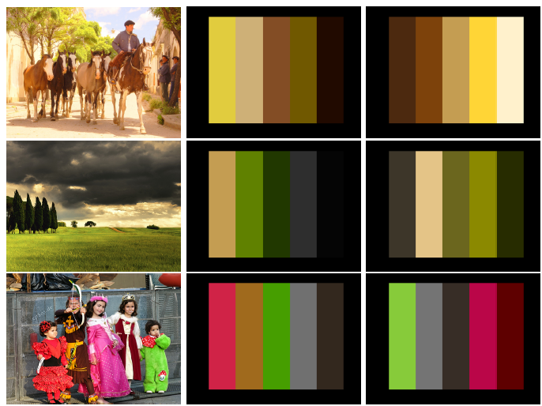
W/O Compatibility
Model
With Compatibility
Model
Notes:
In the middle and right column, we can see the effect on themes without and with the compatibility model. In these examples

Slide 90
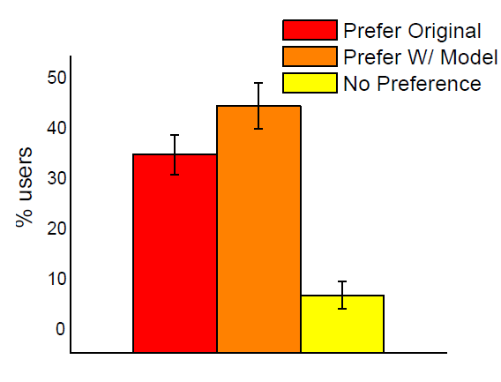
MTurk A/B test
with and without
compatibility model
Notes:
Again, we perform an AB test on mechanical turk. Users saw the original image and both themes, and had to choose the theme which best represents the image. In short, themes created with our model were preferred over those without.

Slide 91


3. Given 4 colors for foreground, suggest background
Notes:
Lastly, we look at color suggestion: given 4 colors from a foreground object, suggest a compatible background color.

Slide 92

Given 4 colors, choose 5th color to maximize score
Want contrast with existing colors
Notes:
The algorithm is quite simple: given 4 colors we choose the 5th to maximize the regression score while also enforcing contrast with the existing colors.

Slide 93

,
, …
Find next best color, $d_{min}$ away from previous choices
Notes:
We then iteratively search for the next best color at least a distance (dmin) away from the previous choices.

Slide 94

Model Suggestions
Random Suggestions
Notes:
The top row shows a set of color suggestions from our model. The bottom row shows random suggestions (which have the same constraints on contrast from foreground and previous colors)

Slide 95
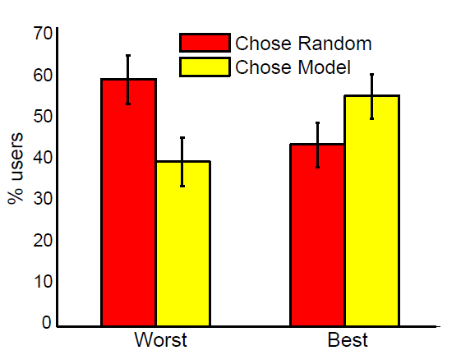
MTurk tests selecting
‘Worst’ and ‘Best’
4 model & 4 random
Notes:
To evaluate, we showed users 8 designs (4 from our model, and 4 random) and asked them to select the best and worst design. The worst designs were more likely to come from the random suggestions, and the best were more likely to come from our model suggestions.

Slide 96
Model Limitations & Future Work
Notes:
Finally, we discuss some limitations of our model and future work.

Slide 97
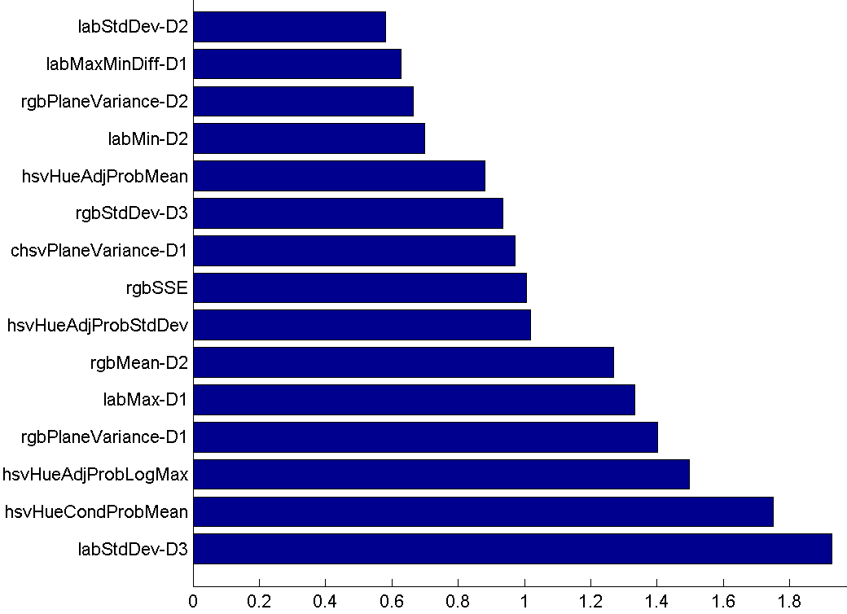
Features
Weights
Hard to interpret
Notes:
Firstly, feature weights can be quite hard to interpret and explain. Simpler models or rules for compatibility which can be easily explained are important future work.

Slide 98
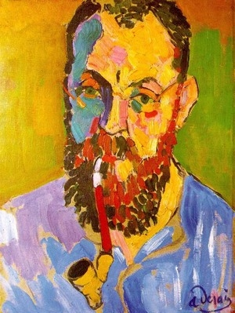
Model has very few abstract colors, only 1-D spatial layout
Notes:
Since our model only deals with a few abstract colors, it’s difficult to apply to complicated images with many colors and 2-d spatial layouts.

Slide 99
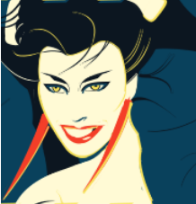
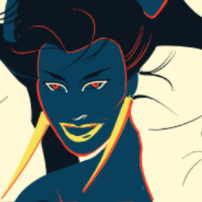
VS
Model does not understand how colors are used
Notes:
More fundamentally, our model has no idea how the colors are actually used in an image. Is the color used as an accent? For a background? For skin? Without this knowledge, color suggestions can have a very different impact, like this example where the same colors have been re-mapped to different regions.

Slide 100


VS
Notes:
Other constraints can also be required of colors in a design. In this case, the cat’s boundary color needs contrast with the background color, as well as the body color.
Future work includes better understanding the roles that colors have in an image and the relationships between them. How do artists choose the mappings from abstract palettes to concrete design decisions?

Slide 101
Conclusions
Color preferences are subjective, but analysis reveals many overall trends
Simple linear models can represent compatibility fairly well
Models can be useful for color selection tasks
Our datasets and learned models are available online
Notes:
To summarize, we’ve shown that while color preferences are subjective, analysis reveals many overall trends. Simple linear models can represent compatibility fairly well, and these models can be useful for color selections tasks. Finally, our datasets and model are available online.
And with that, are there any questions?

Slide 102


