Slide 1



Volumetric Michell Trusses for Parametric Design & Fabrication
Rahul Arora, University of Toronto
with
Alec Jacobson, Timothy R Langlois, Yijiang Huang, Caitlin Mueller, Wojciech Matusik, Ariel Shamir, Karan Singh, David IW Levin
Notes:
Hi, I’m Rahul Arora from the University of Toronto. I’m going to talk about the parametric design and fabrication of volumetric Michell trusses.

Slide 2

Structural Optimization
Structural optimization algorithm
Load
The design of optimal load-carrying structures
Fixed Boundary
Engineer image by GraphicMama-team from Pixabay.
Notes:
This talk is about structural optimization, so let’s begin by trying to understand what structural optimization is.
Say you want to build a structure within this dotted blue region and you have this orange load to support, and some parts will be anchored to the ground over here in brown.
And maybe you position your material like this.
And of course, it fails.
So you find an eerily-happy looking structural engineer, and she helps you figure out something that works.
So here the engineer serves as a structural optimization algorithm.
In general, structural optimization deals with the design of optimal load-carrying structures. And optimal can mean different things depending on the application. But some common measures of optimality look for the stiffest or the lightest structure to hold a particular load.

Slide 3
Topology Optimization
Structural optimization methods that can introduce topological changes
Notes:
Topology optimization, which is a subset of structural optimization involves methods which can change the topological structure.
So even if you start with something like the green domain on the left, you can get something like the blue thing on the right, which is topologically very different; has a number of holes.

Slide 4
A user-centric approach to structural optimization.
By generating a parametrized output, our method generates structures that can be easily controlled and edited a posteriori.
Notes:
In this paper, instead of focussing solely on achieving the stiffest or the lightest possible structure, we advocate for a user-centric approach.
Our algorithm generates parametrized results, which can then be easily controlled and edited by a human user.
Let’s use an example to understand why this is needed.

Slide 5
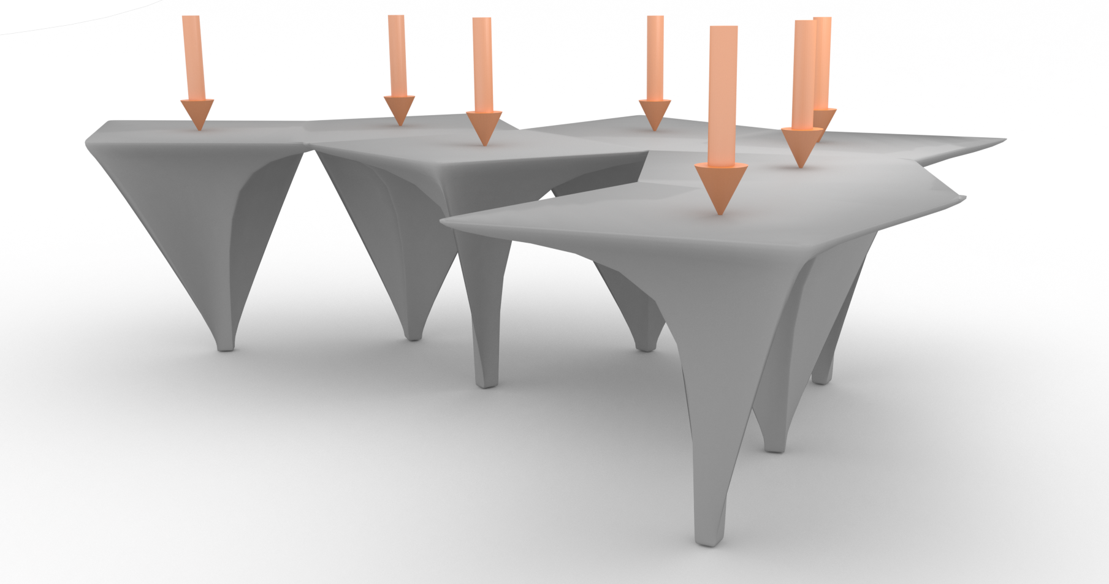
Notes:
Say you are an architect and have this pavilion that you want to optimize. The orange arrows are the loads.

Slide 6
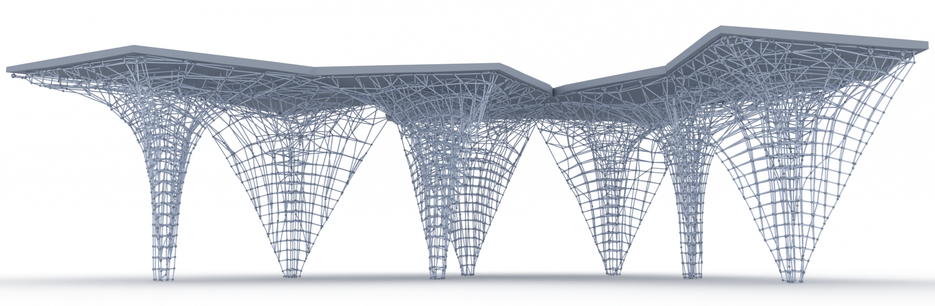
Notes:
You run through our algorithm and get this optimized structure. Now, you want to strengthen the beams bearing the main compressive force.
So, with one click, you select these beams.

Slide 7
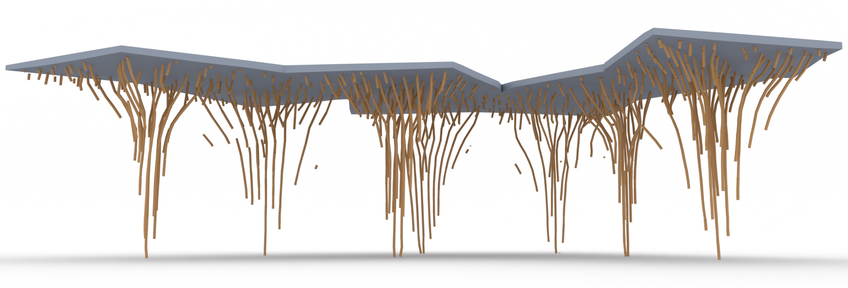
Notes:
And then you can change their thickness and material like here.

Slide 8
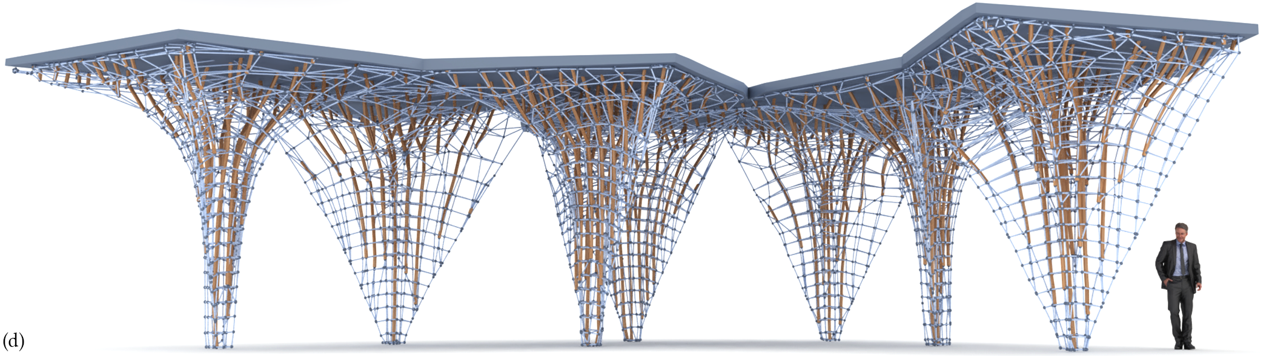
Notes:
And here’s the final structure as per your desire.

Slide 9
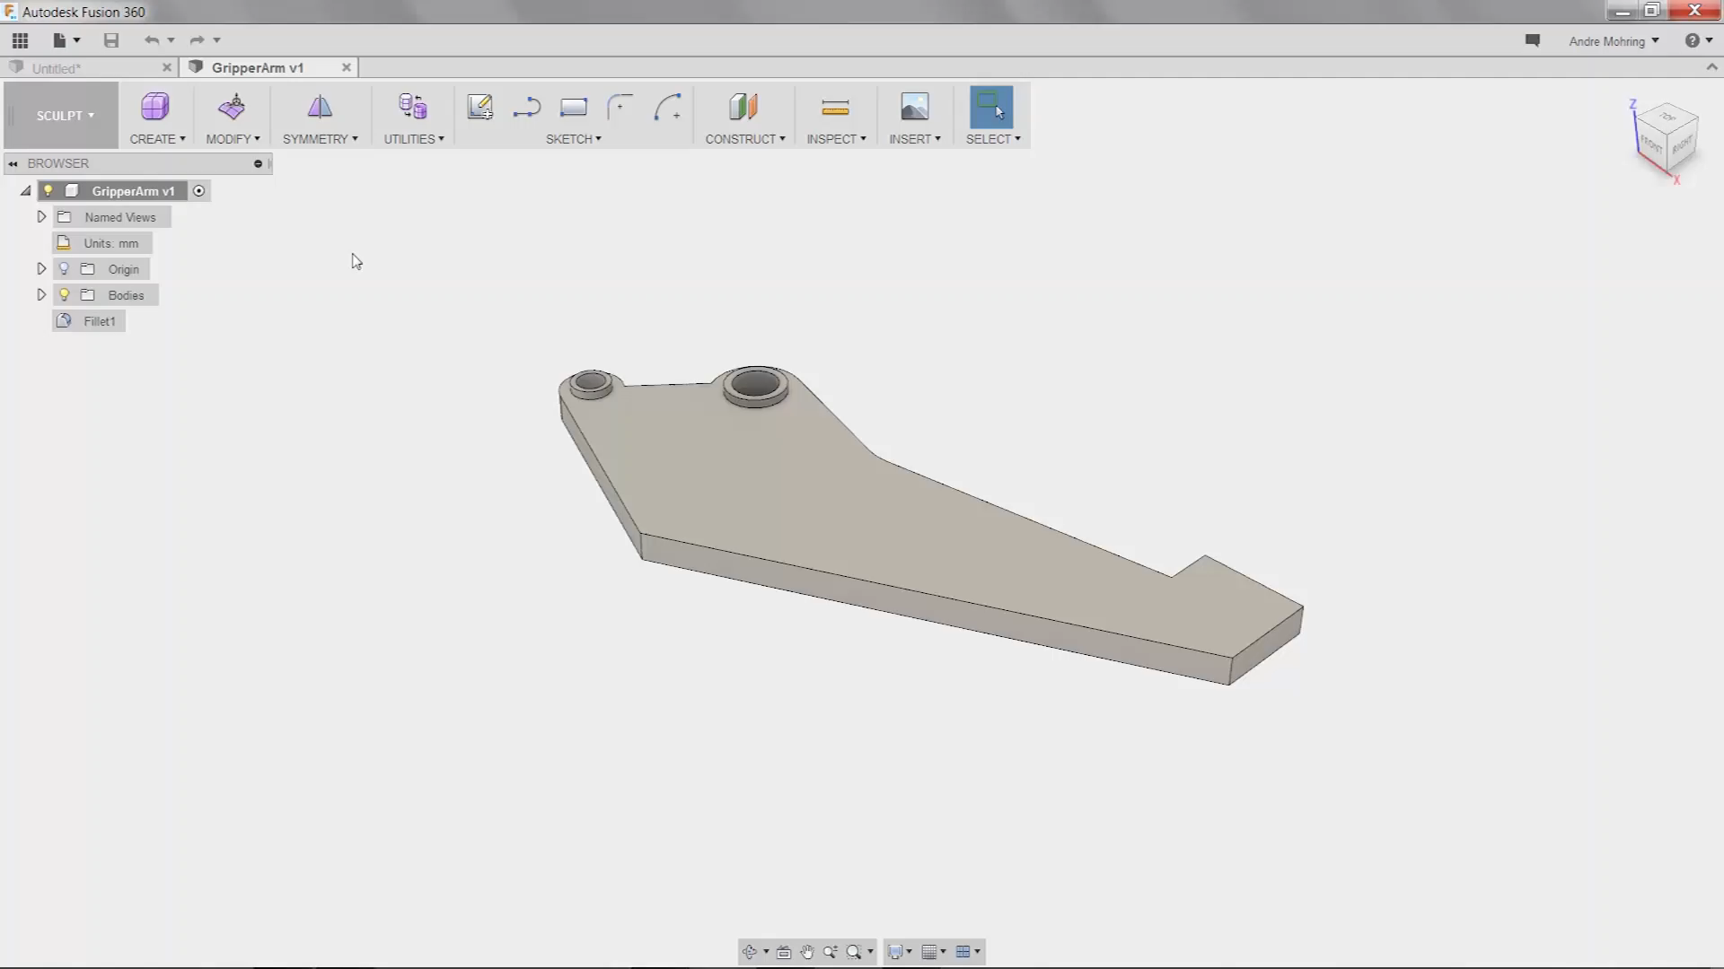
Notes:
Compare this to how you would deal with a typical topological optimization method.
The engineer here ran a state-of-the-art topology optimizer, got the result out…
…and then had to sketch the geometry themselves, just using the optimized result as a guidance, in order to convert to a parametric representation.
And you can imagine how hard this will be for arbitrary 3D shapes, where the domain is not an extruded profile like this.

Slide 10
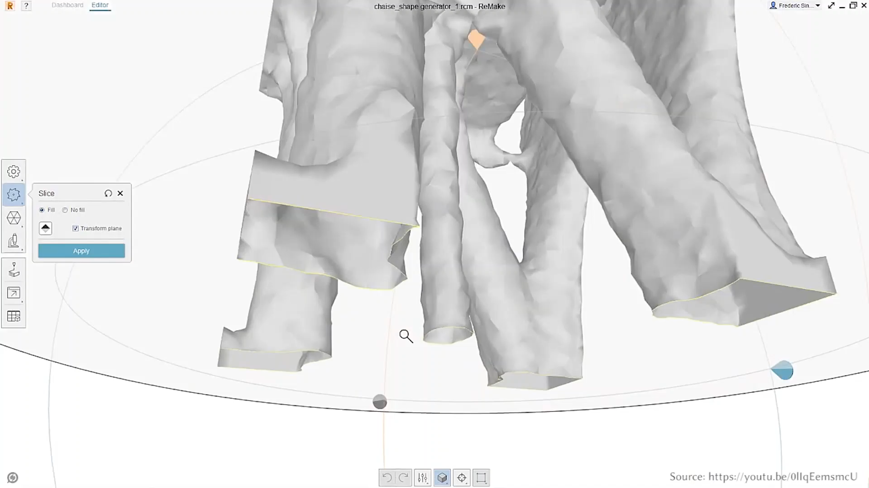
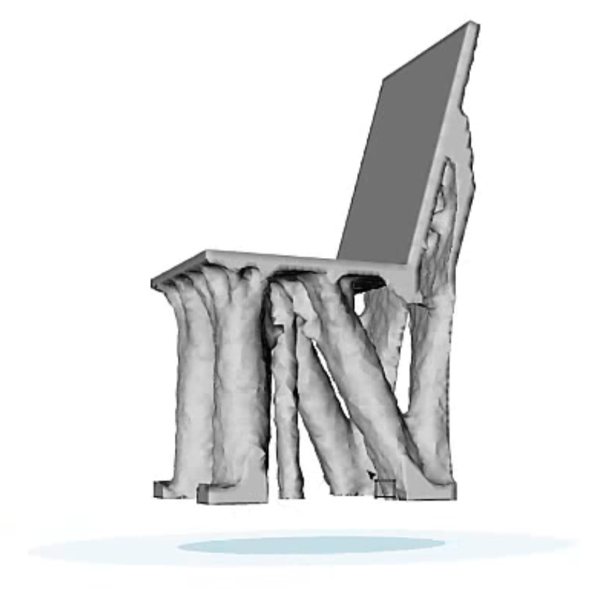
Notes:
Now you might say, well this is only for traditional manufacturing approaches. I have a 3D printer which can build almost anything you throw at it.
I would argue that users still need control. Undesirable features can always appear, and the only option available may be directl editing a complex mesh, which can be unintuitive and tedious.

Slide 11
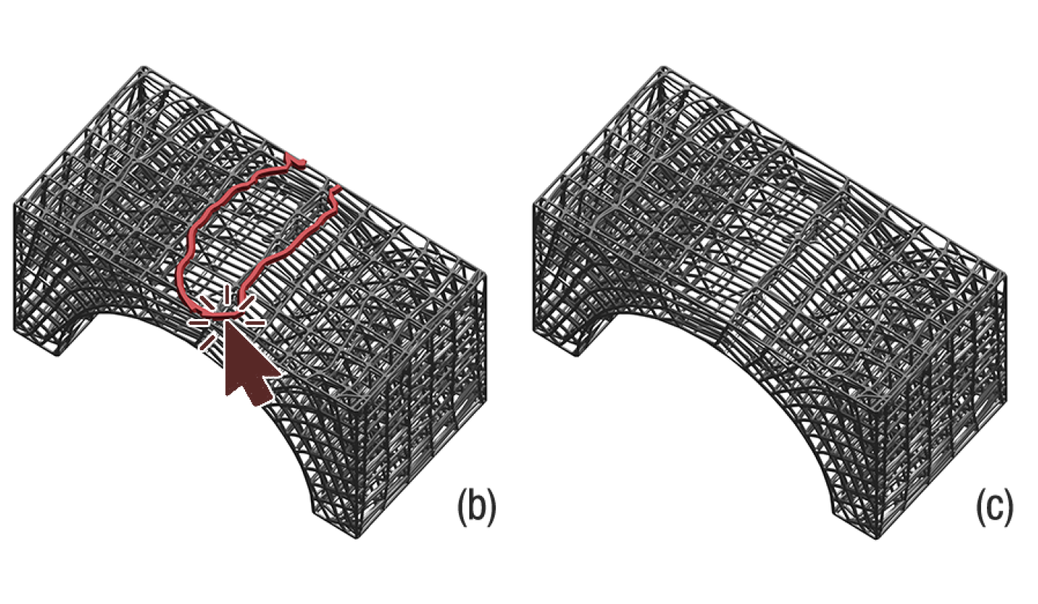
Notes:
In our approach, such interactions look like this. You simply click the feature you don’t like…and delete it. And these are the kind of operations we expect in our editing tools.
Imagine if in Microsoft Word, you had to select each pixel individually to delete a character.

Slide 12
Notes:
Unfortunately, that’s what editing topology optimization results typically feels like.

Slide 13
Background
Notes:
Okay, let’s dive into the technique. I’m going to start with a theoretical background.

Slide 14
[A.G.M. Michell. 1904. The limits of economy of material in frame-structures.]
Notes:
The central formal result belying our work was proved by Michell in 1904.
Michell’s key idea is that if you apply your boundary conditions and compute the stress field induced by them, then…

Slide 15
Position material along the directions of principal stresses
[A.G.M. Michell. 1904. The limits of economy of material in frame-structures.]
Notes:
…the optimal placement of material is along the lines of principal stresses. So what does this mean?
To answer this question, we have to first understand what a stress field looks like.

Slide 16
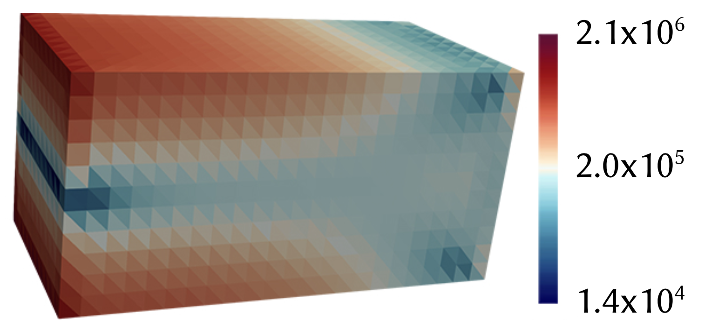
Stress magnitude visualization
Notes:
You have probably seen something like this before where the magnitude of a stress field is visualized over some domain.
But magnitude is only part of the picture, since stress is actually a tensor quantity.

Slide 17
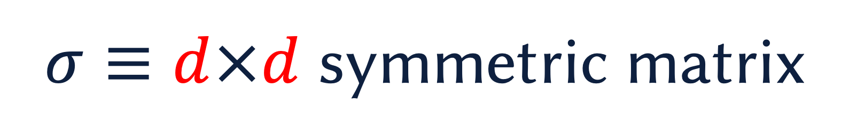
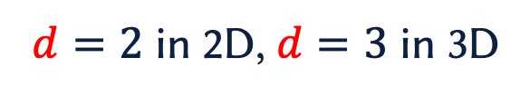
$σ≡d×d$ symmetric matrix
Stress
$d=2$ in 2D, $d=3$ in 3D
Notes:
That is, it looks like a matrix. And actually, it’s a symmetric matrix
One way to visualize symmetric matrices is with this ellipsoidal glyph, with two pieces of information: its orientation and the size of its axes. These axes are what Michell calls the principal stress directions.

Slide 18
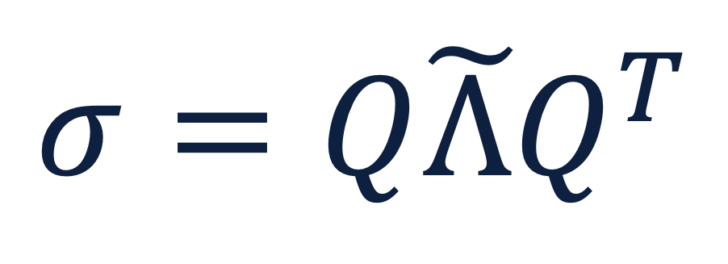
Stress (Symmetric matrix)
$$σ=Q\tilde{Λ}Q^{T}$$
Orientation
(rotation matrix)
Scaling (diagonal matrix)
Eigendecomposition of a stress matrix
Notes:
Mathematically, this visuliazation closely corresponds to the eigendecomposition of the stress matrix.
Here, the eigenvector matrix Q encodes the orientation. While the diagonal matrix lambda-twiddle in the middle contains the eigenvalues, which encode the size of the ellipse’s axes.

Slide 19



Principal stress directions
Stress (Symmetric matrix)
$$σ=Q\tilde{Λ}Q^{T}$$
$$v_{1}$$
$$v_{2}$$
Orientation
(rotation matrix)
Scaling (diagonal matrix)
Computed eigenvectors
Eigendecomposition of a stress matrix
Notes:
In practice, your computational method will give you two vectors, one aligned with each of the ellipse axes.

Slide 20
Computed eigenvectors
$$v_{1}$$
$$v_{2}$$
Notes:
Okay, so now what we’ve done is we have computed the stress field on this domain, and we can use eigendecomposition to figure out the directions where we need to position material to follow Michell’s theorem. So, one computational method you can imagine is this.

Slide 21
Notes:
We’ll just trace out these eigenvectors and position material along all of those.

Slide 22
Notes:
You do this for the first eigendirection show in black, and then the second one in red.
And you can just keep on going like this.
Unfortunately, this does not work.

Slide 23


$$v_{1}$$
$$v_{2}$$
Cross-field symmetry
Computed eigenvectors
Notes:
The issue is that there is an inherent cross-field symmetry in the principal stresses.
First, when computing eigenvectors there is a sign ambiguity.
So, a computational method may give you this result.

Slide 24
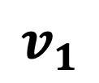
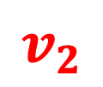
$$v_{1}$$
$$v_{2}$$
Cross-field symmetry
Computed eigenvectors
Notes:
Or this one. Both are correct.

Slide 25
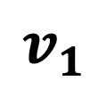
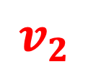
$$v_{2}$$
$$v_{1}$$
Cross-field symmetry
Computed eigenvectors
Notes:
Or the eigenvectors can be interchanged.

Slide 26
Notes:
Due to the sign ambiguity, you can have a situation where you’re tracing along a direction, and you’re suddenly flipped back. So you don’t finish tracing this line.

Slide 27
Notes:
Or due to interchange between the two vectors, you might take a sharp 90 degree turn, which is not desirable for a smooth parametrized result.

Slide 28


$$v_{2}$$
$$v_{1}$$
Isotropic stress tensor
(tensor field singularity)
Notes:
The other issue is that you’d frequently run into isotropic stress tensors, where there isn’t a unique choice for the eigenvectors, and your eigensolver can give an arbitrary set of orthogonal vectors.
In tensor field literature, this situation is called a singularity and poses problems for a number of geometric algorithms.
But physically, it’s very nice. Earlier you were restricted to a finite number of directions to position your material. Here, you can orient the material in any manner, and it doesn’t change the strength of your structure, so this gives us some extra freedom to build a computational method.

Slide 29
Method
Notes:
Okay, let’s see how we build it.

Slide 30
Algorithm: Overview
Step 0: Problem Specification
Step 1: Stress-field
Step 2: Stress-aligned frame-field
Step 3: Texture parametrization
Step 4: Truss layout
Finally: Editing & fabrication
Later…
Notes:
Our algorithm has 4 main steps. Let’s go through them one-by-one.

Slide 31
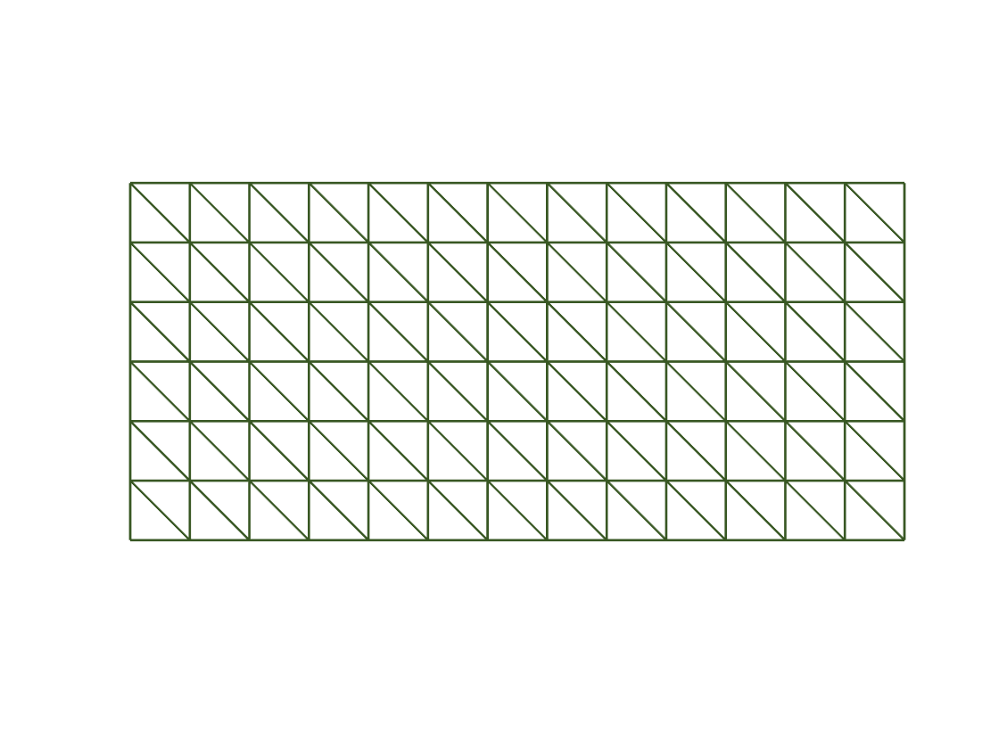
1. Stress Field Computation
Problem description
Stress field
Notes:
The first step is going from a problem description to a stress field.
The input is discretized as a simplicial mesh, and we use linear finite elements to compute the stresses.

Slide 32
2. Stress-Aligned Frame-Field Generation
Stress field
Smooth frame field
Notes:
The second step is the main non-trivial step in our method, where we deal with the issues in tensor fields that I alluded to earlier.
This step takes the stress tensor field, and computes a smooth frame field from it.
A frame is a set of orthogonal axes. So you can think of it as your XYZ axes in 3D or XY axes in 2D and just rotating them arbitrarily.
We want these frames to be aligned with the principal stresses, and to vary smoothly across the domain.
And to do that, we design an energy functional which measures how well frames are aligned with the stresses.

Slide 33
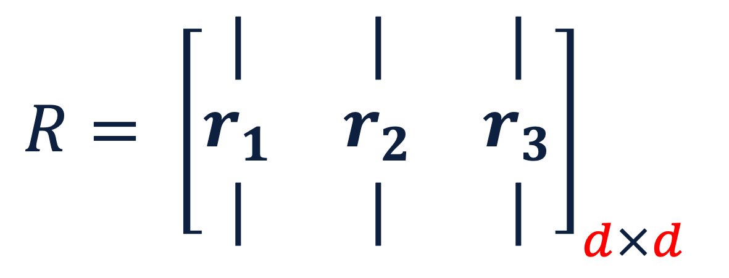
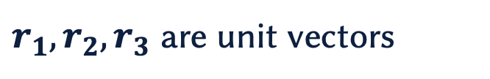
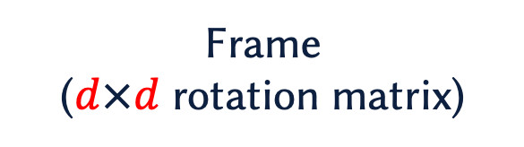
$r_{1}, r_{2}, r_{3}$ are unit vectors
$$R= {\left[\begin{matrix}| & | & | \\ r_{1} & r_{2} & r_{3} \\ | & | & |\end{matrix}\right]}_{d×d}$$
Frame
($d×d$ rotation matrix)
Notes:
A frame can be represented as an orthonormal matrix, or a rotation matrix. And its columns, which are unit vectors, we call them r1, r2, r3 in 3D, and just r1 and r2 in 2D.

Slide 34
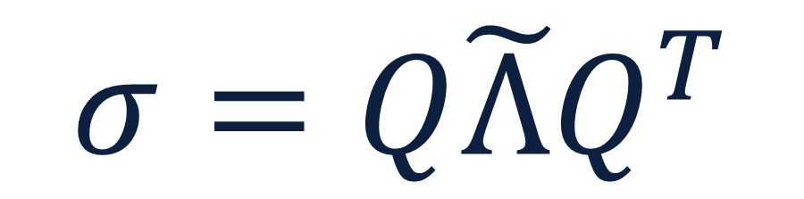
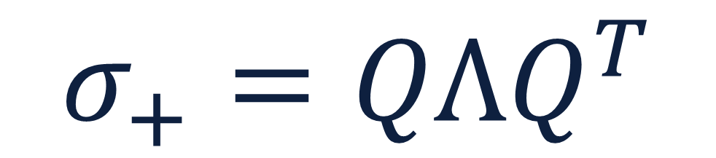
Stress (Symmetric matrix)
Positive-definite matrix
$$σ=Q\tilde{Λ}Q^{T}$$
$$σ_{+}=QΛQ^{T}$$
Orientation
(rotation matrix)
Scaling (diagonal matrix)
Notes:
In order to create an energy which can measure how well a frame is aligned with the principal stress directions, we need to change the stress tensor a little bit.
What we do is, we apply a scale and translation on the values of lambda-twiddle so that they are all positive. Now, this gives us a positive-definite matrix which has the same eigenvectors as the stress tensor sigma.
So the same orientation. Also the same nature of singularities, but converted to a positive definite matrix.

Slide 35
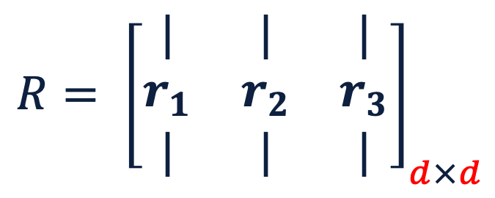
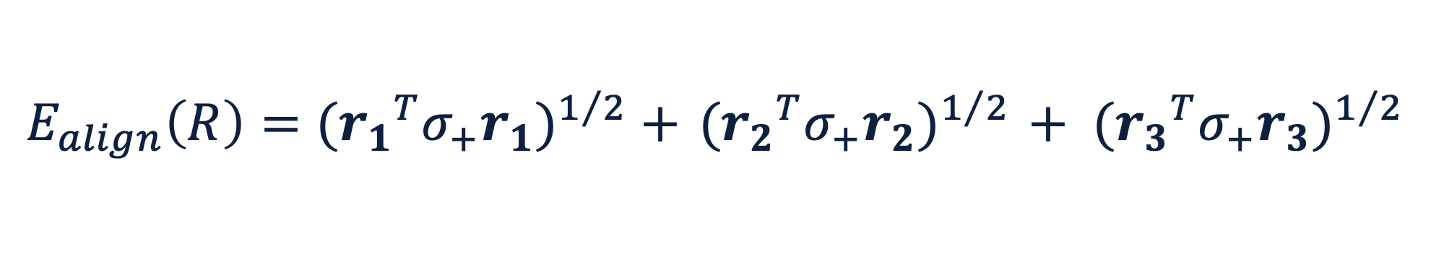
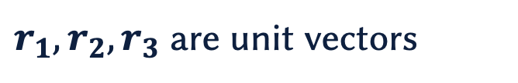
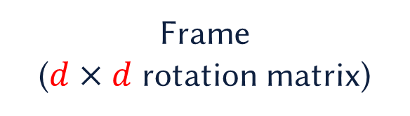
$$R= {\left[\begin{matrix}| & | & | \\ r_{1} & r_{2} & r_{3} \\ | & | & |\end{matrix}\right]}_{d×d}$$
$r_{1}, r_{2}, r_{3}$ are unit vectors
Frame
($d×d$ rotation matrix)
$$E_{align}\left(R\right)={({r_{1}}^{T}σ_{+}r_{1})}^{1/2} +{ ({r_{2}}^{T}σ_{+}r_{2})}^{1/2} + {({r_{3}}^{T}σ_{+}r_{3})}^{1/2}$$
Notes:
Then the energy is simply given like this. We take each vector and multiply it with itself with the positive-definite stress in the middle, take a square root and add the three up.
Obviously, if you change the sign of the vectors, or if you interchange the vectors of this frame, then the energy remains unchanged. So, it’s taking into account the cross-field symmetries.
As for the singularities…

Slide 36
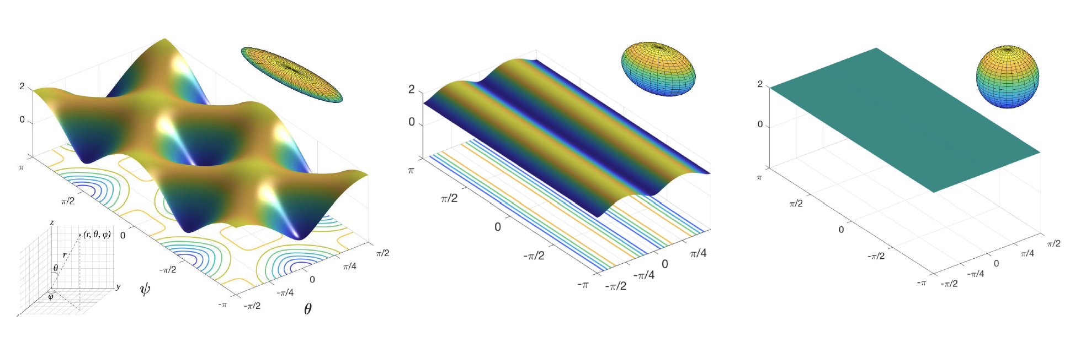
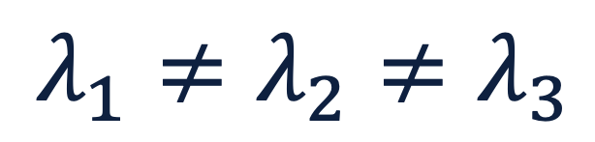
$$λ_{1}≠λ_{2}≠λ_{3}$$
Notes:
Let’s begin by looking at the case with no singularity. That is, when all the eigenvalues are distinct.
Your principal stresses look like this, and this plot shows that for frames which are aligned with it, like this
Or this…or this…et cetera
The energy attains a minimum there.

Slide 37

$$λ_{1}=λ_{2}≠λ_{3}$$
or
$$λ_{1}≠λ_{2}=λ_{3}$$
Notes:
If we look at the energy plot for the case when there is a repeated eigenvalue, we have some freedom, right?
Instead of this axis widget, our principal stress directions look like this.

Slide 38
$$λ_{1}=λ_{2}≠λ_{3}$$
or
$$λ_{1}≠λ_{2}=λ_{3}$$
Notes:
If you have a repeated eigenvalue, then this gives you more freedom. Instead of the eigenvectors looking like this, we have only one direction physically relevant, and the other two can arbitrarily rotate. And this is exactly how this energy behaves. You get minima for these frames, and nothing else.

Slide 39
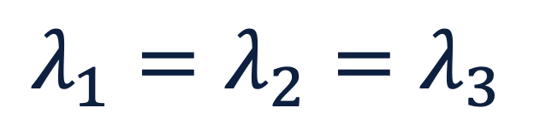
$$λ_{1}=λ_{2}=λ_{3}$$
Notes:
And finally, for a spherical stress tensor where all the eigenvalue are equal, you can take any frame, and it gives you the same energy. Again what physics is telling you to do.

Slide 40
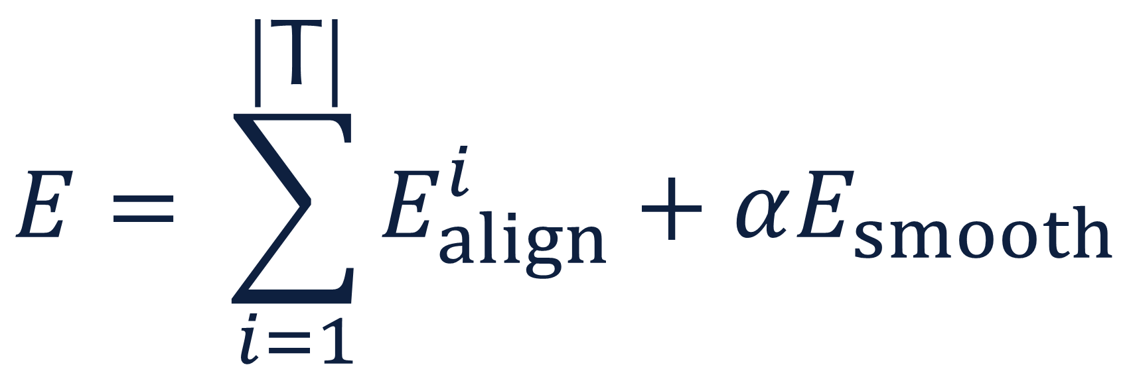

Summed over all tets
$$E= \sum_{i=1}^{\left|\text{T}\right|}{E_{align}^{i}+αE_{smooth}}$$
$$α$$
Laplacian-based smoothness cost
Notes:
Now we’ve solved the tensor field issues, but we still have multiple minima. What we need is a consistent choice of minima across neighbouring stress tensors.
Fortunately, this is easily solved by adding a Laplacian smoothness terms between neighbouring frames.
We follow an iterative procedure where we start with a high smoothing weight alpha, and progressively lower it down to a small value.

Slide 41
3. Texture Parametrization
Frame field
Frame-aligned parametrization
Notes:
The third step takes us from the frame field to a parametrization. Think of it as computing texture coordinates over the input domain.
And what we want from the parametrization is that its isolines are aligned with the frame directors.

Slide 42
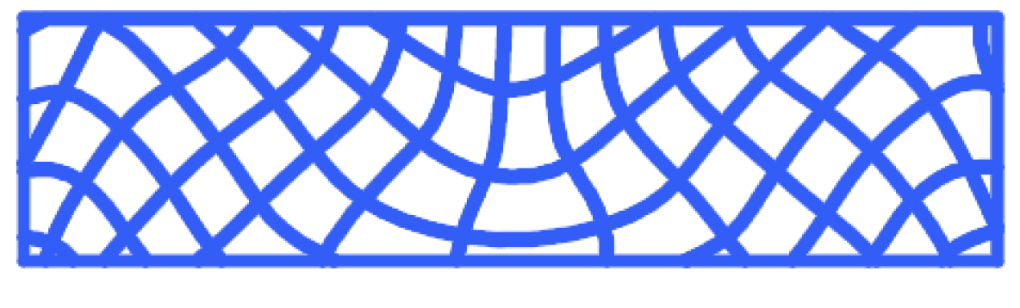
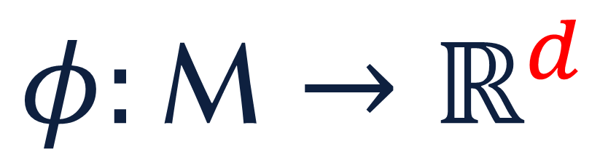


$$φ:\text{M}→ℝ^{d}$$
$$∇φ=R$$
$ℝ^{d}$-valued
parametrization
Notes:
Mathematically, this is very easy to formulate. Here, we denote the parametrization with phi, and we just want its to be aligned with the frames that we’ve computed.
And we compute a global parametrization. That is, you can think of it as taking a regular grid and reshaping it so that it the gridlines follow the frame directors.

Slide 43
4. Truss Layout Extraction
Global parametrization
Truss layout
Notes:
The last step takes the parametrization and traces along its integer isolines.
This gives you a graph which we call the truss layout.
As we perform this tracing, we don’t forget the parametrizatio. So the final truss elements themselves carry that parametrization.

Slide 44
Results
Notes:
Let’s see what that allows us to do.

Slide 45
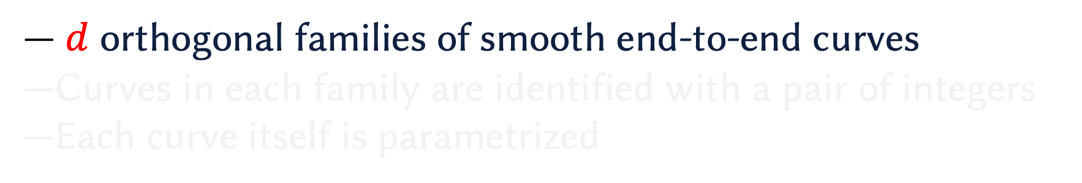
$d$ orthogonal families of smooth end-to-end curves
Curves in each family are identified with a pair of integers
Each curve itself is parametrized
Notes:
Let’s look closely at what the parametrization gives us.
First, it gives us families of smooth end-to-end curves. These families are mutually orthogonal.

Slide 46
Notes:
I showed you a result in the beginning where ann architect used the global parametrization to make a stronger pavilion.
And now, after making it strong, you’d also want to make it look pretty. I think this already looks great during the day…

Slide 47
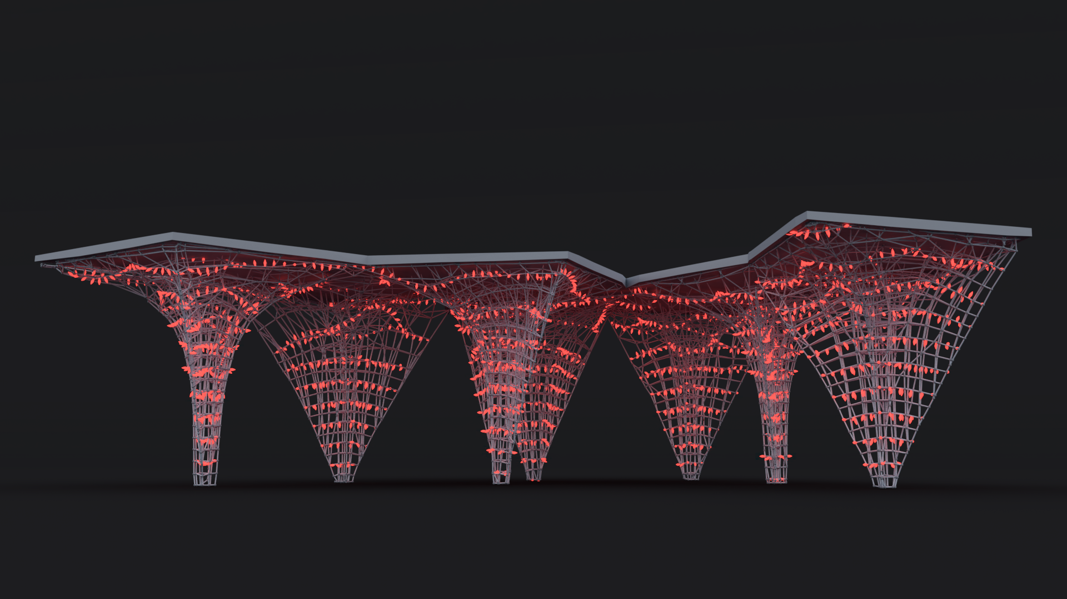
Notes:
But you can use the parametrization to lay lights along a curve family, and this makes it look splendid in the night as well.

Slide 48
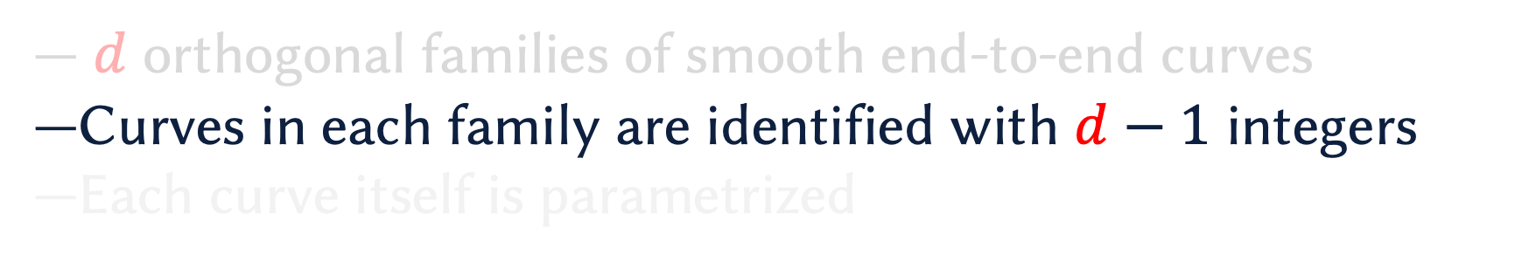
$d$ orthogonal families of smooth end-to-end curves
Curves in each family are identified with $d−1$ integers
Each curve itself is parametrized
Notes:
Further, you can select curves based on the parameters that stay constant on them. What you can do with this?

Slide 49
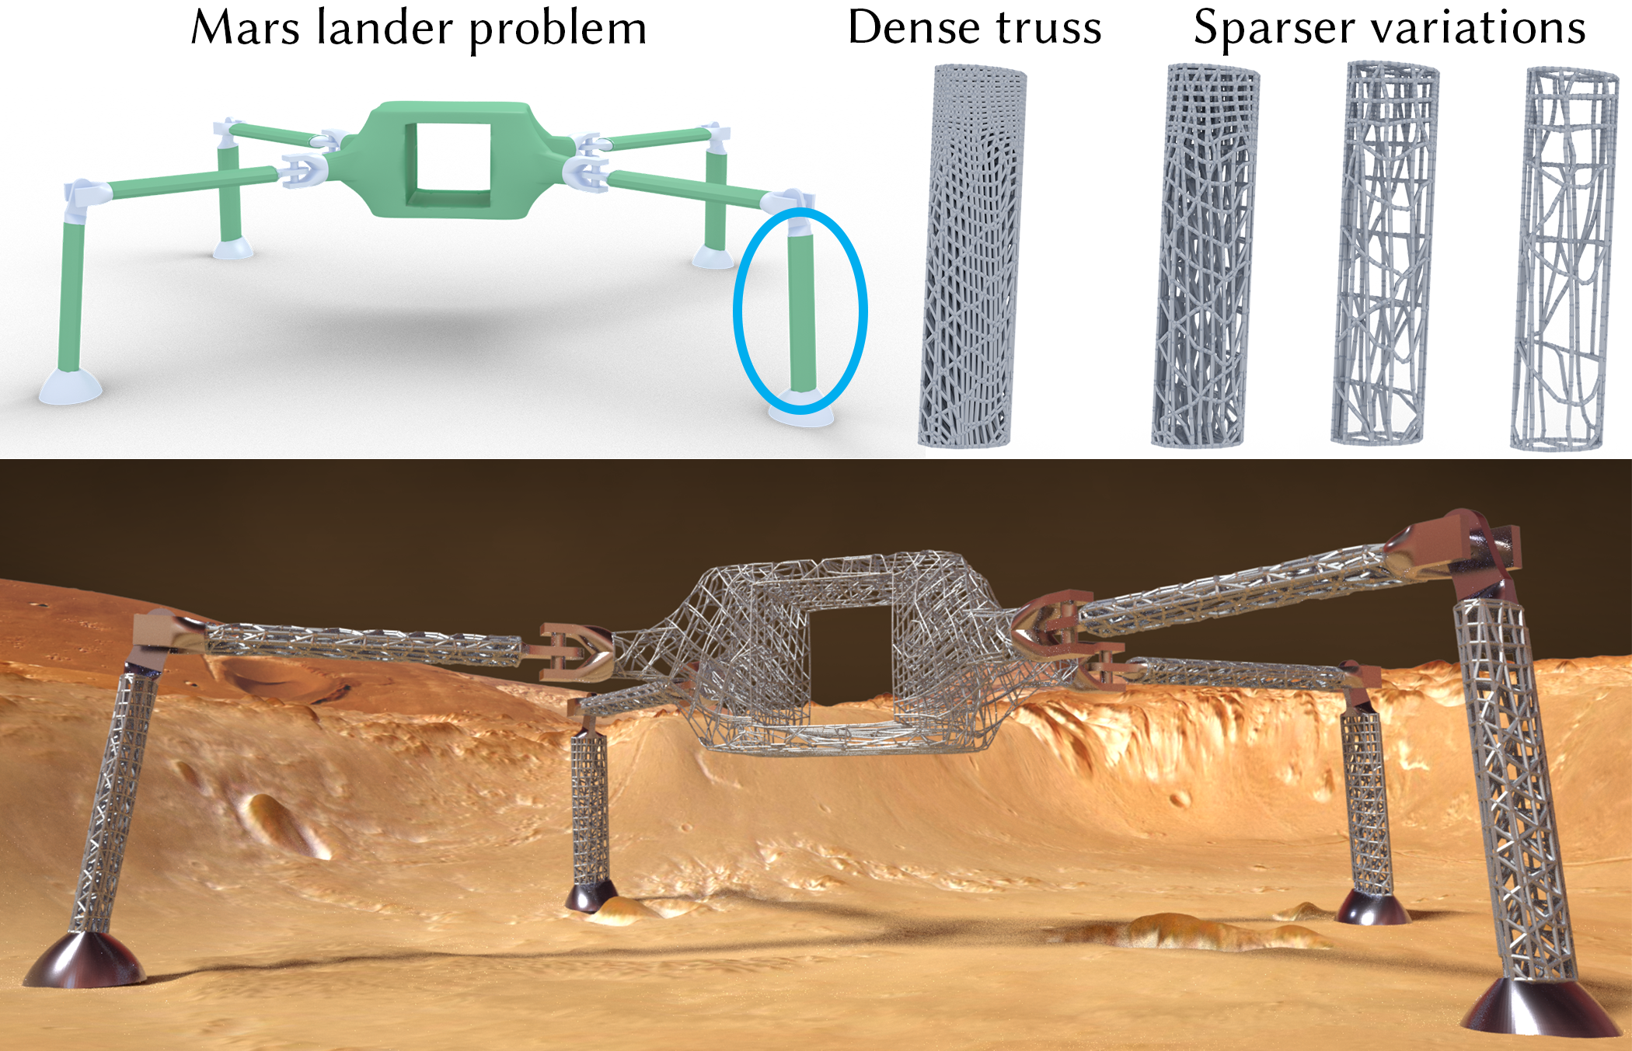
Notes:
For example, you can choose the level of sparsity along a direction, or along all the directions.
Here, for example, a user is choosing every nth parameter line, and variations on n. So taking all of them, or every second, or every third, etc.

Slide 50
Notes:
And here’s the final result.

Slide 51

Notes:
This becomes critical if you plan to optimize the rebar structure inside a concrete pillar.

Slide 52
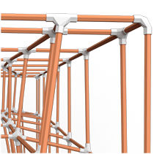
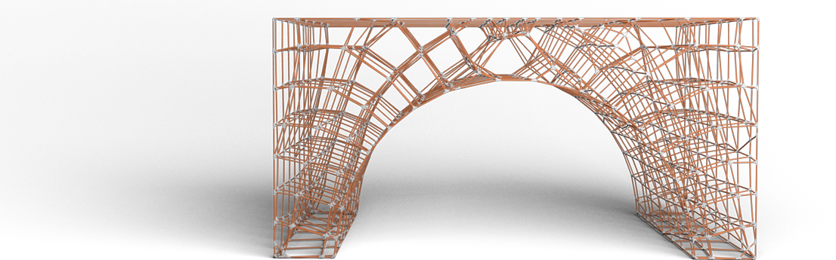
Notes:
Or when you’re constructing with materials such as dowel rods where the assembly requires a large amount of time and effort and you need enough access space

Slide 53
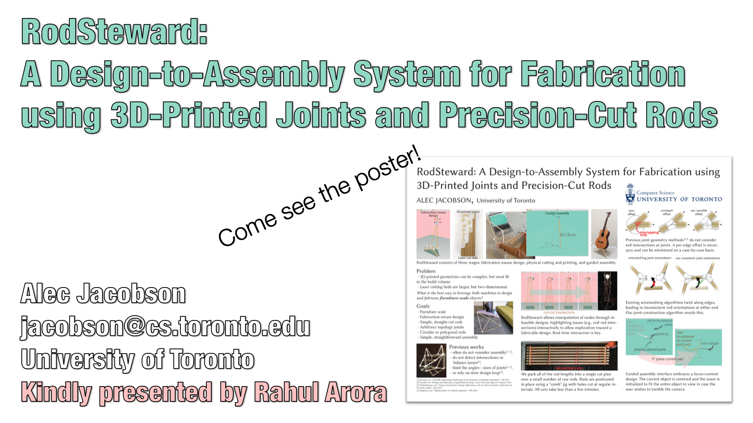
Notes:
And by the way, I presented Alec’s poster yesterday which describes an interface that helps you assemble such structures.
So please take a look at the poster as well.

Slide 54
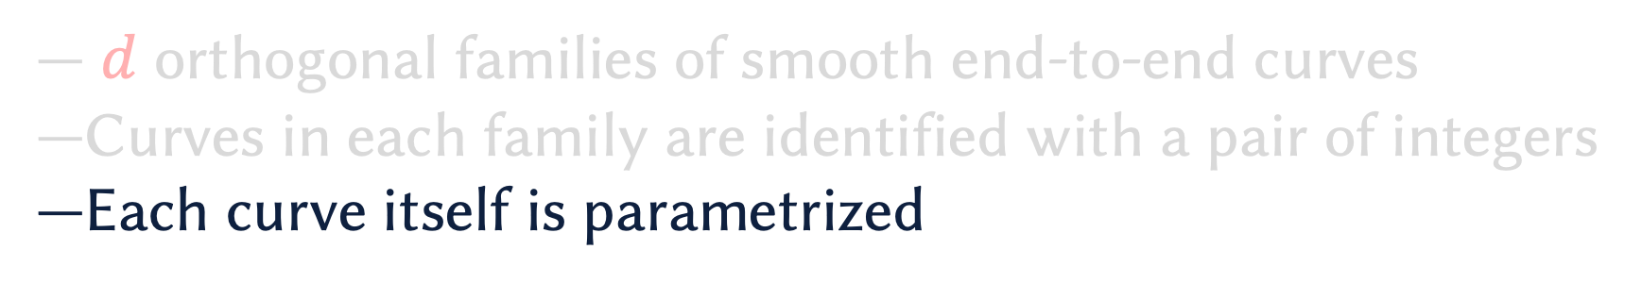
$d$ orthogonal families of smooth end-to-end curves
Curves in each family are identified with a pair of integers
Each curve itself is parametrized
Notes:
Coming back to the parametrization-based edits…we also note that each curve is itself parametrized! So you can vary things along the curve.

Slide 55
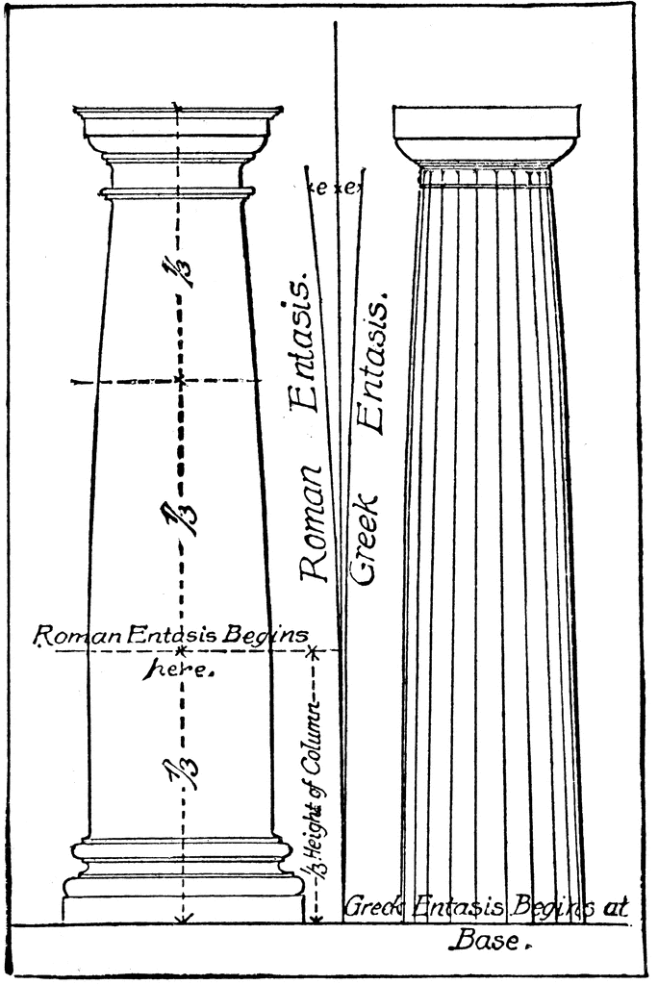
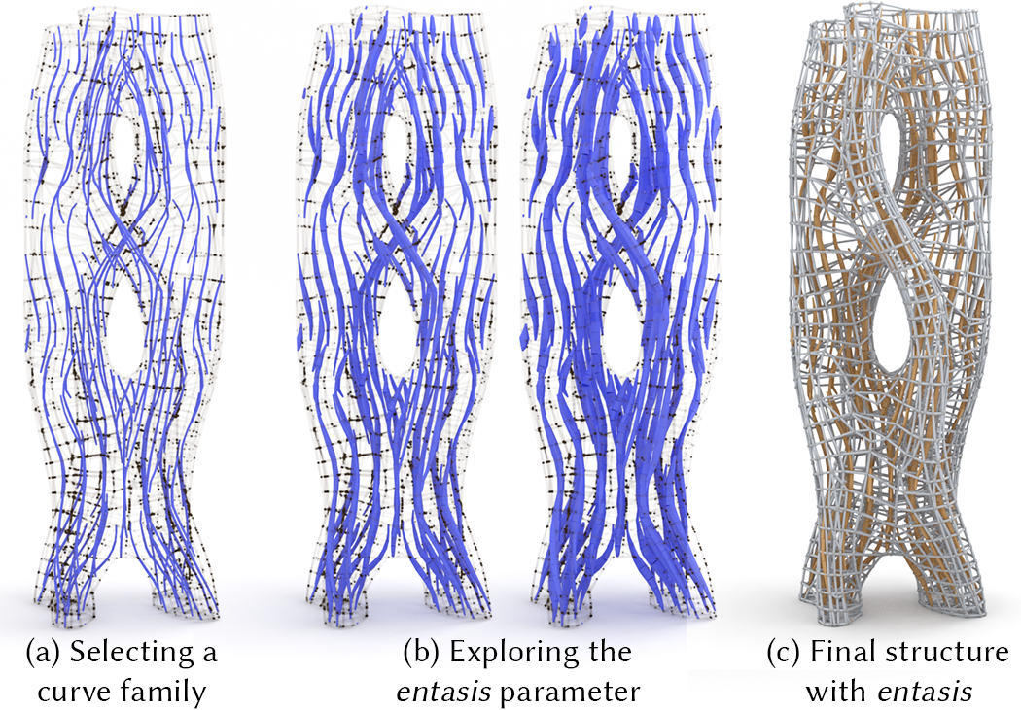
Entasis
(Greek/Roman architecture)
Image Source: William Dwight Whitney The Century Dictionary: An Encyclopedic Lexicon of the English Language (New York, NY: The Century Co., 1911)
Notes:
We use this to incorporate an ancient architectural motif called entasis into our designs. Greek architects would make the base of pillars thicker to visually indicate that it’s holding a lot of weight.
And we can do something similar with our parametrization. Along, each curve, we can have entasis, and control the degree of relative thickening.

Slide 56
Structural Tests
Notes:
Finally, let me walk you through a couple of experiments we performed to confirm the strength of our fabricated structures.

Slide 57
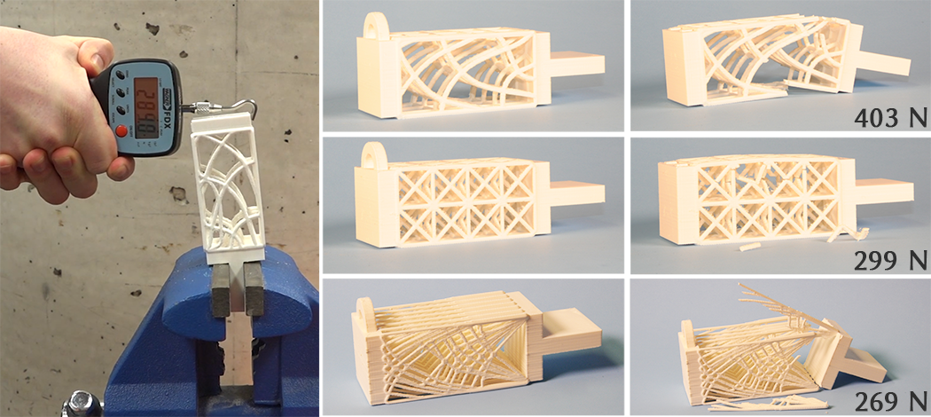
Ours
Regular grid (unoptimized)
GRAND3 [Zegard and Paulino 2015]
Testing the cantilever beam
Notes:
The First one is a standard cantilever beam. We compared our optimized structure with an unoptimized truss, and also against a ground-structure based approach.
And our method outperforms both by a wide margin.

Slide 58
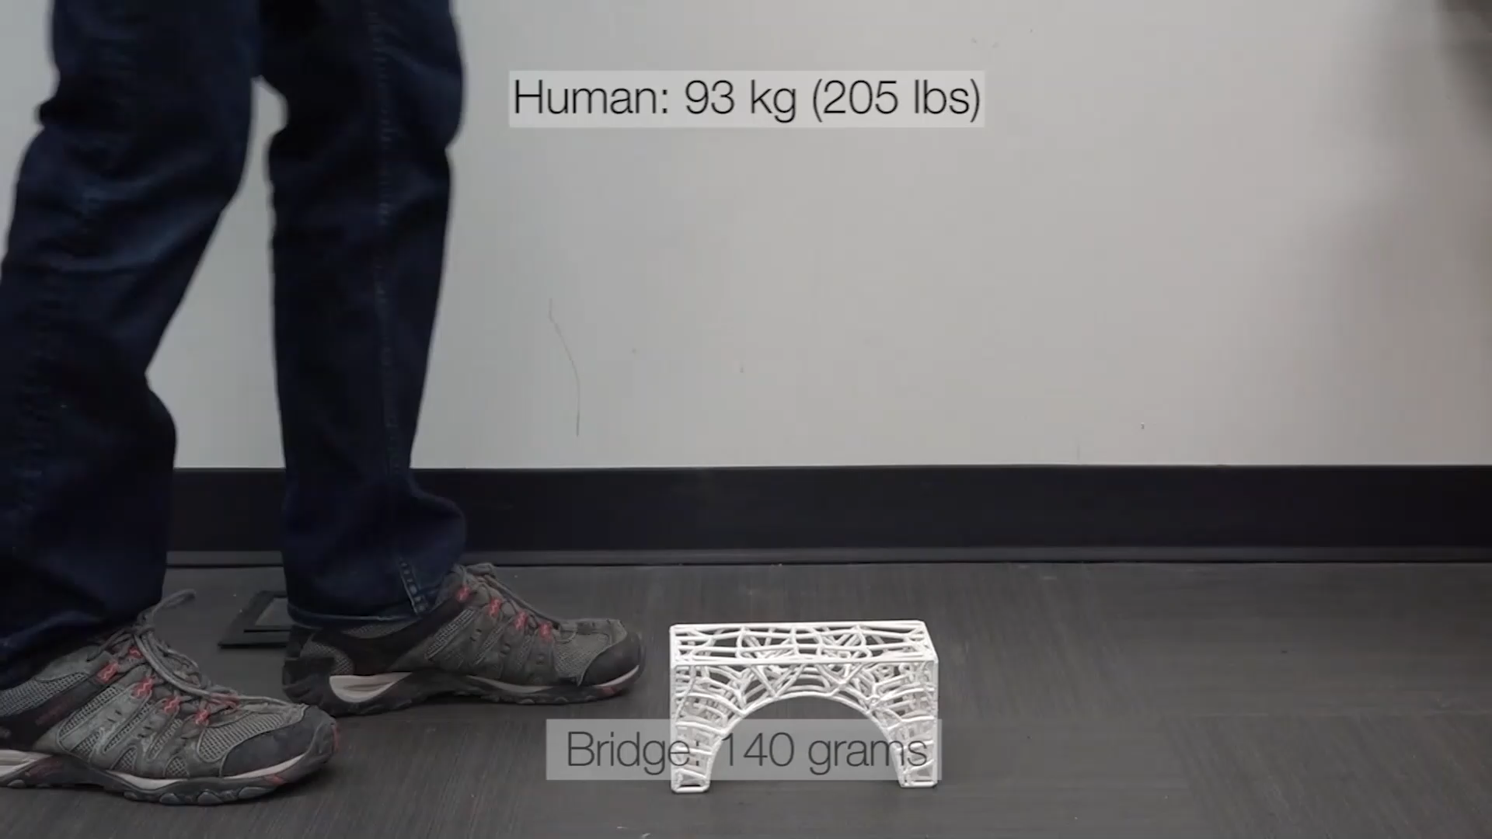
Notes:
And we tested this ABS plastic bridge by just stepping onto it.
And the 140 gram bridge came unscathed under the 93 kilogram load.

Slide 59
Limitations and Future Work
Manufacturing constraints not accounted for
  Wire-bend each curve
  Generate construction sequences for dowel assembly
Sizing optimization
Notes:
Of course, there’s work that we would like to do in the future.
The first challenge we would like to attack but haven’t so far is the manufacturing constraints imposed by various manufacturing techniques.
And another interesting area is sizing optimization. We have so far only looked at how material should be oriented, but optimizing for the thickness of the truss elements as potentially a post-process on our results would be interesting.

Slide 60
Acknowledgements
We thank Lawson Fulton and Sarah Kushner for their immense help with rendering the results, Peter Hamilton for narrating the video, and other members of the DGP lab for helping with the structural tests.
This research was funded in part by NSERC Discovery (RGPIN-2017-05524, RGPIN-2017-05235, RGPAS-2017-507938), NSERC Accelerator (RGPAS-2017-507909), New Frontiers in Research Fund (NFRFE–201), UofT Connaught Fund 03114, Canadian Foundation for Innovations John Evans Leadership Fund, the Ontario Early Research Award program, the Canada Research Chairs program, the Fields Centre for Quantitative Analysis and Modelling, the Adobe Research Fellowship program, and gifts by Adobe Systems, Autodesk and MESH Inc.
Notes:
Finally, I would like to acknowledge the support of my lab members who helped make this work successful, and the financial support of our funding agencies.
And thanks to you for your attention.

Slide 61
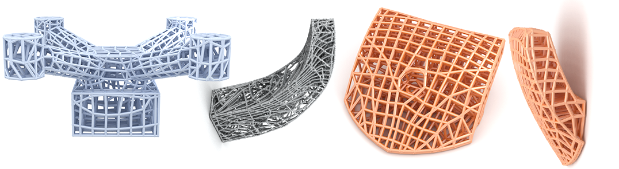
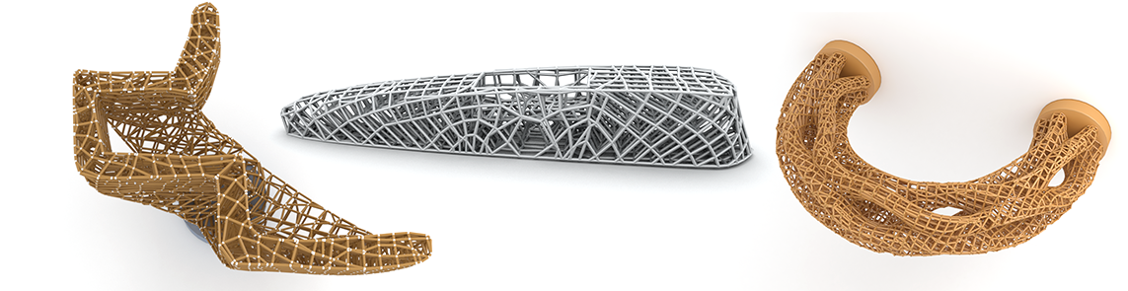
Open-source! (MIT License)
https://github.com/rarora7777/VolumetricTruss
Notes:
Before I finish, I would like to remind you that our implementation is entirely open-source. So please try it on your own problems!

Slide 62

Volumetric Michell Trusses for Parametric Design & Fabrication
Rahul Arora, Alec Jacobson, Timothy R. Langlois, Yijiang Huang, Caitlin Mueller, Wojciech Matusik, Ariel Shamir, Karan Singh, David I.W. Levin
Project page | https://www.dgp.toronto.edu/projects/michell
Code | https://github.com/rarora7777/VolumetricTruss
Contact | arorar@dgp.toronto.edu
Notes:
And that’s all fro me. Thank you again for listening!

