Slide 1
Subspaces from Force Distributions
Otman Benchekroun
Eitan Grinspun
Maurizio Chiaramonte
Philip Allen Etter
Notes:
In high schoo, I learned all about resonance.

Slide 2
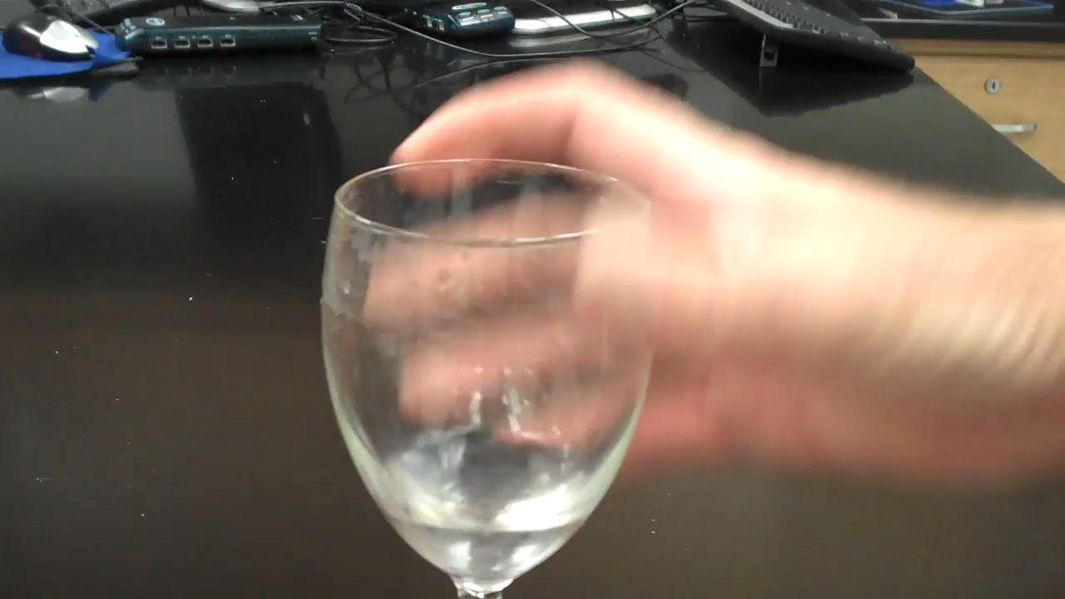
Resonance
https://www.youtube.com/watch?v=X5Uy7MhFiWA
Notes:
And I annoyed a lot of people with it.
I was told that the reason I could make this sound, is that all shapes have a natural way in which they vibrate,
and that the fingers moved at just the right frequency to trigger those natural vibrations.
If you go too fast or if your fingers move too slow, the natural vibrations don’t resonate in an appreciable manner
Fast forward 8 years, and I hear about these natural vibrations again, but this time in a different context.

Slide 3
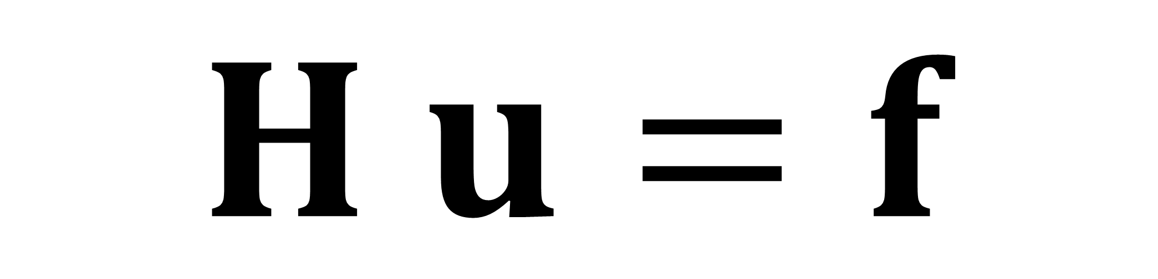
displacements
$$H u=f$$
Energy Hessian
forces
Notes:
Im now a grad student doing numerical simulation, whose whole mantra is trying to accelerate the solution to this one equation, many times for every timestep.
Here H is some physical energy hessian, f represents any external forces, and u represents displacements that we solve for every iteration.

Slide 4
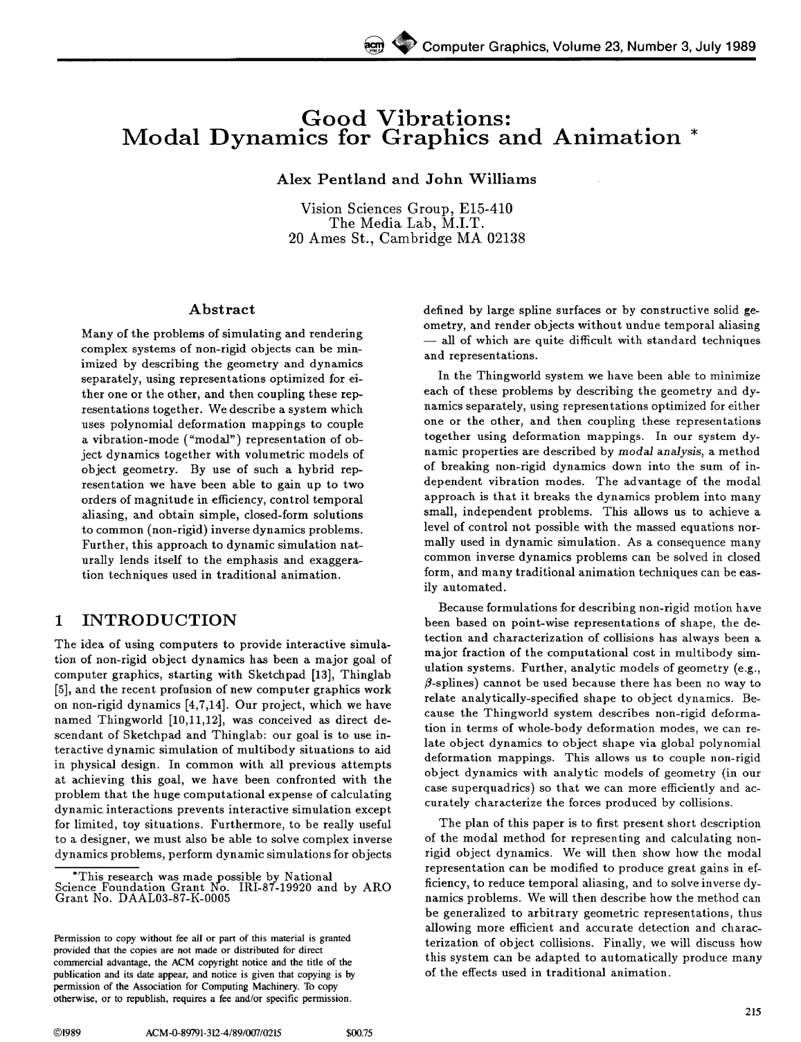
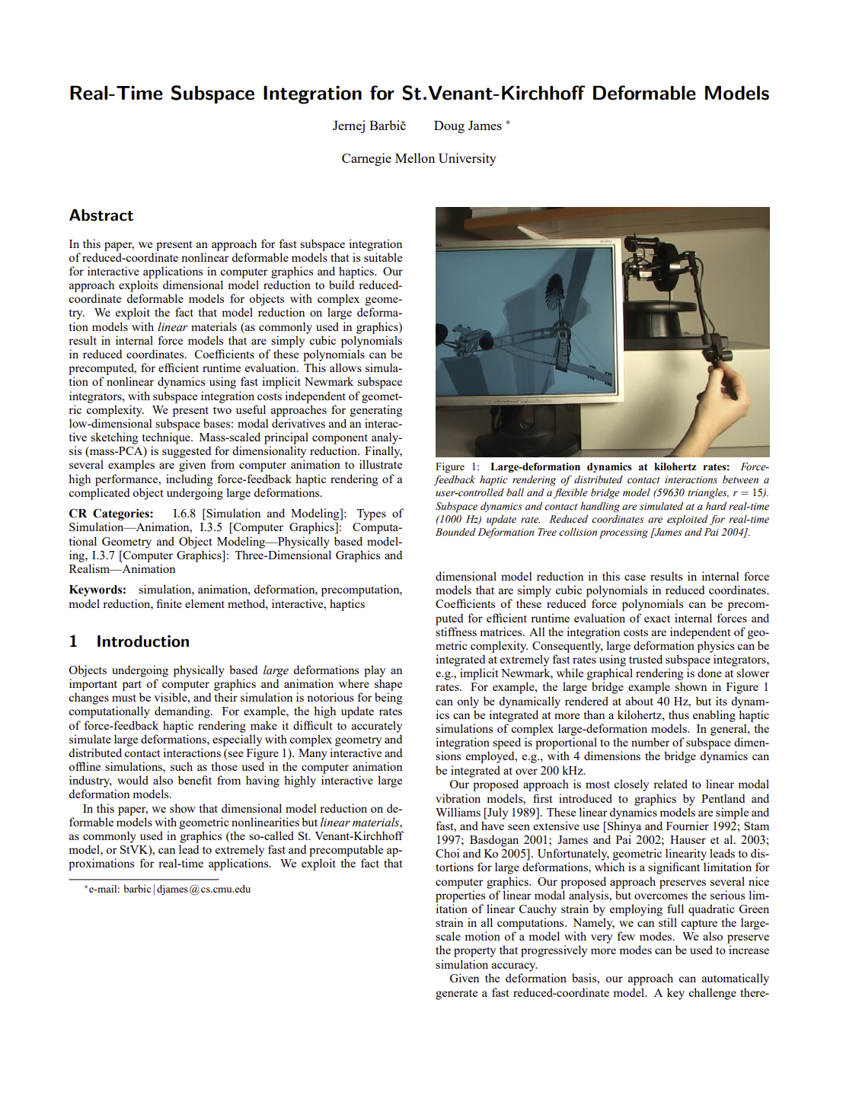
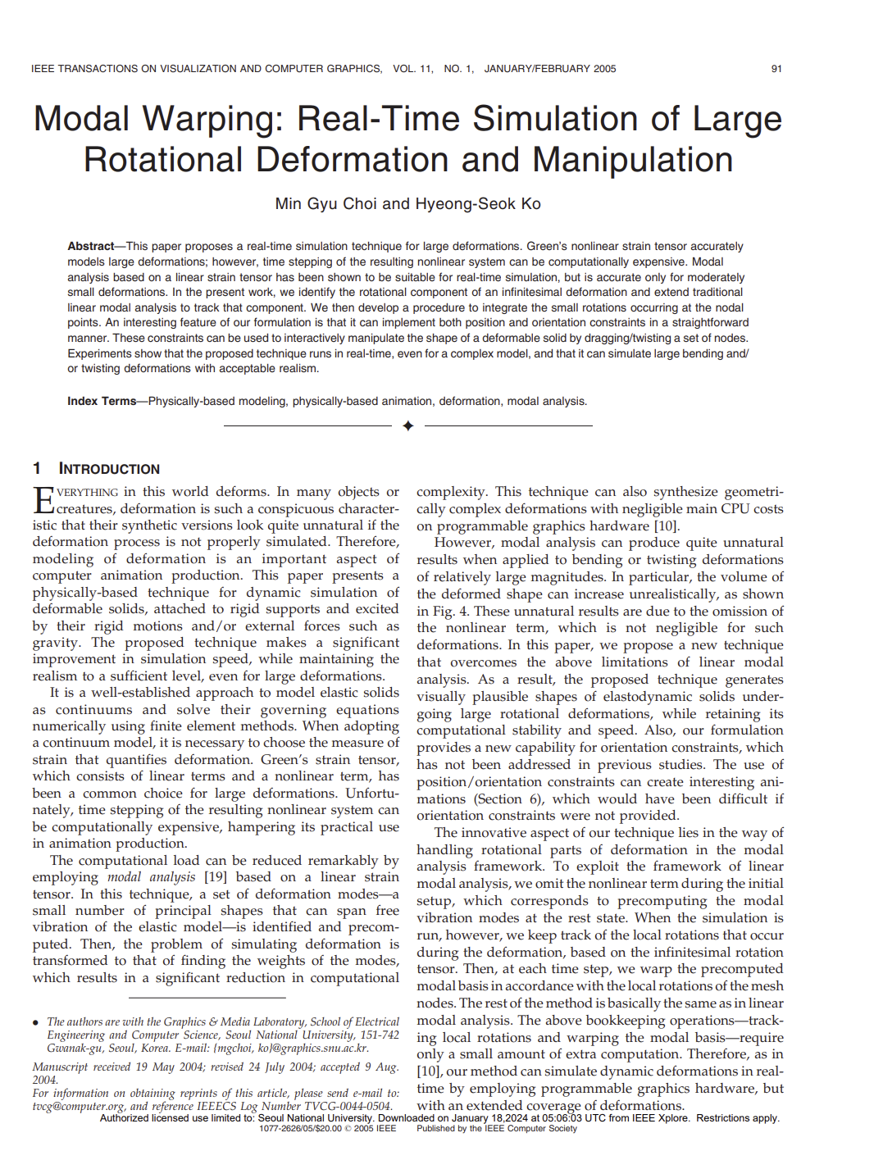
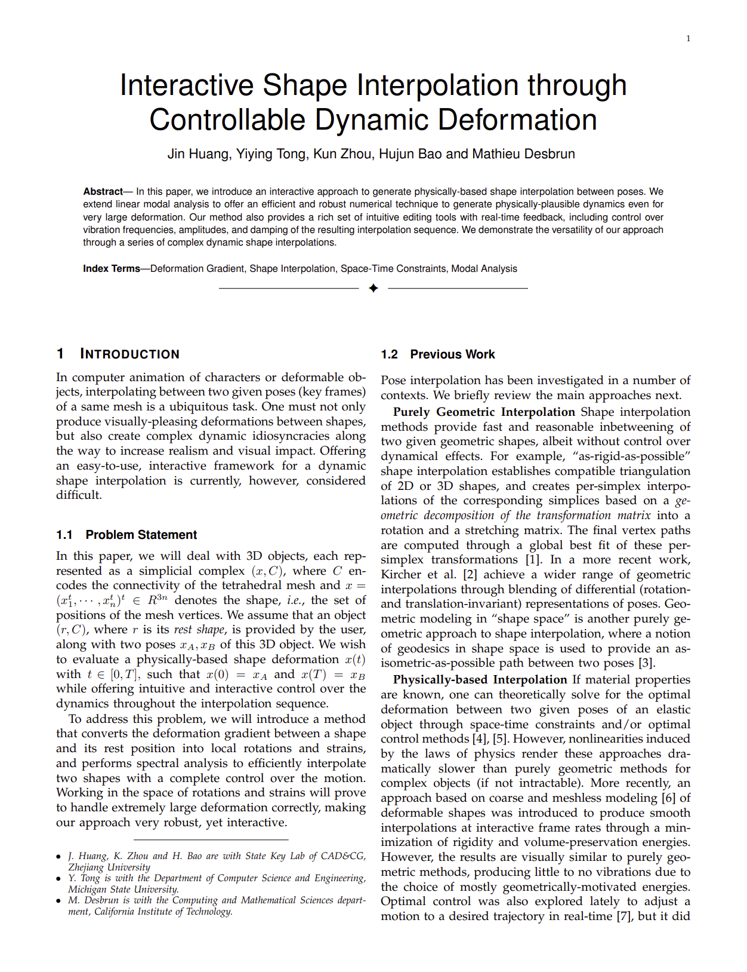
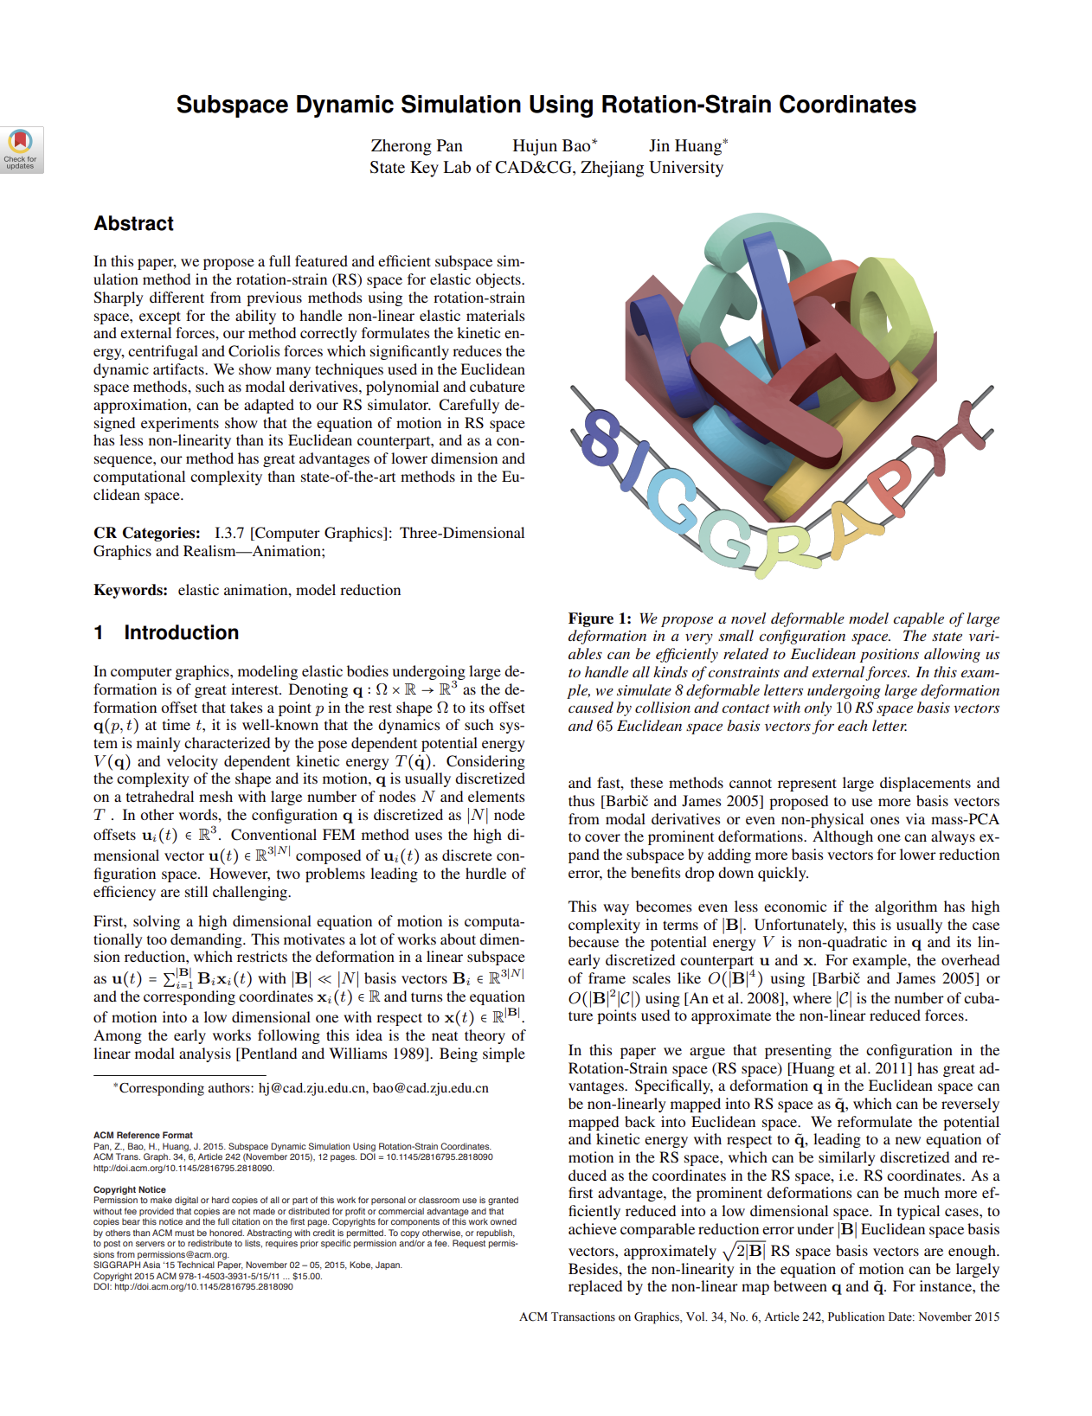
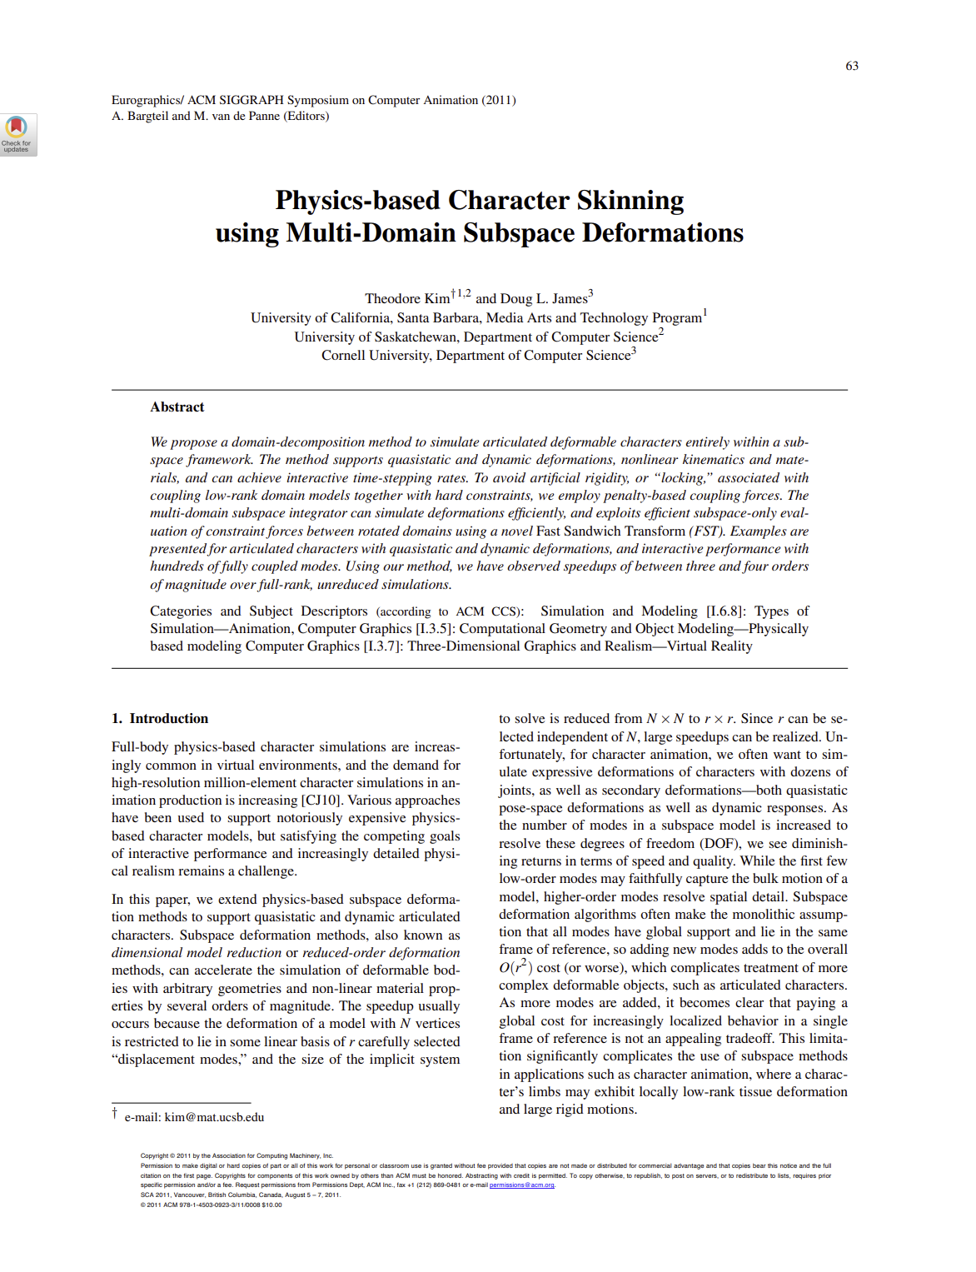
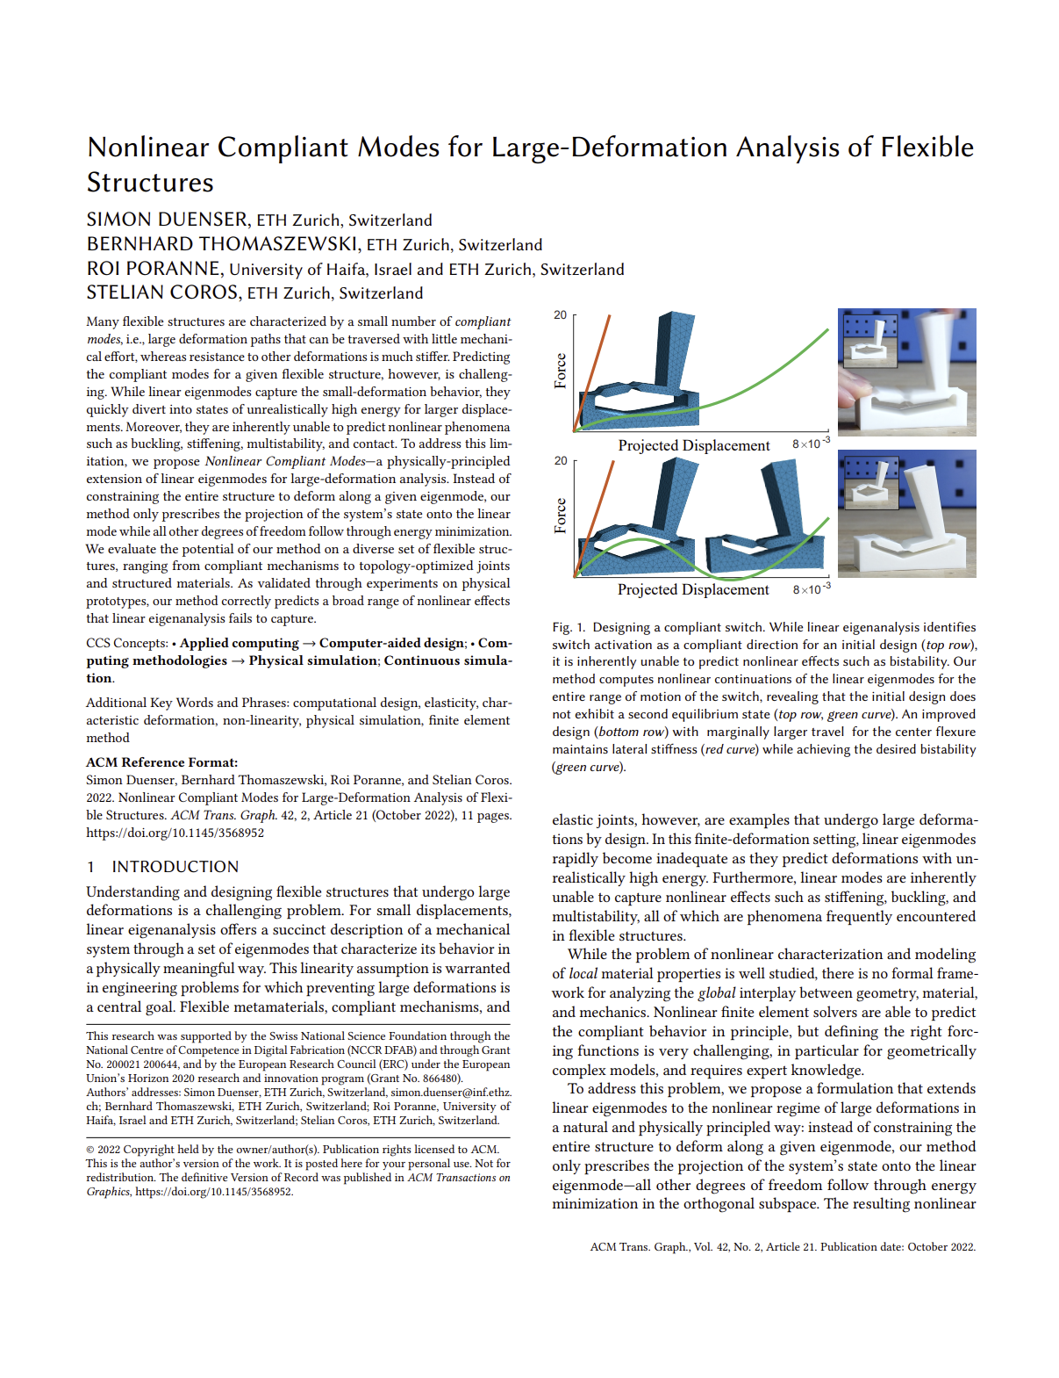
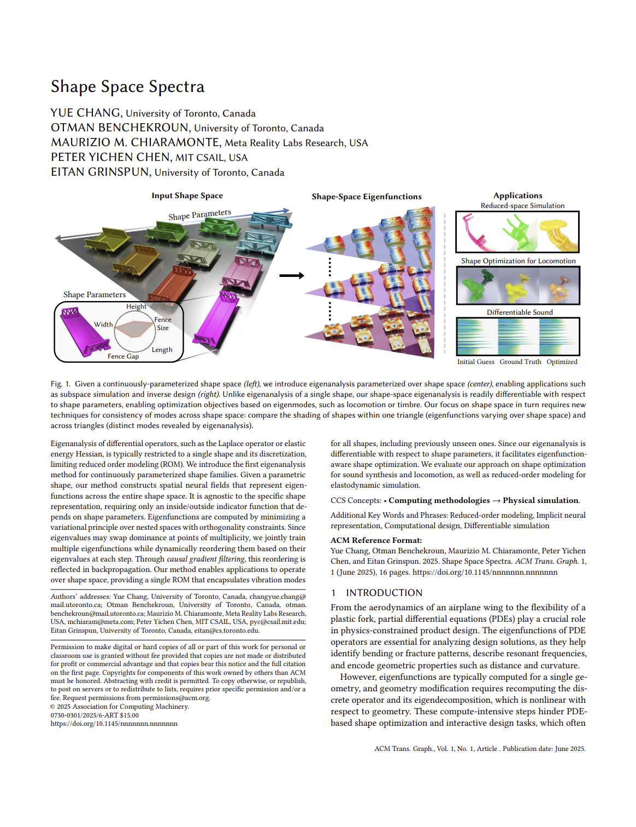
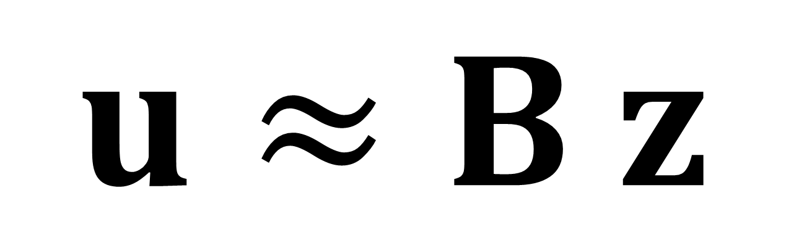
Subspace matrix
Low-dimensional
degrees of freedom
$$u≈B z$$
Notes:
The way we speed this up as is the theme in this workshop, is by introducing a linear subspace approximation to our degrees of freedom u, where z are these new low dimensional degrees of freedom,
And B is this precomputed subspace mapping matrix.
Decades worth of literature in graphics builds this subspace from the natural vibrations of the shape.
The same ones I was using to announce I was bored at the dinner table all those years ago.

Slide 5
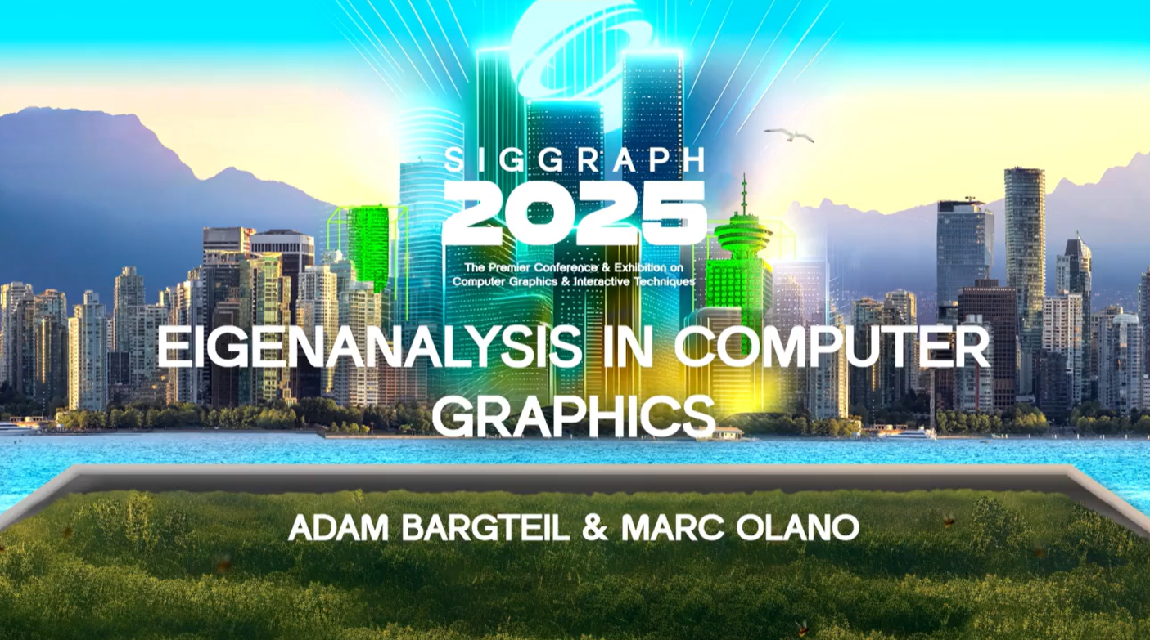
Modal Analysis
Notes:
This is called Linear Modal Analysis, which you would have heard about if you attended the excellent Eigenanalysis course on Sunday by Adam Bargteil and Marc Olano.

Slide 6
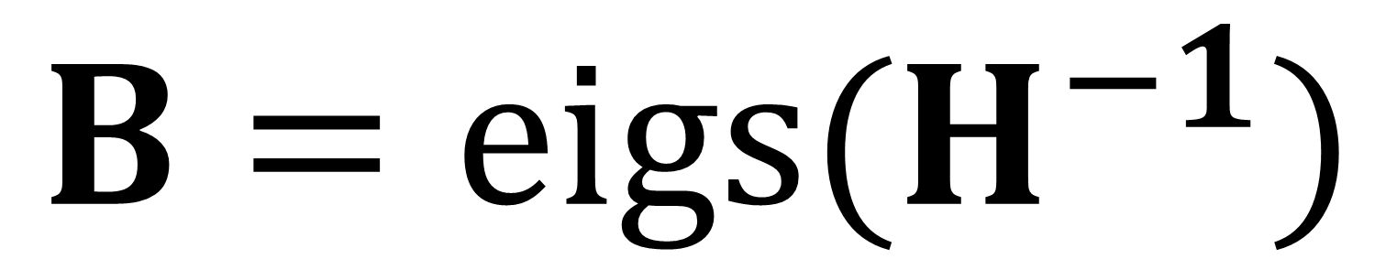
Linear Modal Analysis
$$B=eigs(H^{−1})$$
eigenvectors
Notes:
The way it works is simple.
You simply find the eigenvecors of your hessian matrix Hinverse.
These eigenvectors of your system correspond to the natural vibrations of your shape.
While this does indeed speed the simulation up it has its well known problems:
It’s very easy to induce jarring artifacts when you actually go and use this in a real simulation.

Slide 7
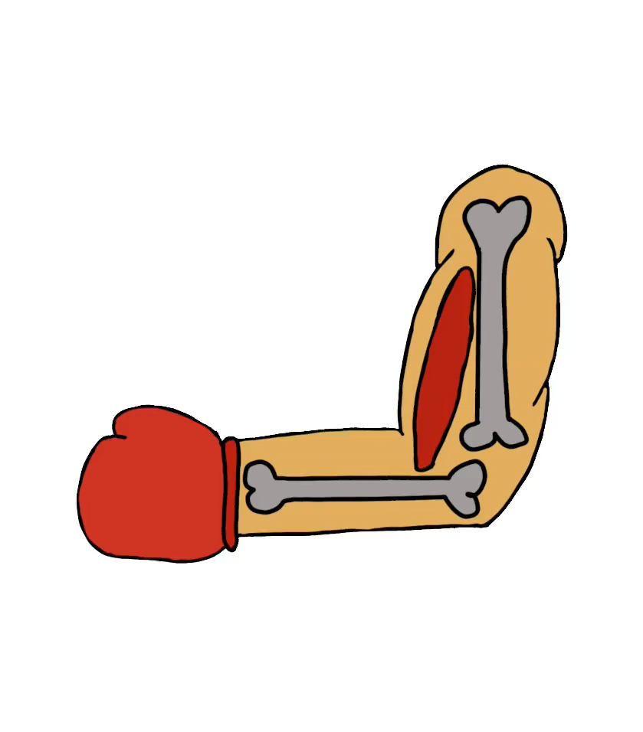
Spooky Action at A Distance!
Notes:
For example, if you want to flex this boxer’s muscle, and you use a Modal analysis subspace, you’ll observe this weird deformation around the wrist.
Ouch.
I like like to call these global artifacts spooky action at a distance.
Why does it happen?
The reason is actually very simple, but it calls into question the reason we use modal analysis for subspace simulation in the first place

Slide 8
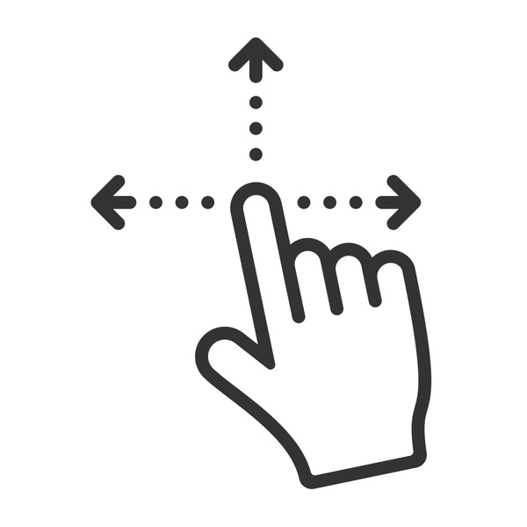
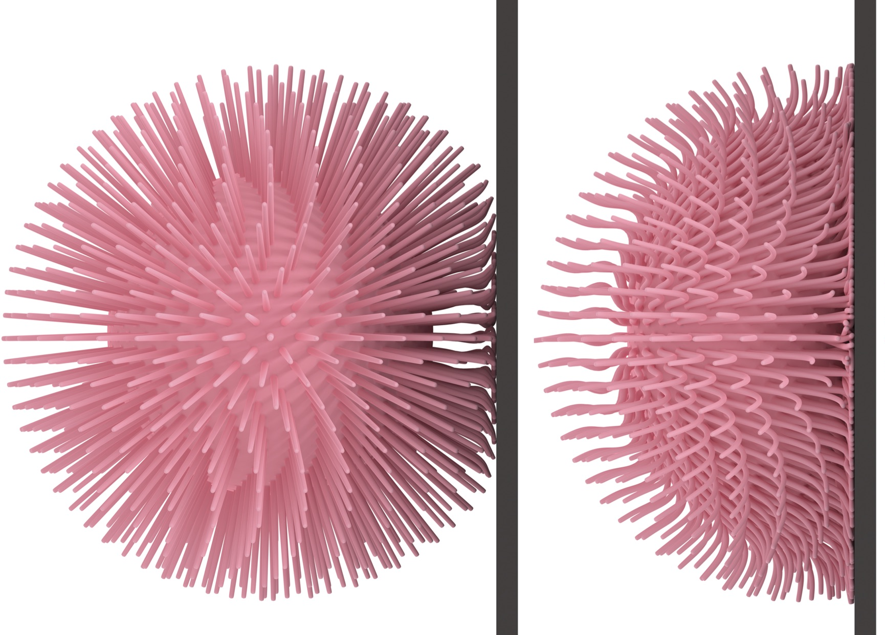
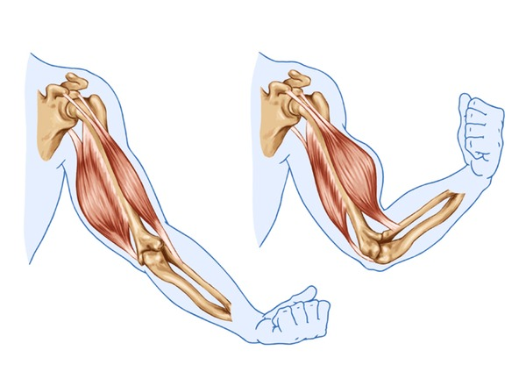
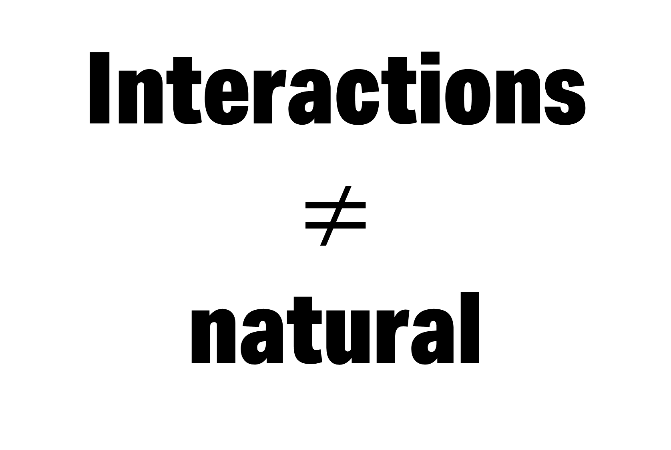
Interactions
$$≠$$
natural
Notes:
We very rarely interact with a simulation at its natural] vibrations!
In fact at run-time whether we’re dealing with contact, point drag forces, or muscle actuation.
All these forces very rarely excite the natural vibrations of the system in a relevant enough capacity unless meticulously crafted. I mean think about how much care I had to put in to move my fingers just right in order to make the glass and make it resonate.
To derive a subspace better suited for everydayl force interactions, we need to start from scratch at our favourite old equation.

Slide 9



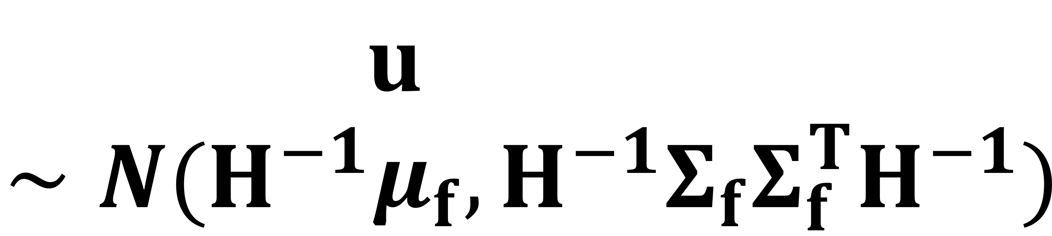
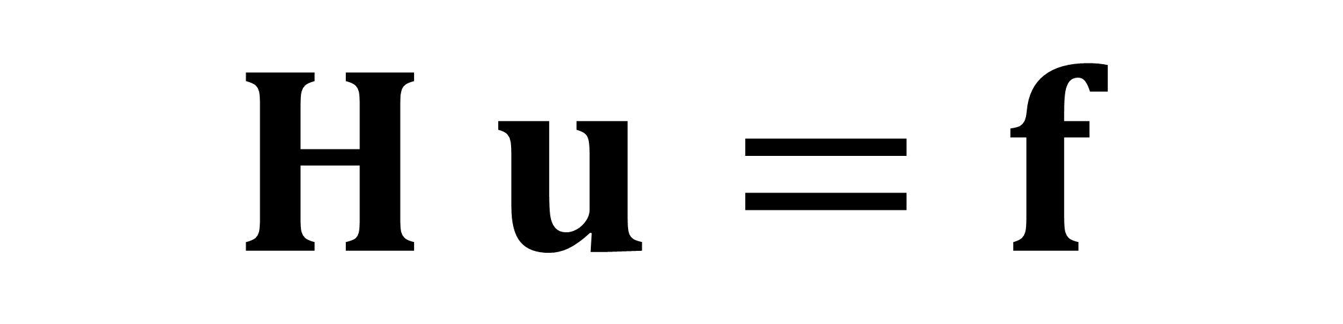
$$H u=f$$
$$f∼N(μ_{f}, Σ_{f})$$
$$u∼N(H^{−1}μ_{f},H^{−1}Σ_{f}Σ_{f}^{T}H^{−1})$$
Notes:
Except this time, we’ll be treating our external forces as a first class citizen in our derivation.
We start by treating the forces to to be uncertain, Gaussian random variables, which are parameterized with a mean and a covariance.
These Gaussian-distributed forces, through their linear relationship with u, induce a distribution on displacements u

Slide 10

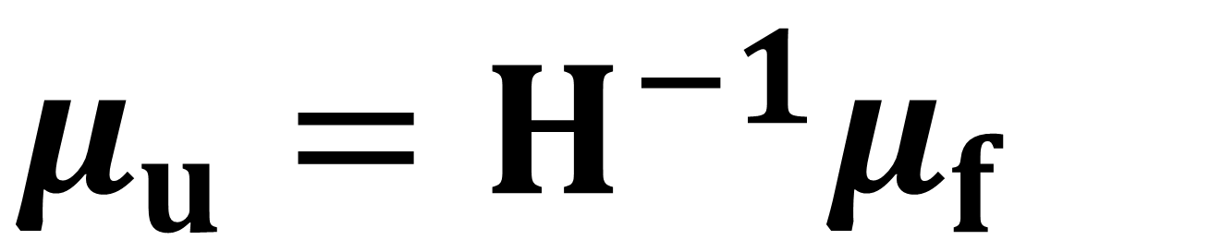
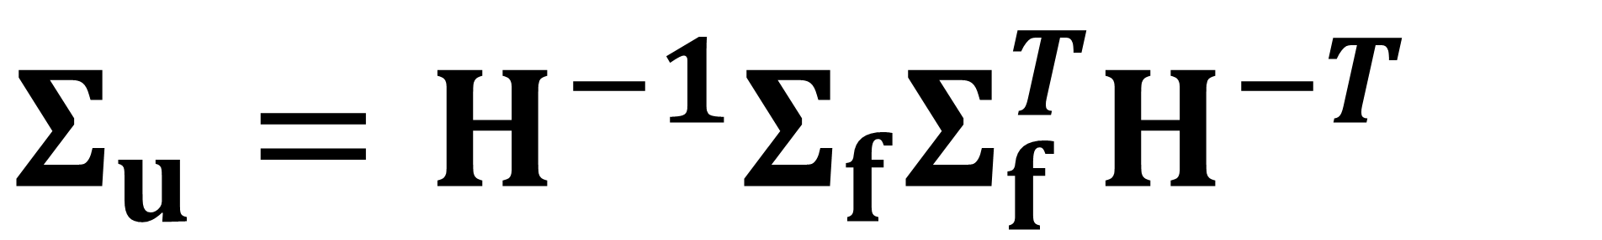
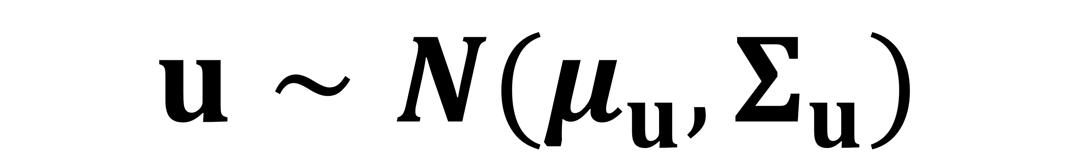
$$u∼N(μ_{u},Σ_{u})$$
$${μ_{u}=H}^{−1}μ_{f}$$
$$B=eigs(H^{−1}Σ_{f}Σ_{f}^{T}H^{−T})$$
$$B=eigs(Σ_{u})$$
$$Σ_{u}=H^{−1}Σ_{f}Σ_{f}^{T}H^{−T}$$
Notes:
This distribution on u is easily shown to be Gaussian with the following mean mu_u and covariance Sigma_u
Finally we can just use PCA to obtain the low-dimensional subspace that best captures and reconstructs this distribution u.
This, again gives an eigenproblem!
This time it’s on Sigma_u.
Except it’s of this matrix!
That’s it. That’s the extent of our main theoretical contribution.
In order to build a subspace, one should solve the eigenproblem on this big matrix.
We traded one eigenproblem for another. Let’s see what changed

Slide 11

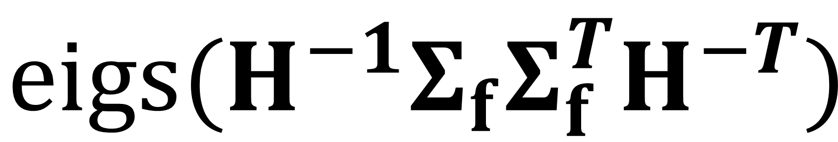

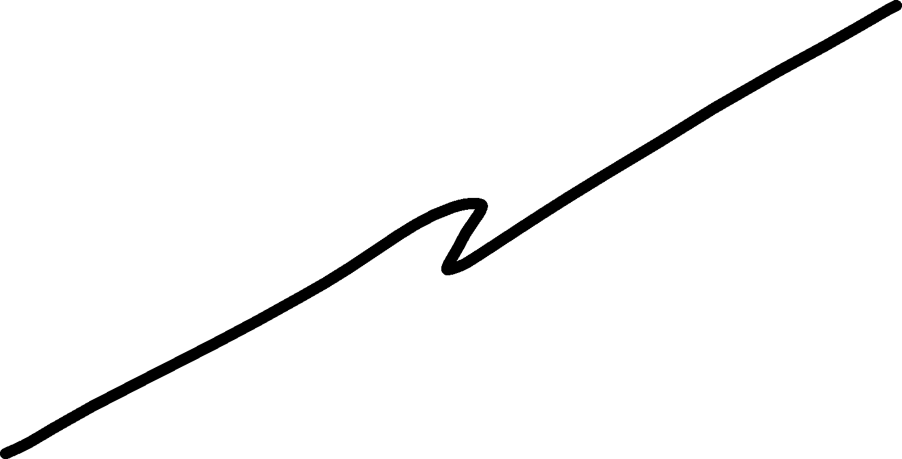

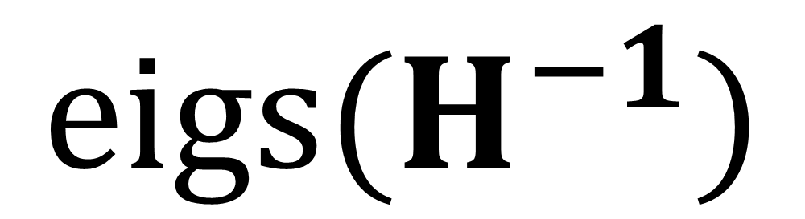
$$eigs(H^{−1})$$
$$Σ_{f}=I$$
$$eigs(H^{−1}Σ_{f}Σ_{f}^{T}H^{−T})$$
$$I$$
Notes:
Modal Analysis finds the highest eigenvectors of H inverse period.
We also have an Hinverse ! Except this time it sandwiches our Sigma_F the force covariance.
As a result our analysis becomes sensitive to our distribution on force we’ve prescribed.
Moreover you can derive that if Sigma_F is the identity. Then the resulting eigenvectors will be the same for both frameworks!

Slide 12
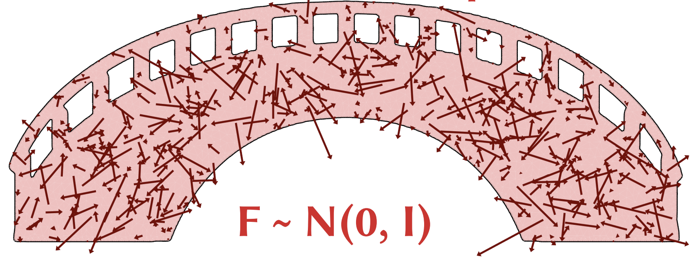
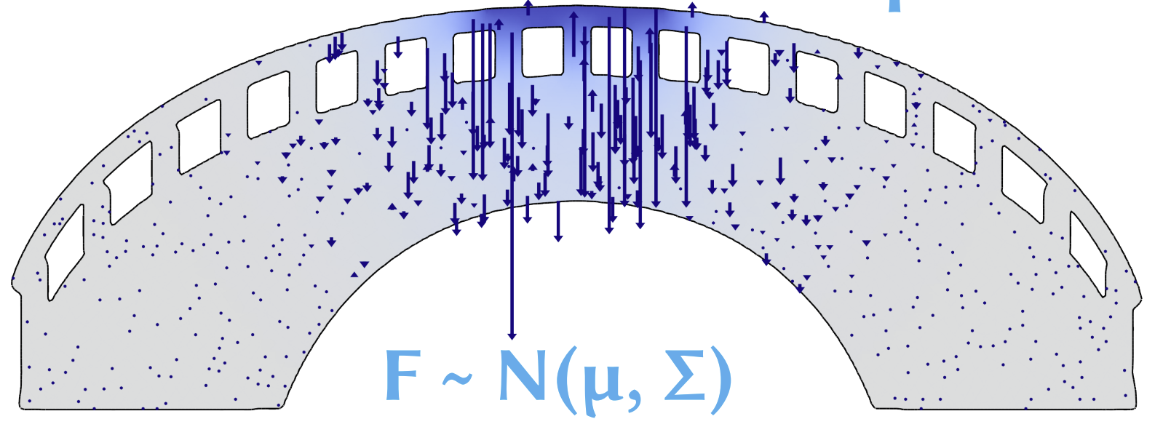
Modal Analysis
Force Sample
Our
Force Sample
Notes:
In other words our framework tells us that modal analysis assumes a force distribution of randomly uncorrelated forces acting everywhere on this bridge at all of the time.
That’s pretty extreme.
Fortunately, our methods allows us to explore different, more realistic distributions on our forces F

Slide 13

Notes:
By properly considering a statistical distribution acting on the muscle, our reduced simulation properly allows the boxer to flex on us,
Without sustaining wrist injuries

Slide 14
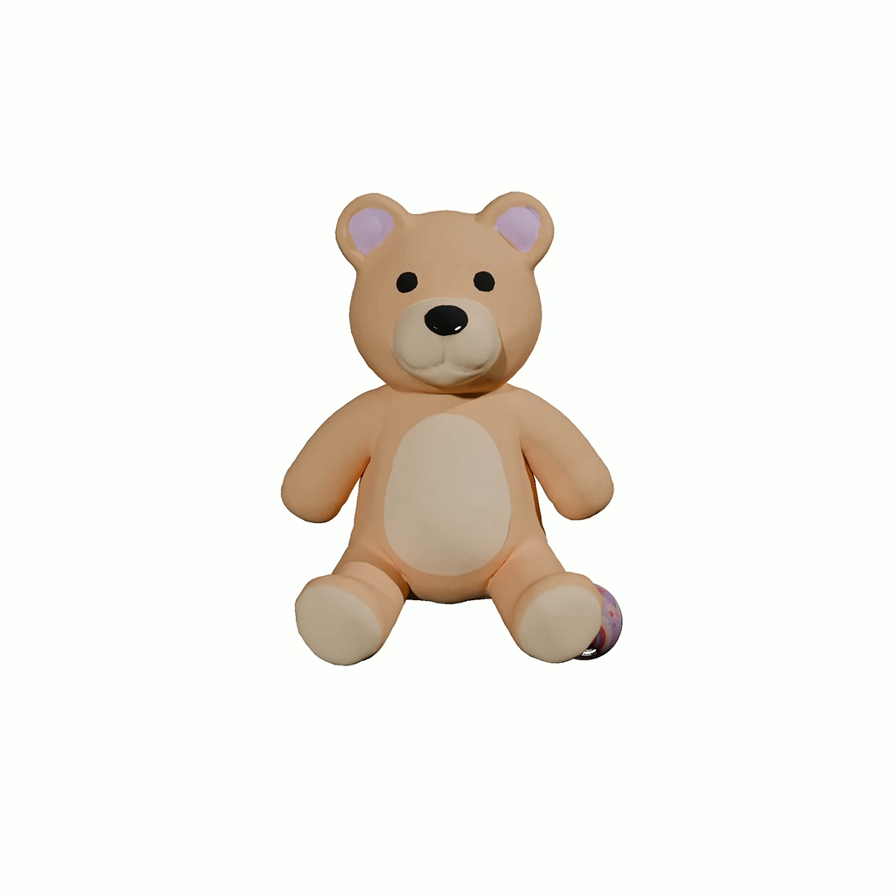
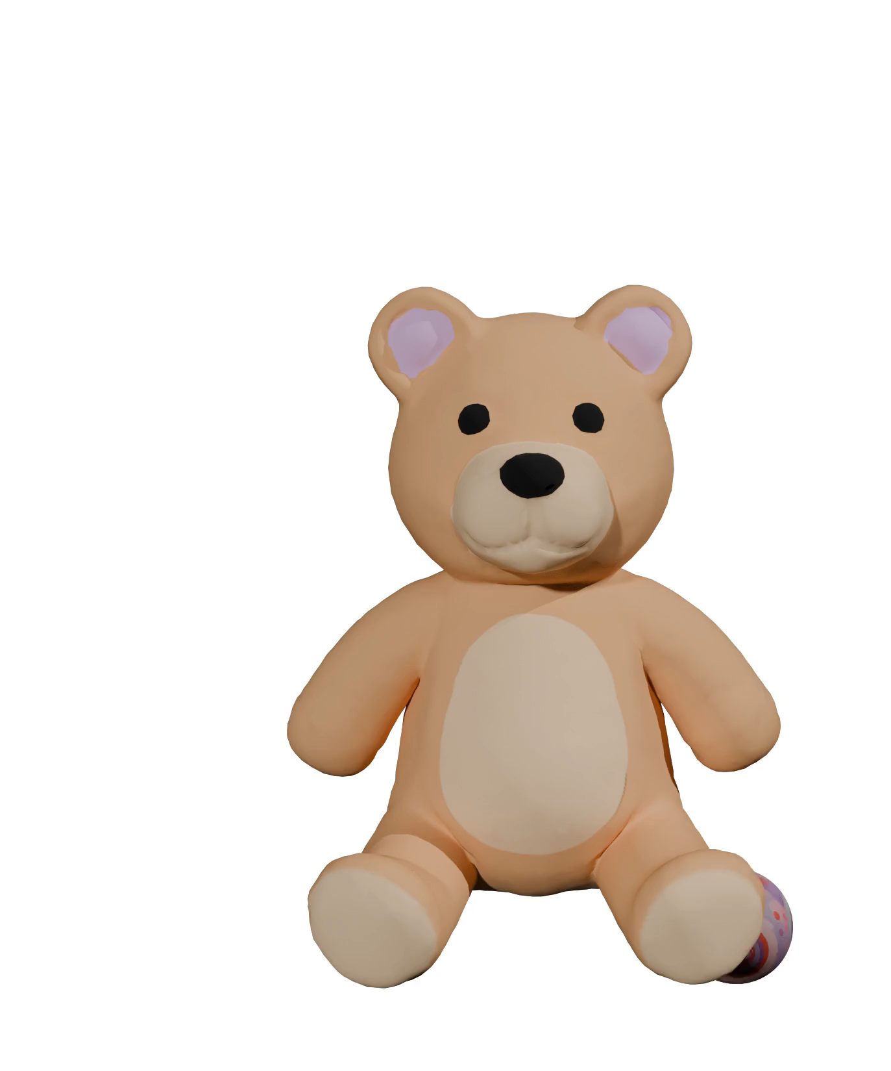
Full
Simulation
Modal
Analysis
Ours
0.14FPS
37 FPS
37 FPS
Notes:
Similarly we can evaluate our method for a simple contact simulation.
Using modal analysis, we get spooky action at a distance because multiple parts of the bear to move at the same time
Instead, by better approximating the statistical distributions we expect of contact,
we obtain a simulation capable of capturing local interaction, with no new changes in speed.

Slide 15
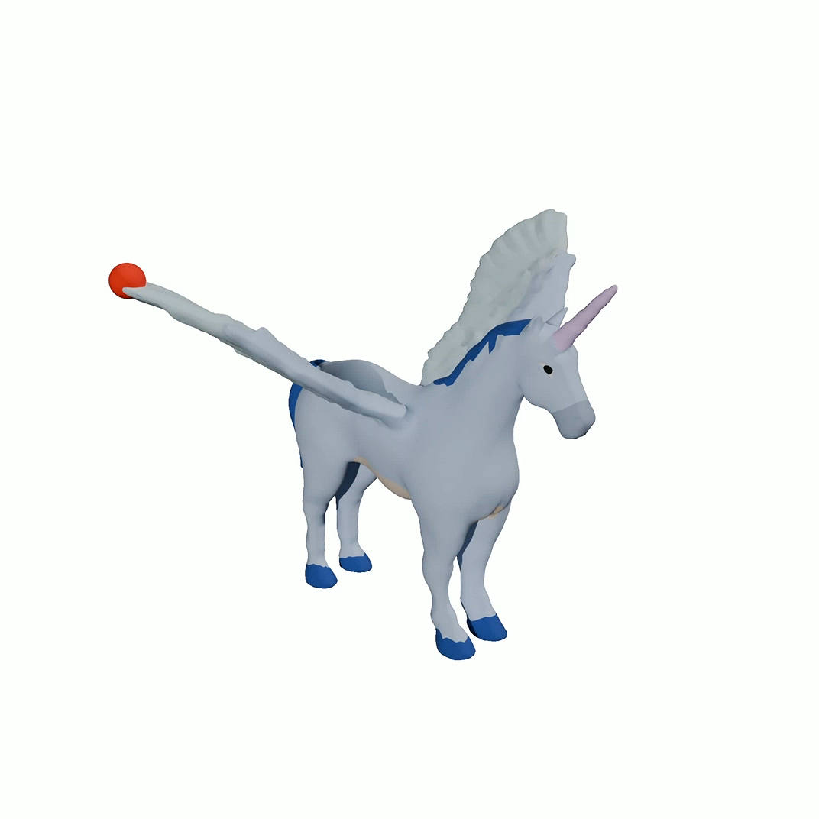

Modal Analysis
Ours
Notes:
Similarly we can click and drag points on our octopus.
Using modal analysis, we see our Pegasus wing collapses into itself, while dragging down the horn makes the wings move alarmingly.
Instead, by better approximating the statistical distributions for our click interaction,
our sim is capable of capturing the bending of the wing and motion of the horn,
with the same number of degrees of freedom.

Slide 16
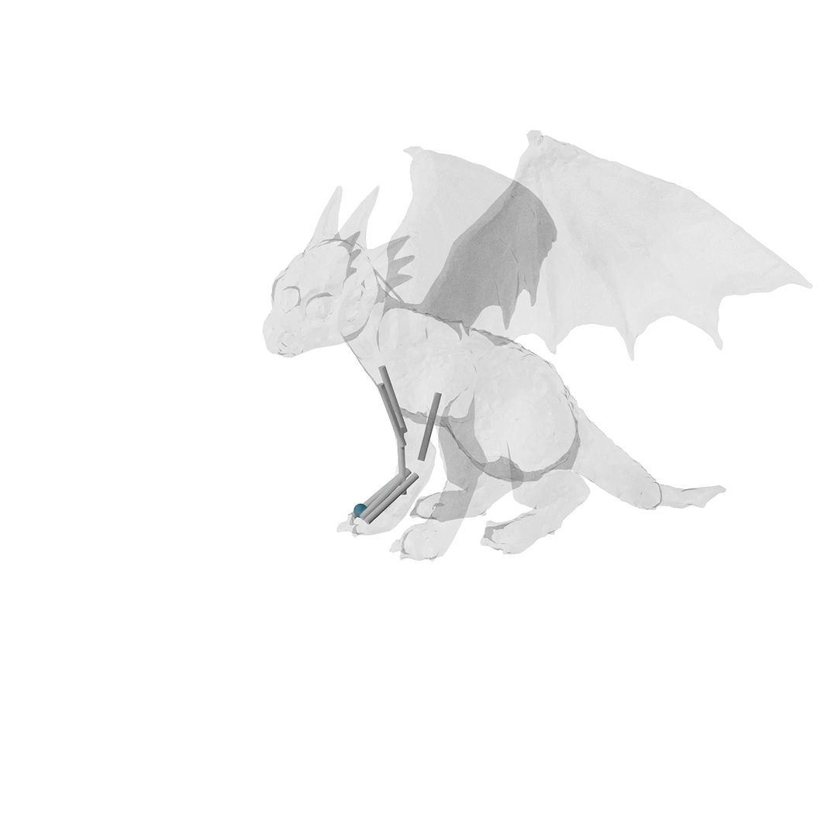

Modal
Analysis
Ours
Notes:
Getting this force distribution right is super important, especially for inverse control problems.
Here’ I’m adjusting the rest length of the spring muscles of the dragon with inverse kinematics and simulating the dragon so that it’s front paw follows the control point.
Notice that using a Linear Modal analysis subspace causes the whole dragon to move globally, almost completely ignoring its muscles
Taking into account the force distribution lets the inverse kinematics actually leverage the muscles correctly, and the hand much more faithfully follows the control point.

Slide 17
Conclusion
Subspace construction $≠$ Vibration analysis
Reduced Order Modelling requires as input
force distributions that will be observed at run-time.
Notes:
In conclusion,
We should not be deriving our subspace construction from vibration analaysis, we just got extremely lucky the two agree with each other in this special case.
By providing as input a description of your force distributions, we can easily design subspaces that better capture scene interactions.

Slide 18

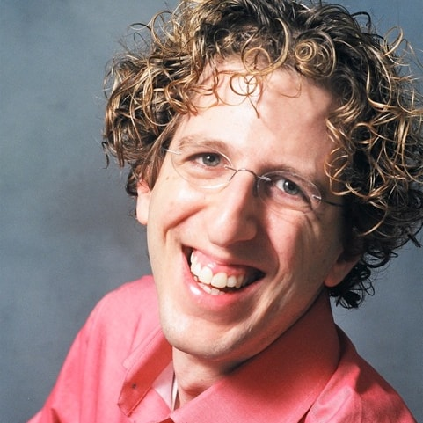
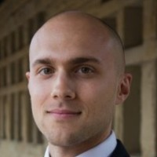
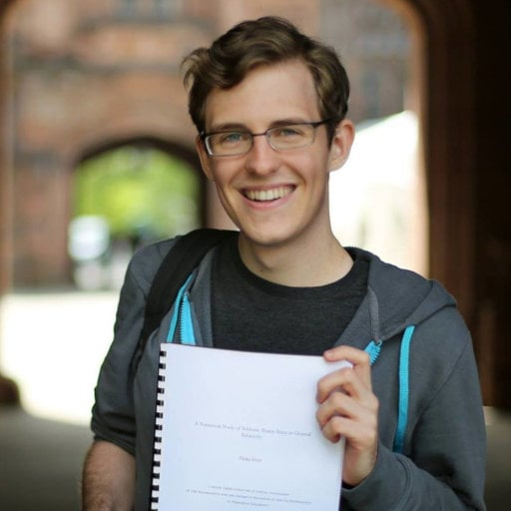

Thank You!
Otman Benchekroun
Eitan Grinspun
Maurizio Chiaramonte
Philip Allen Etter
Stay tuned…
Notes:
Thanks for listening, I’d like to thank my collaborators.
Stay tuned for more results, our paper just got into SIGGRAPH Asia in hong kong!

