Slide 1
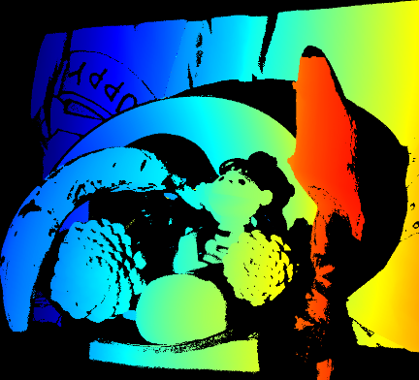
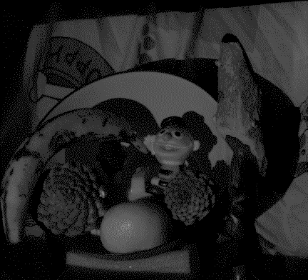
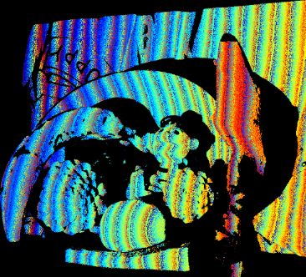
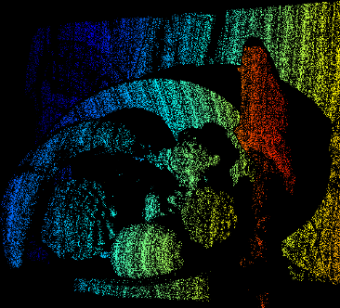
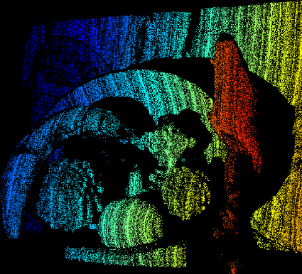

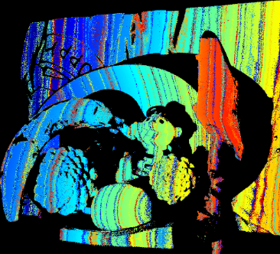
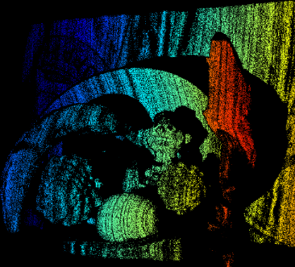
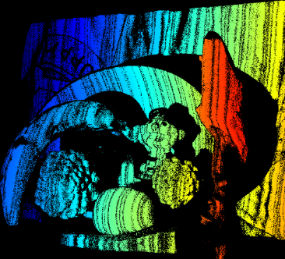
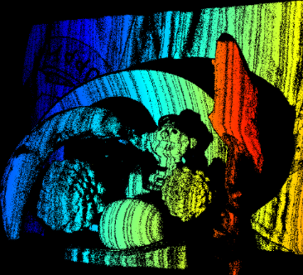
Encoder | Decoder | error=0 | error≤1 | error≤2
MPS | ZNCC | 26.00% | 38.83% | 39.74%
optimized | ZNCC | 33.73% | 60.48% | 65.80%
ground truth
camera image
Encoder: MPS (K=4, f=16) Decoder: ZNCC
all valid pixels
error=0
error≤1
error≤2
Encoder: optimized (K=4, f=16, ε = 0, w/out ROI) Decoder: ZNCC
all valid pixels
error=0
error≤1
error≤2

Slide 2
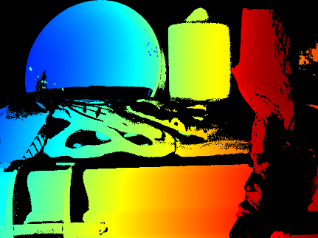
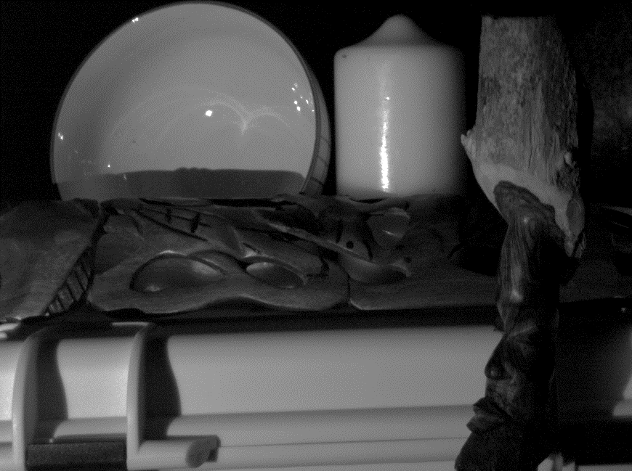
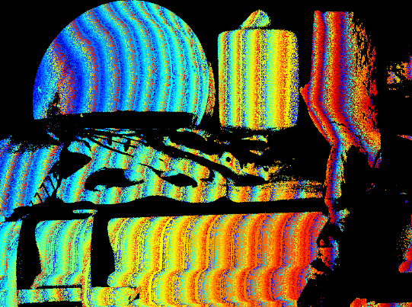
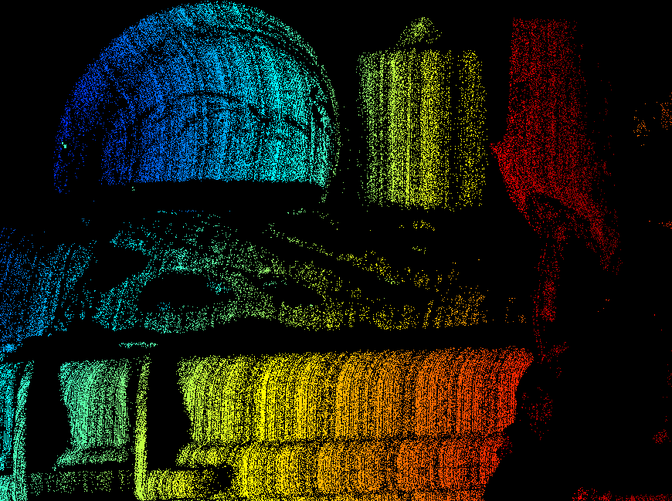
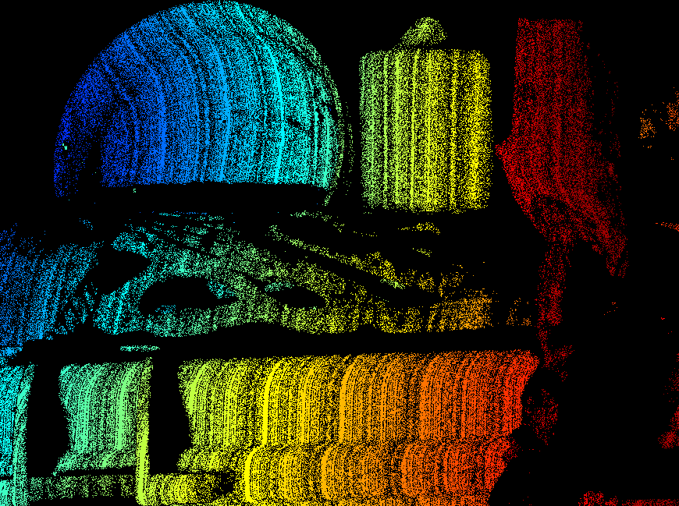

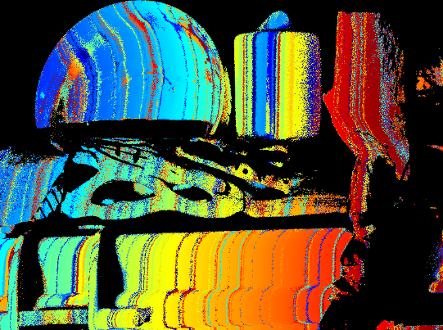
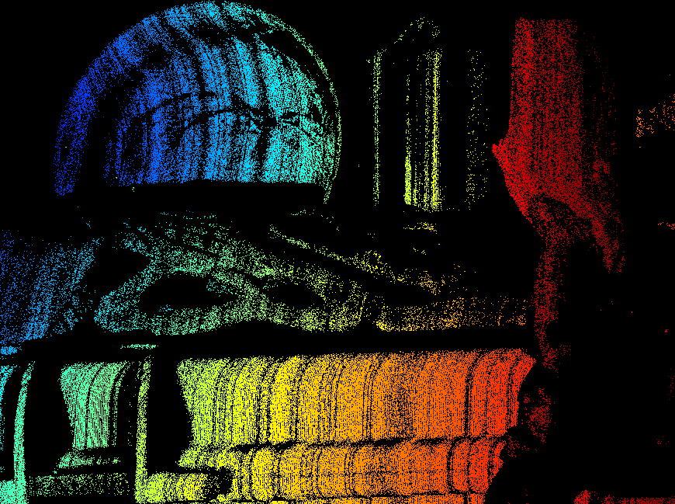
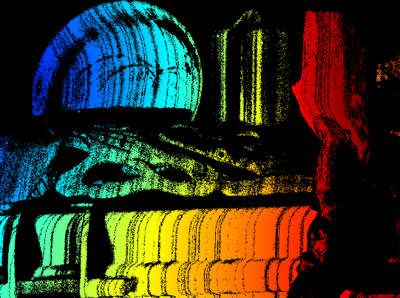
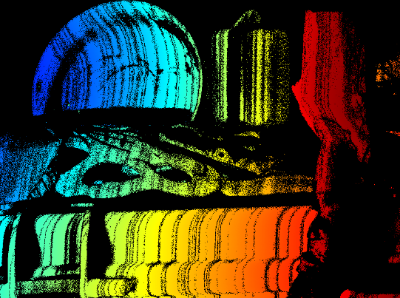
Encoder | Decoder | error=0 | error≤1 | error≤2
MPS | ZNCC | 29.95% | 42.61% | 43.91%
optimized | ZNCC | 34.78% | 57.32% | 62.54%
ground truth
camera image
Encoder: MPS (K=4, f=16) Decoder: ZNCC
all valid pixels
error=0
error≤1
error≤2
Encoder: optimized (K=4, f=16, ε = 0, w/out ROI) Decoder: ZNCC
all valid pixels
error=0
error≤1
error≤2

Slide 3
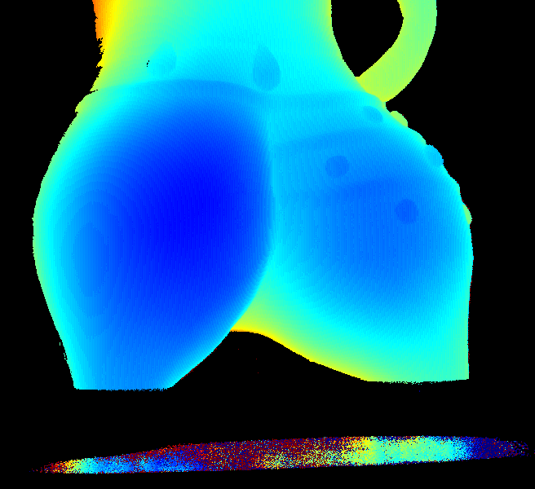
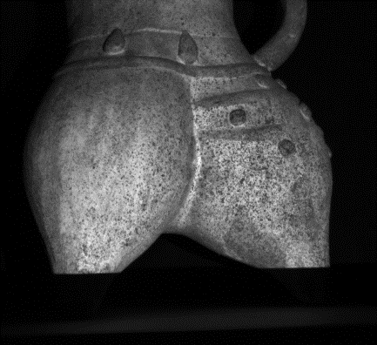
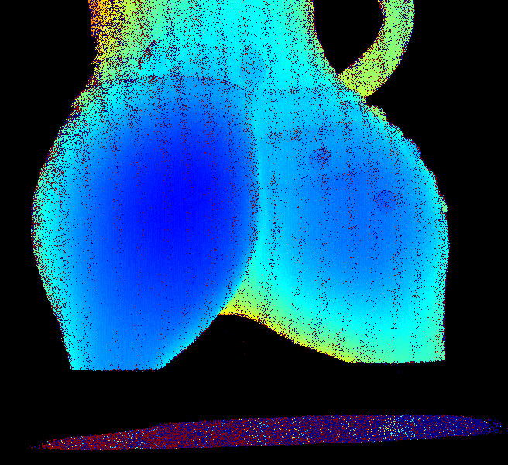
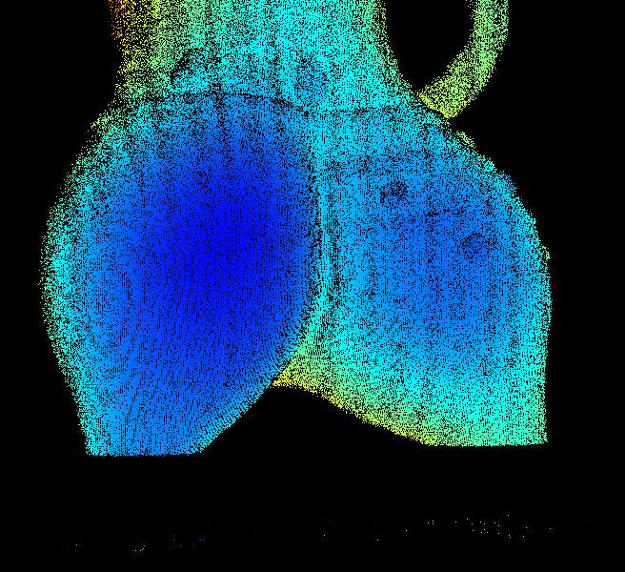
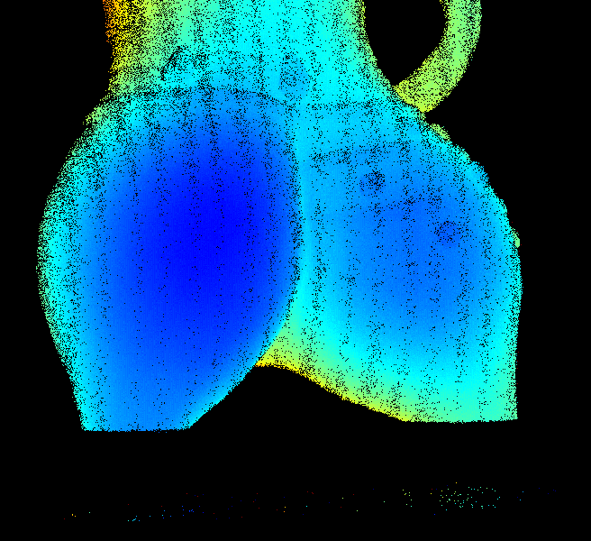
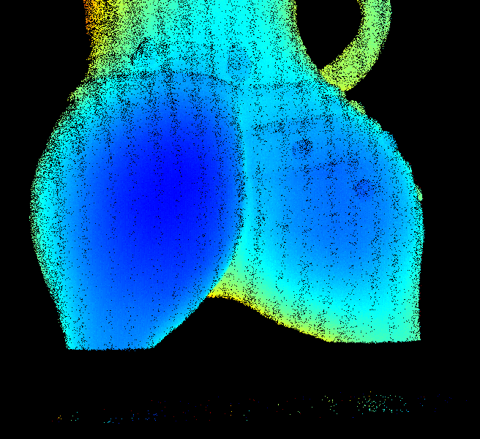
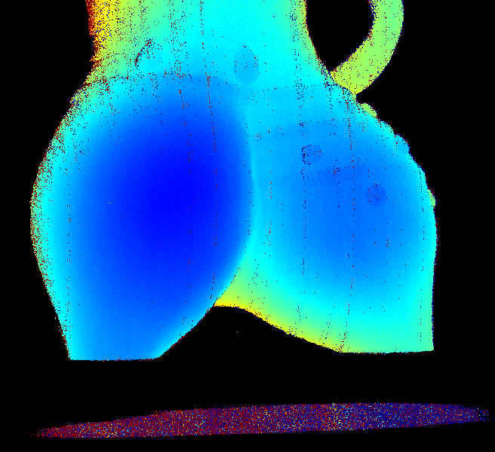
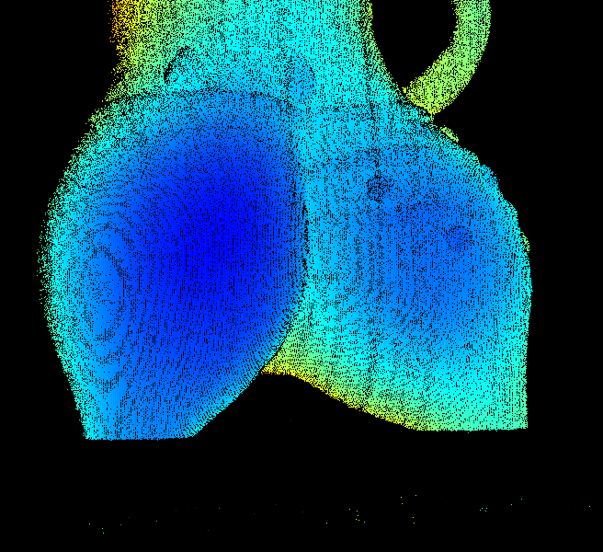
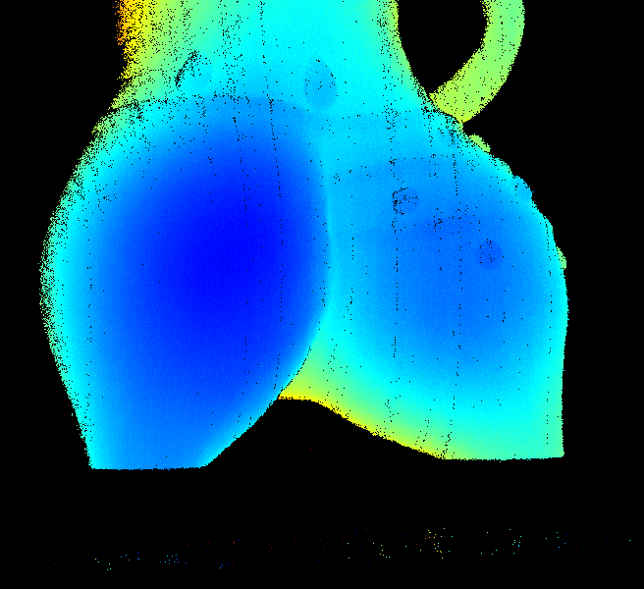

Encoder | Decoder | error=0 | error≤1 | error≤2
EPS | ZNCC | 64.44% | 82.77% | 83.03%
optimized | ZNCC | 72.37% | 89.23% | 89.50%
ground truth
camera image
Encoder: EPS (K=5, f=17) Decoder: ZNCC
all valid pixels
error=0
error≤1
error≤2
Encoder: optimized (K=5, f=32, ε = 0, w/out ROI) Decoder: ZNCC
all valid pixels
error=0
error≤1
error≤2

Slide 4
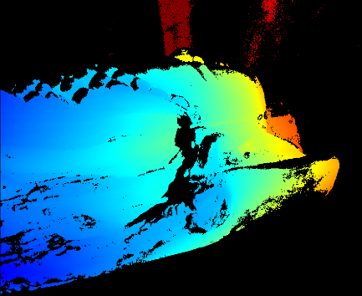
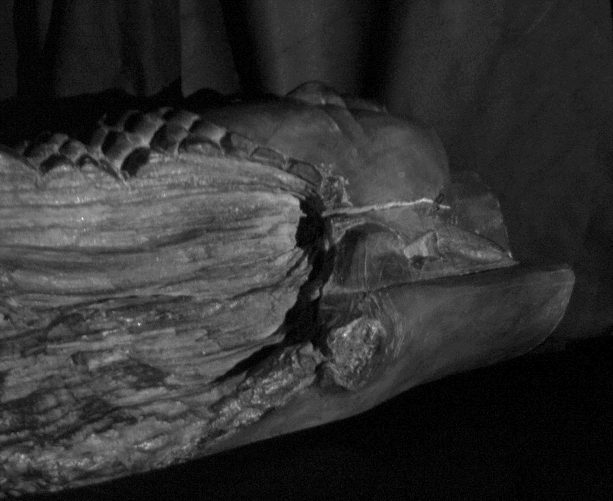
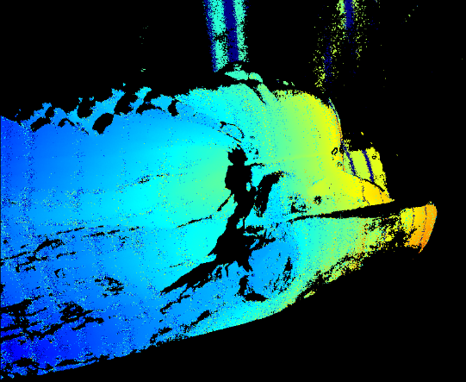
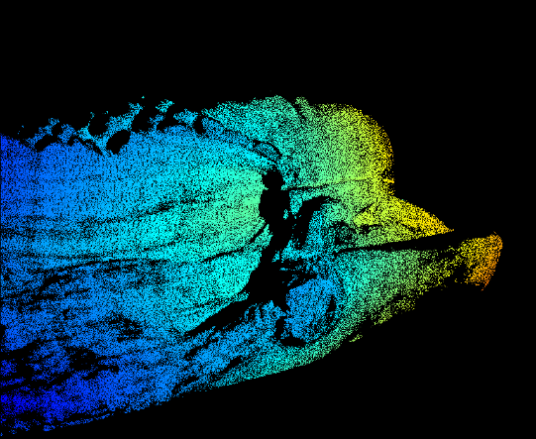
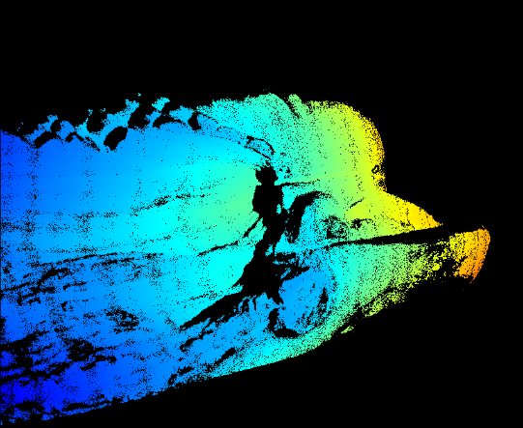
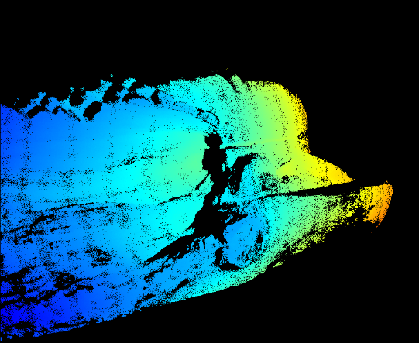
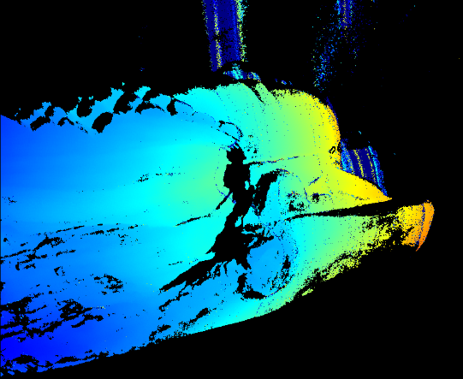
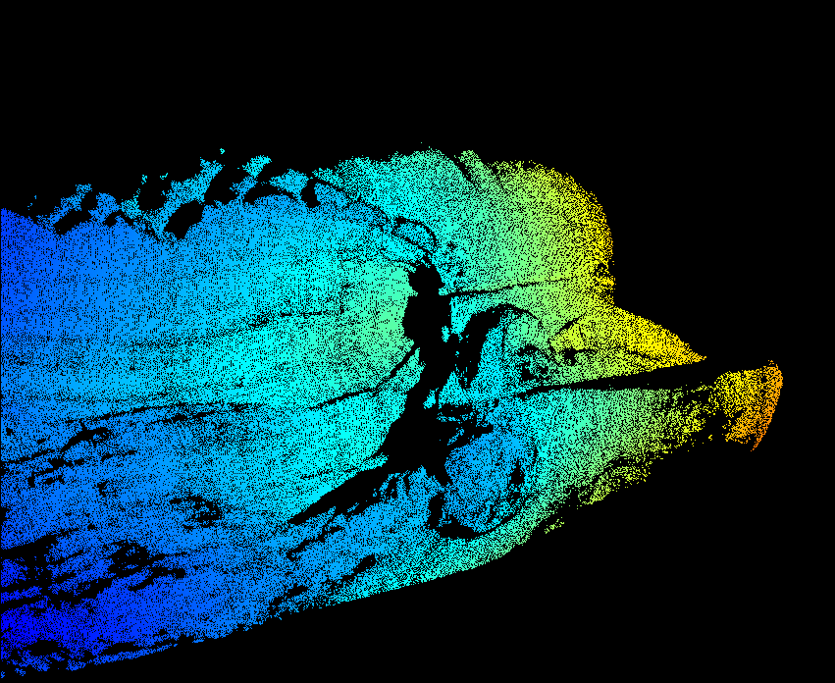
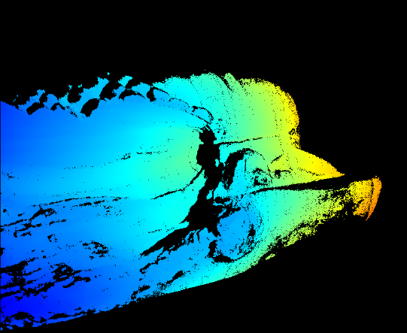

Encoder | Decoder | error=0 | error≤1 | error≤2
MPS | ZNCC | 56.28% | 81.05% | 81.96%
optimized | ZNCC | 66.49% | 88.54% | 89.10%
ground truth
camera image
Decoder: ZNCC (with ROI)
Encoder: MPS
(K=5, f=16)
all valid pixels
error=0
error≤1
error≤2
Encoder: optimized (K=5, f=32, ε = 1, with ROI in front of camera) Decoder: ZNCC (with ROI)
all valid pixels
error=0
error≤1
error≤2

Slide 5
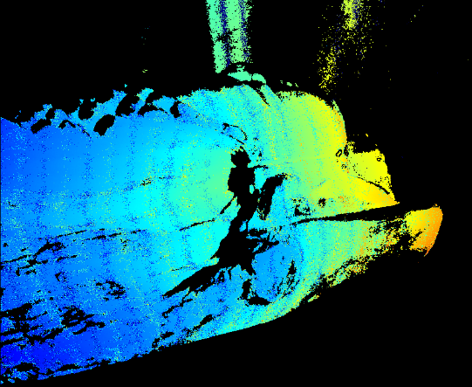
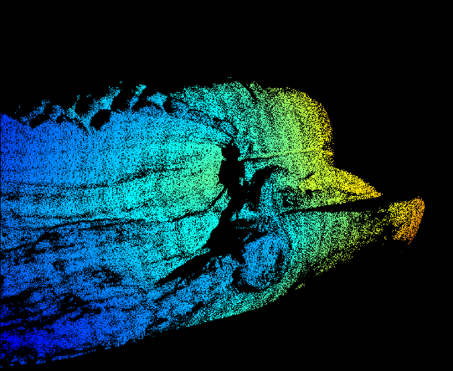
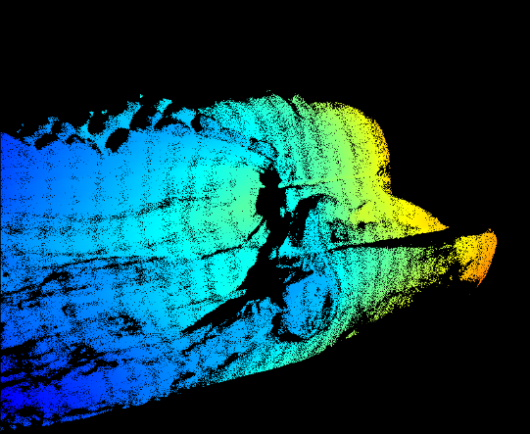
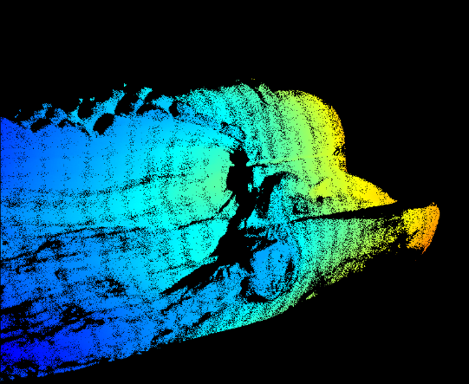
Encoder | Decoder | error=0 | error≤1 | error≤2
EPS | ZNCC | 55.98% | 75.30% | 75.75%
optimized | ZNCC | 66.49% | 88.54% | 89.10%
ground truth
camera image
Decoder: ZNCC (with ROI)
Encoder: EPS
(K=5, f=17)
all valid pixels
error=0
error≤1
error≤2
Encoder: optimized (K=5, f=32, ε = 1, with ROI in front of camera) Decoder: ZNCC (with ROI)
all valid pixels
error=0
error≤1
error≤2

Slide 6
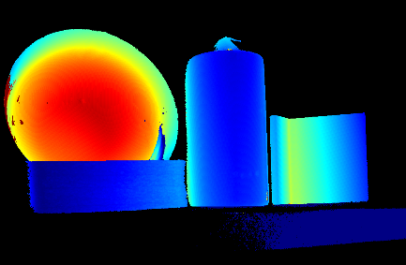
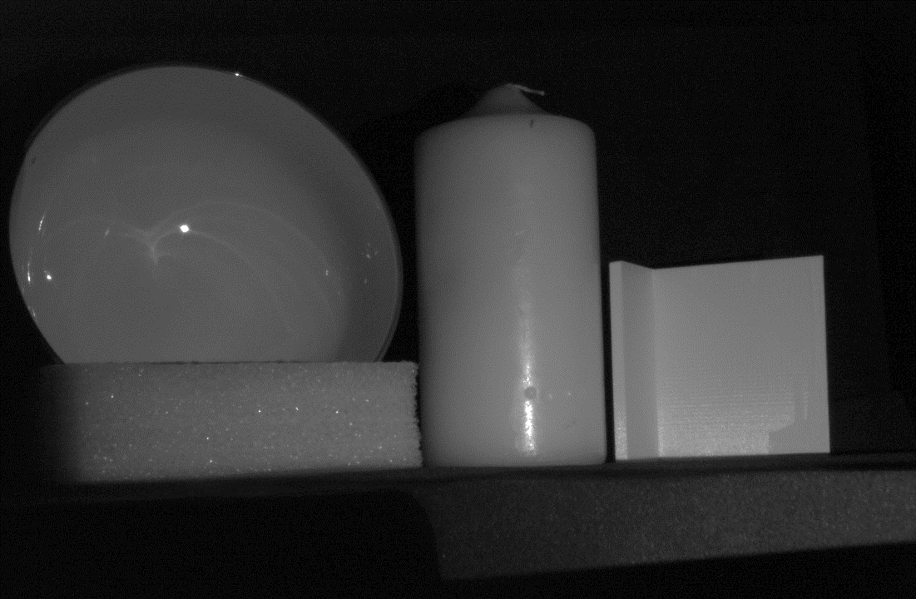
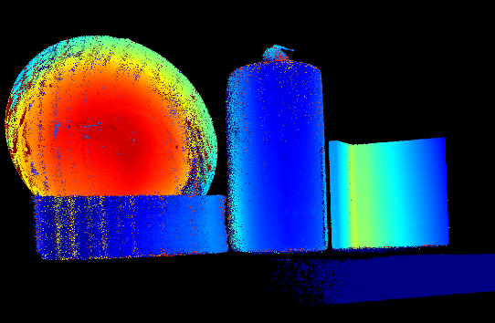
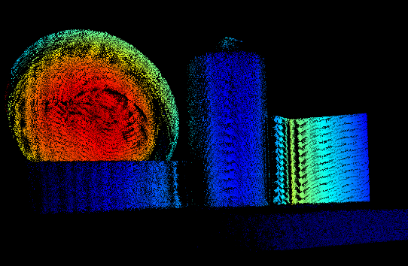
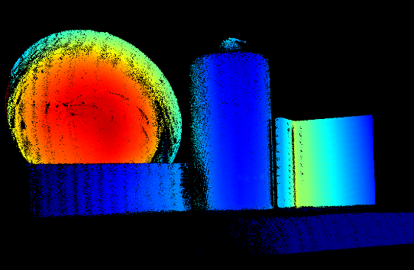
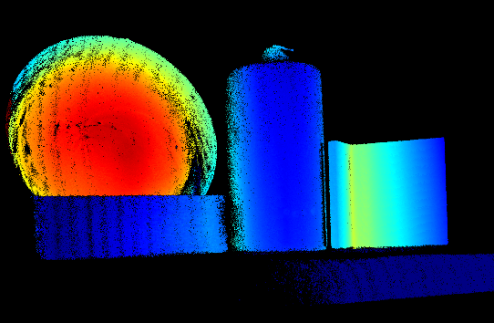
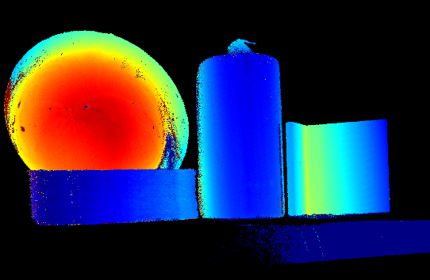
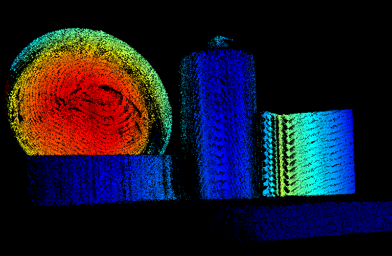
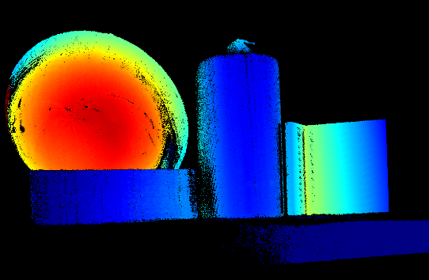
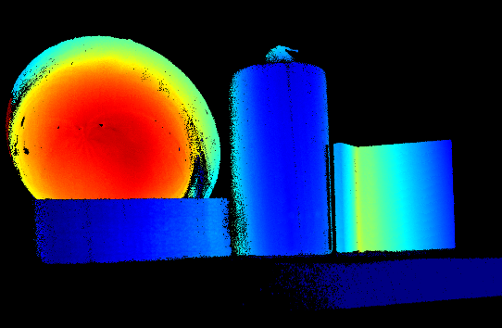
Encoder | Decoder | error=0 | error≤1 | error≤2
MPS | ZNCC | 51.24% | 83.10% | 87.54%
optimized | ZNCC | 56.74% | 90.34% | 94.78%
ground truth
camera image
Decoder: ZNCC (with ROI)
Encoder: MPS
(K=6, f=16)
all valid pixels
error=0
error≤1
error≤2
Encoder: optimized (K=6, f=16, ε = 1, with ROI in front of camera) Decoder: ZNCC (with ROI)
all valid pixels
error=0
error≤1
error≤2

Slide 7





Encoder | Decoder | error=0 | error≤1 | error≤2
EPS | ZNCC | 54.20% | 80.82% | 83.37%
optimized | ZNCC | 56.74% | 90.34% | 94.78%
ground truth
camera image
Decoder: ZNCC (with ROI)
Encoder: EPS
(K=6, f=17)
all valid pixels
error=0
error≤1
error≤2
Encoder: optimized (K=6, f=16, ε = 1, with ROI in front of camera) Decoder: ZNCC (with ROI)
all valid pixels
error=0
error≤1
error≤2

Slide 8










Encoder | Decoder | error=0 | error≤1 | error≤2
MPS | ZNCC | 28.54% | 57.23% | 63.85%
optimized | ZNCC | 36.46% | 65.47% | 70.03%
ground truth
camera image
Decoder: ZNCC
Encoder: MPS
(K=4, f=8)
all valid pixels
error=0
error≤1
error≤2
Encoder: optimized (K=4, f=16, ε = 0, w/out ROI) Decoder: ZNCC
all valid pixels
error=0
error≤1
error≤2

Slide 9





Encoder | Decoder | error=0 | error≤1 | error≤2
optimized ε = 2 | ZNCC | 34.46% | 67.78% | 76.49%
optimized ε = 0 | ZNCC | 36.46% | 65.47% | 70.03%
ground truth
camera image
Encoder: optimized (K=4, f=16, ε = 2, w/out ROI) Decoder: ZNCC
all valid pixels
error=0
error≤1
error≤2
Encoder: optimized (K=4, f=16, ε = 0, w/out ROI) Decoder: ZNCC
all valid pixels
error=0
error≤1
error≤2

